Slide 1
Genetics
Genes, Chromosomes, & Cell Division

Slide 2
species characteristics
vs.
individual characteristics

Slide 3
What makes you YOU?
inherited genes
environment
spiritual nature

Slide 4
Genetics
the study of heredity—the passing on of characteristics from parent to offspring

Slide 5
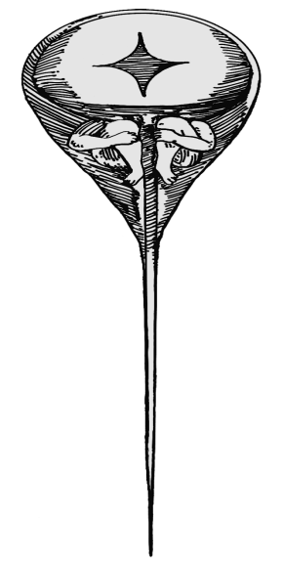
History of Genetics
Aristotle
traits passed through the parents’ blood
preformationists
complete organism in the father’s sperm

Slide 6
History of Genetics
Gregor Mendel
traits caused by “factors”
“Father of Genetics”
Watson & Crick

Slide 7
Gene
a section of DNA that produces a particular polypeptide chain of amino acids
causes a specific trait

Slide 8
Characteristics of genes
Genes are the same in kind and amount in the cells of an organism.
Genes are the same in kind and amount in the cells of each organism of a species.

Slide 9
Characteristics of genes
Genes are chemicals which can function as individual units.
Genes are able to carry information for the formation of organic chemicals.
“biosynthesis”

Slide 10
Characteristics of genes
Genes are able to reproduce themselves.
Genes are able to be passed on to the next generation.
Genes are found in the cell’s nuclear material.

Slide 11
What is a chromosome?

Slide 12
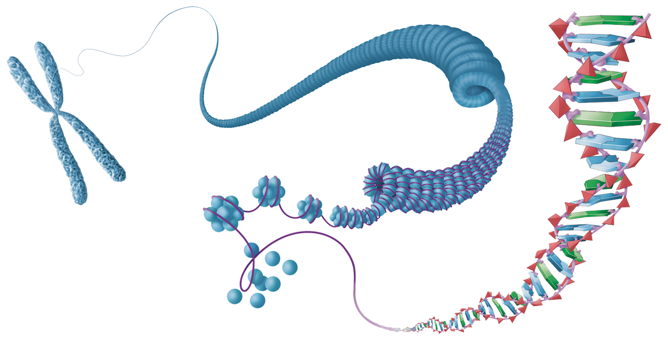
Chromosome
a strand of DNA with proteins (histones) attached

Slide 13
Chromatin Material
chromosomes as they appear in an active, nondividing cell
Notes:
cell micrograph: cheek cell, taken in the studio by Elizabeth Lacy, BJU PDL

Slide 14
Chromatid
a duplicated chromosome
attached to its sister by the centromere

Slide 15
It is not the number of chromosomes that determines a species, but rather the genes on the chromosomes.

Slide 16
Karyotype
a picture of the chromosomes in a cell

Slide 17
Chromosome Number
Chromosomes come in pairs.
Each pair is called a homologous pair of chromosomes.
Individual chromosomes of a pair are called homologues.

Slide 18
Chromosome Number
Chromosomes come in pairs.
Both homologues in a pair have genes for the same characteristics.

Slide 19
Diploid
2n
describes a cell that has homologues
humans
23 pairs
2n = 46

Slide 20
Haploid
n
only one set of chromosomes

