Slide 1
Genetics
Genes, Chromosomes, & Cell Division

Slide 2
Meiosis
the reduction of a cell’s chromosome number from diploid to haploid by two consecutive cell divisions

Slide 3
The reason:
2n + 2n = 4n
Not Good!

Slide 4
The reason:
n + n = 2n
Good!

Slide 5
Zygote
a diploid cell that results from the union of two haploid cells
n + n = 2n

Slide 6
Meiosis
prophase I
same as mitosis
chromosomes coil up
spindle forms
nuclear membrane disintegrates

Slide 7
Meiosis
prophase I
different from mitosis
homologous chromosomes pair up
form a tetrad

Slide 8
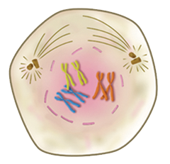
Prophase I
tetrad

Slide 9
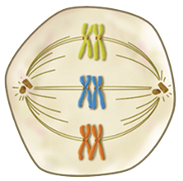
Meiosis
metaphase I
tetrads line up on the equatorial plane

Slide 10
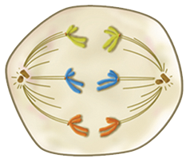
Meiosis
anaphase I
homologous chromosomes separate (not the sister chromatids as in mitosis)

Slide 11
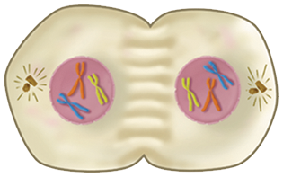
Meiosis
telophase I
chromosomes reach opposite poles
cell undergoes cytokinesis

Slide 12
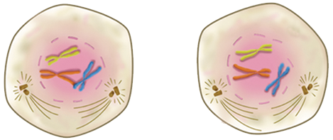
Meiosis
prophase II
mitotic spindle reforms

Slide 13
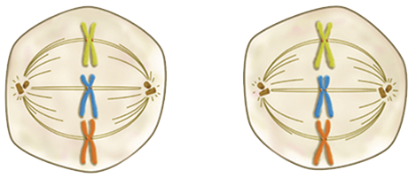
Meiosis
metaphase II
chromosomes line up on the equatorial plane

Slide 14
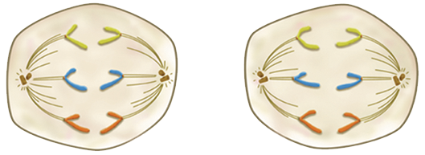
Meiosis
anaphase II
sister chromatids separate

Slide 15
Meiosis
telophase II
daughter chromosomes reach opposite poles
nuclei reform
cytokinesis occurs

Slide 16
Telophase II

Slide 17
Gametes
haploid cells that are formed during meiosis
unite to form a diploid zygote
fertilization
the process of forming a diploid zygote

Slide 18
Gametes

Slide 19
Gametes
isogametes
“iso” = equal
usually motile
heterogametes
“hetero” = different
sperm and ovum

Slide 20
Gametes
spermatogenesis
meiosis resulting in the formation of sperm
oogenesis
meiosis resulting in the formation of eggs (ova)

Slide 21
Sexual Reproduction
the union of haploid gametes, producing a diploid zygote
results in genetic variety

