Slide 1
The Science of Life
God and Science

Slide 2
Bios
Bio
logy
logos
+
“life”
“study of”

Slide 3
Science
a body of facts that man has gathered by observing the physical universe

Slide 4
So What is Truth?

Slide 5
Is something true
because people believe it?
because it seems to work?
because it is seen repeatedly?
because it seems logical?

Slide 6
Is something true because people believe it?

Slide 7
The Doctrine of Humors
developed by Hippocrates, c. 350 B.C.
held that living things are made up of four liquids, or “humors”
taught that a person’s humors must be in perfect balance for him to be healthy

Slide 8
The 4 Humors
blood: heart
black bile: spleen
phlegm: brain
bile: liver

Slide 9
Is something true because it seems to work?

Slide 10
The Doctrine of Signatures
held that God left behind signs or “signatures” to help cure the illnesses resulting from Adam’s sin
used to prescribe remedies based on physical similarities

Slide 11
Is something true because it is seen repeatedly?

Slide 12
Spontaneous Generation
nonliving materials can change into living organisms spontaneously
also called abiogenesis
supported by the observations of John Needham

Slide 13
Is something true because it seems logical?

Slide 14
Logical Reasoning
inductive
deductive

Slide 15
Logical Reasoning
inductive
begins with a number of observed facts and derives a general conclusion

Slide 16
Inductive Reasoning
example
Fact 1: Jim was in the bank.
Fact 2: The bank was robbed.
Fact 3: Jim has lots of money.
Conclusion: Jim robbed the bank.

Slide 17
Logical Reasoning
inductive
begins with a number of observed facts and derives a general conclusion
deductive
begins with a general principle and draws conclusions about specifics

Slide 18
Deductive Reasoning
example
All boys are smart.
Steve is a boy.
Therefore, Steve is smart.

Slide 19
God’s Truth
the only absolute truth
Christ said, “I am the way, the truth, and the life.” (John 14:6)

Slide 20
Science
a body of knowledge based on observations
the process used to gain that knowledge

Slide 21
Model
a simplified depiction or explanation of how something works

Slide 22
God’s Truth and Science
Is there a conflict?
The same One who created the physical world inspired the Bible.
He gave man the senses and mind to observe the physical world.

Slide 23
God’s Truth and Science
Is there a conflict?
Therefore, science is man’s attempt to observe and describe the natural processes God established to govern the universe.

Slide 24
The Science of Life
The Scientific Method

Slide 25
The Scientific Method
a logical procedure for choosing an answer to a question

Slide 26
The Scientific Method
Define the problem.
Do preliminary research.
Form a hypothesis.

Slide 27
Hypothesis
an educated guess that attempts to answer a problem

Slide 28
Scientific Method Steps
Set up an experiment or survey.
Observe the experiment or survey.
Collect and record the data.

Slide 29
Data
the recorded information from an experiment or survey

Slide 30
Scientific Method Steps
Set up an experiment or survey.
Observe the experiment or survey.
Collect and record the data.
Classify the data.

Slide 31
Scientific Method Steps
Analyze the data.
Choose the answer.
Verify the answer.
valid = accurate & reliable
Predict future results.

Slide 32
Controlled Experiments
typically two identical groups that differ in only one variable
independent variable—the factor being tested
experimental group = exposed to the i.v.
control group = constant

Slide 33
Controlled Experiments
typically two identical groups that differ in only one variable
independent variable—the factor being tested
dependent variable—the factor being measured

Slide 34
Multiple variables cause an experiment to be invalid.

Slide 35
Sample Experiment
problem
What are the habitat preferences of brine shrimp?

Slide 36
Sample Experiment
hypothesis
Brine shrimp thrive in areas of high salinity.

Slide 37
Sample Experiment
procedure
Obtain 4 tanks and fill each with water of a varying concentration gradient (fresh water, 5% salinity, 15% salinity, 25% salinity). At equal intervals, remove a sample from each tank and count the number of live shrimp.

Slide 38
What is the dependent variable?
temperature of the water
salinity of the water
number of live shrimp
pH of the water

Slide 39
If we raised the temperature of the water in the tanks, the results would be invalid because
we had more than one variable.
we did not have both a control group and an experimental group.
our hypothesis was wrong.

Slide 40
If you use the scientific method correctly, the data will never suggest more than one possible answer.
true
false

Slide 41
What is the difference between a control group and an experimental group?
independent variable
dependent variable
control variable

Slide 42
Limitations of Science
Science must deal with physical phenomena.
Observations may be faulty.
Science can only describe, not explain.
Science must deal with repeatable results.

Slide 43
Workability
the ability to apply scientific knowledge to similar cases

Slide 44
Limitations of Science
Bias can cloud judgment.
Science cannot deal with values and morals.
Science cannot prove a universal statement.
Science cannot be used to produce truth.

Slide 45
Science and the Christian
Christians have an obligation to subdue the earth and have dominion over it.
Creation Mandate
Genesis 1:28

Slide 46
And God blessed them, and God said unto them, Be fruitful, and multiply, and replenish the earth, and subdue it: and have dominion over the fish of the sea, and over the fowl of the air, and over every living thing that moveth upon the earth.

Slide 47
Pure or Applied Science
pure science
gaining scientific knowledge
uses the research method
applied science
using scientific knowledge to solve problems
uses the technical method

Slide 48
Science and the Christian
Technology and other scientific advancements are the result of God allowing man to discover and invent.
Science in itself is not good or bad.

Slide 49
Science and the Christian
Christians must be careful not to become dependent on science and fail to trust God.
Science is not the answer to men’s problems.

Slide 50
Science and the Christian
A Christian should look on science as an opportunity given to him by God to learn as much as he can about God’s creation.

Slide 51
The Science of Life
Biology and the Study of Life

Slide 52
Characteristics of Living Things
exhibit movement
locomotion
internal movement

Slide 53
Characteristics of Living Things
achieve growth
Growth is by assimilation, not by accumulation.
Growth is achieved by the organism, not done to the organism.

Slide 54
Characteristics of Living Things
reproduce
Living things reproduce by making offspring similar to the original parent(s).

Slide 55
Characteristics of Living Things
come from similar preexisting life
biogenesis
variation with limitation

Slide 56
Characteristics of Living Things
have a similar chemical makeup
organic
inorganic
are composed of cells

Slide 57
Characteristics of Living Things
exhibit irritability
the ability to respond to one’s environment

Slide 58
Characteristics of Living Things
require energy
sunlight
food
an organic, energy-containing substance

Slide 59
Characteristics of Living Things
maintain a high level of organization
face death

Slide 60
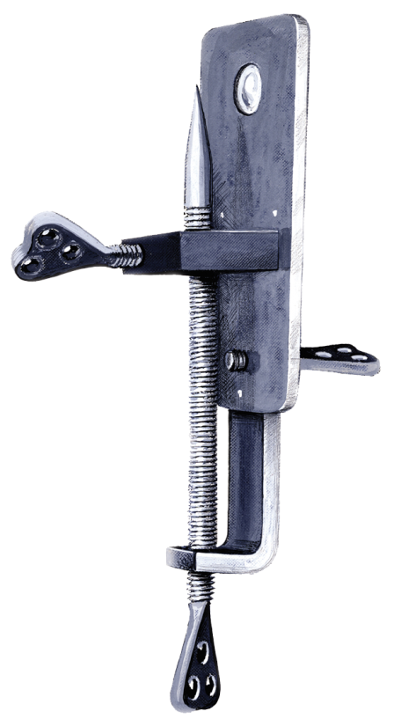
Microscopes
history
simple microscopes
Anton van Leeuwenhoek: “The Father of Microscopy”
single lens

Slide 61
Microscopes
history
compound microscopes
Zacharias Janssen
two lenses
ocular
objective

Slide 62
Light Magnification
reflection
the image caused by light rays bouncing off an object
refraction
the bending of a light ray as it passes through a substance

Slide 63
Light Magnification
resolution
the ability to see fine detail

Slide 64
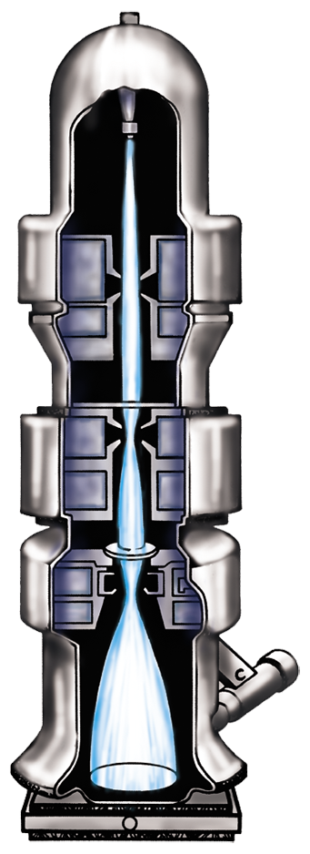
Microscopes
electron microscopes
magnify from 1,500 to 250,000 times
electrons replace light rays
greater magnification & resolution

Slide 65
Microscopes
electron microscopes
two types: transmission and scanning
produce electron micrographs

Slide 66
Validity of Biological Studies
Errors can be made
by the biologist in his observations
if the specimen is atypical
when crude techniques are used

