Slide 1
Bacteria and Viruses
Bacteria

Slide 2
Microbiology
the study of microbes (microscopic organisms)

Slide 3
Characteristics of Bacteria
very small (1,000 times smaller than human cells)
hard to study
can live anywhere
prokaryotic
help eliminate waste, enable us to digest, make air breathable
destructive, cause disease and death

Slide 4
Kingdom Archaebacteria
archae- = “ancient”
no peptidoglycans in cell walls
extremophiles
thermoacidophiles
methanogens
halophiles

Slide 5
Kingdom Eubacteria
larger kingdom
peptidoglycans in cell walls
non-extreme environment
cause disease

Slide 6
Pathogen
an agent that causes disease

Slide 7
Decomposer Organism
an organism that breaks down organic substances
Bacteria & fungi are the primary decomposers.

Slide 8
Uses of Bacteria
Most are not pathogenic.
Some are used in making food.
cheese
yogurt
vinegar
sauerkraut
silage

Slide 9
Uses of Bacteria
Some are the sources of medical supplies.
insulin
antibiotics
blood proteins

Slide 10
Bacterial Shapes
coccus
Spherical, 1 um in diameter
bacillus
rod-shaped, 1 um in width, 2-10 um in length
spirillum
spiral-shaped, slightly longer than bacillus

Slide 11
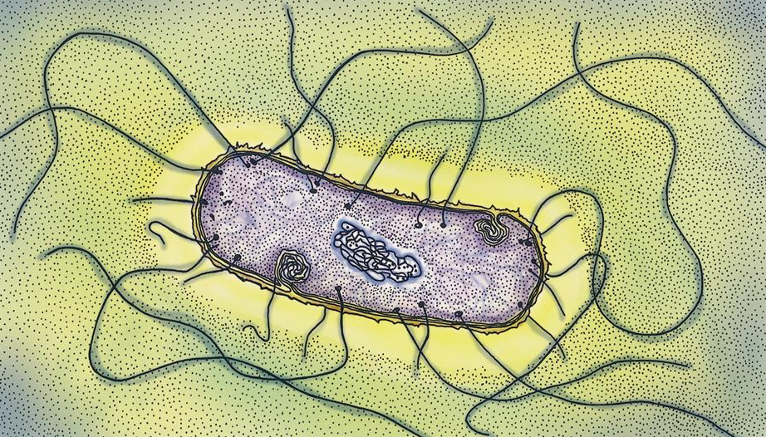
Structure of Bacteria
nucleoid region
plasmids
cell wall
capsule
ribosomes
flagella

Slide 12
Cyanobacteria
blue-green algae
originally classified with plants
prokaryotic
photosynthetic
unicellular or colonial

Slide 13
Filament
a chain of cells

Slide 14
Heterocyst
a large colorless cell found in the filament of some cyanobacteria

Slide 15
Bacteria reproduce by simple binary fission that does not involve mitosis.

Slide 16
Binary Fission

Slide 17
Conjugation
conjugation tube

Slide 18
Transformation
a genetic change that occurs when one bacterium takes up another bacterium’s DNA that is free in the environment

Slide 19
Bacterial Nutrition
Some are autotrophic.
photosynthetic
chemosynthetic
Most are heterotrophic.
Saprophytic (feed on dead organic matter)
Parasitic (feed on living host)
Some are obligate parasites.
(require the presence of living tissue)

Slide 20
Conditions for Growth
moisture
temperature
pH
nutrition

Slide 21
Endospore
layers of hard material around the nucleoid region
(within the plasma membrane)
helps a bacterium survive unfavorable conditions

Slide 22
Oxygen Requirements
obligate anaerobes (w/o Oxygen)
obligate aerobes (w/ Oxygen)
facultative anaerobes (either)
Read the Controlling Bacteria in Food box on page 231!

