Slide 1
Bacteria and Viruses
Viruses

Slide 2
The Discovery of Viruses
Iwanowski (1892)
worked with the tobacco mosaic virus (TMV)
Stanley (1930s)
won the Nobel Prize for isolating TMV

Slide 3
Controversy
Are viruses chemicals?
Are viruses organisms?
Are viruses alive?

Slide 4
The Structure of Viruses

Slide 5
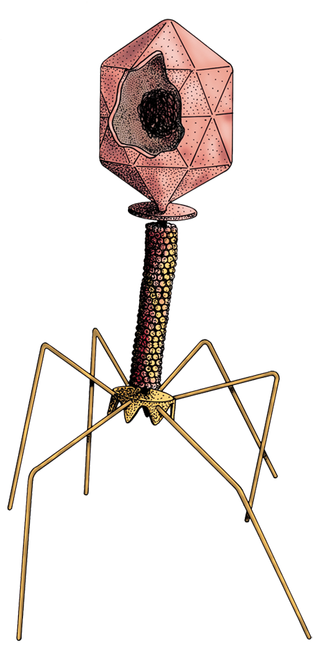
Virus
microscopic noncellular particle
two parts
nucleic acid core
capsid
(envelope)

Slide 6
Viruses are obligate intracellular parasites.
highly specific
˅

Slide 7
Bacteriophage
a virus that infects certain bacteria

Slide 8
Virulence
the ability of a pathogen to affect cells
Lytic Cycle
the activity of a virulent virus

Slide 9
Lytic Cycle
Attachment
Entry
Replication & transcription
Assembly
Release

Slide 10
Classification of Viruses

Slide 11
Classification
core of DNA
uses the host’s enzymes to produce RNA
incorporates into the host’s DNA
core of RNA
hijacks the host’s ribosomes
retrovirus

Slide 12
Retrovirus
“back,” “behind,” “backward”
contains the enzyme reverse transcriptase
uses viral RNA to produce viral DNA

Slide 13
Viroid
a short, single strand of circular RNA without capsid or envelope

Slide 14
Prion
an abnormal form of a protein
does not contain any nucleic acids
may cause disease

Slide 15
Mad Cow Disease
bovine spongiform encephalitis
possibly caused by a prion
destroys the central nervous system

Slide 16
Lysogenic Cycle
The virus enters the cell & remains inactive (latent).
The viral genome incorporates into the host genome.
The virus can be activated by various stimuli.
Example: herpes simplex virus

Slide 17
Other Kinds of Viruses
persistent
releases virus particles without going through lysis
transforming
adds new genetic information to the host cell

Slide 18
“Lysis” literally means
“join.”
“loosen.”
“poison.”
“nourish.”

Slide 19
Viral Diseases

Slide 20
Viruses
usually highly specific
limited to type of organism
sometimes even type of cell
hard to destroy once they are inside a cell
mutate rapidly

Slide 21
Control of Viral Disease
vaccination
antiviral drugs

Slide 22
Vaccination
inactivated vaccine
altered virus that can’t replicate
weaker immunity
attenuated vaccine
“live” virus that can replicate
stronger immunity

Slide 23
Antiviral Drugs
block viral metabolism and enzymes
interferons
proteins produced by the body as a defense against viruses

Slide 24
Emerging Viruses
a virus that has spread from an animal host to humans
examples
influenza virus
HIV?

