Slide 1
Bacteria and Viruses
Diseases & Disorders

Slide 2
Infectious Disease
a disease caused by a virus or an organism that invades the body

Slide 3
Bacteria & viruses are the two most important pathogens.

Slide 4
Disease Detection
Etiology – the study of the cause of a disease or condition
germ theory of disease
Robert Koch – developed a technique for confirming the cause of a particular disease

Slide 5
Koch’s Postulates
The suspected pathogen should be found only in the body of a sick individual, not one that is healthy.
The suspected pathogen should be grown in a laboratory culture.

Slide 6
Koch’s Postulates
The suspected pathogen should cause the same disease when injected into a healthy individual.
When isolated from the second individual, the pathogen should be the same as the original.

Slide 7
Incubation Period
the time between infection by a pathogen and the appearance of the first symptoms

Slide 8
Effects of Pathogens
tissue destruction
toxin formation

Slide 9
Tuberculosis (TB)
bacterial
spread by inhalation
attacks lung tissue
forms clumps of tissue called “tubercules”
fatigue, weight loss, persistent cough

Slide 10
Kinds of Toxins
exotoxins
endotoxins

Slide 11
Exotoxins
diffuse from the living cell into surrounding tissue
cause the symptoms of most infectious diseases

Slide 12
Diphtheria
bacterial
produces exotoxins
affects the respiratory system
causes a sore throat (becomes covered with a leathery, bluish-white membrane)
death by suffocation

Slide 13
Endotoxins
remain in the pathogen as part of its structure
cause violent reactions in the surrounding tissues when the pathogen dies

Slide 14
Botulism
bacterial
exotoxin that causes food poisoning
often spread through improperly canned food
nerve toxin

Slide 15
Communicable Disease
a disease that can spread from one person to another by direct or indirect contact

Slide 16
Contagious Disease
a disease that spreads easily to others

Slide 17
The term used to describe a disease-causing agent is a
saprophyte.
halophile.
pathogen.
bacteriophage.

Slide 18
How Diseases are Spread
airborne
direct contact
touching a sore on the skin or on a mucous membrane
includes bloodborne pathogens

Slide 19
How Diseases are Spread
airborne
direct contact
indirect contact
touching a contaminated object

Slide 20
How Diseases are Spread
airborne
direct contact
indirect contact
contamination
contaminated food or water
affects the digestive system
Wash your hands!

Slide 21
How Diseases are Spread
airborne
direct contact
indirect contact
contamination
wound
vector-carried
insects or other arthropods

Slide 22
Immune Carriers
people (or animals) that spread a pathogen without suffering from the symptoms of the disease

Slide 23
Defense Against Infection
Your body is its own best defense.

Slide 24
Structural Defenses
“1st line of defense”
prevent pathogens from entering the body
include:
skin, mucous membranes
acids in the stomach
tear glands & lysozyme

Slide 25
Nonspecific Defenses
“2nd line of defense”
include:
fever
inflammation

Slide 26
Inflammation
characterized by increased blood flow resulting in redness, heat, pain, and swelling

Slide 27
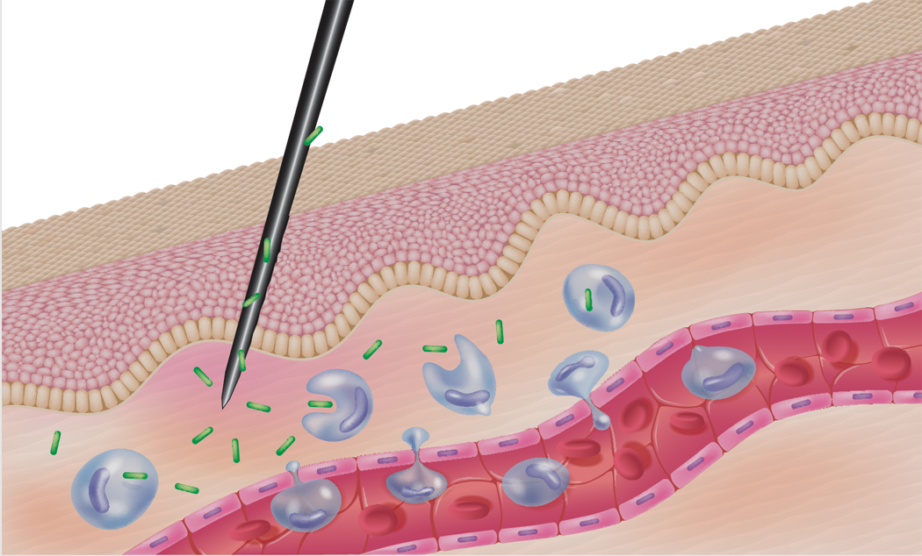
epidermis
bacteria
phagocyte
capillary

Slide 28
Nonspecific Defenses
“2nd line of defense”
include:
fever
inflammation
phagocytic cells
lymphatic system

Slide 29
Specific Defenses
“3rd line of defense”
include:
antibodies
proteins that combat specific pathogens
other specialized cells

Slide 30
Chemotherapy
the use of chemicals to prevent or treat disease
antibiotics
Sir Alexander Fleming
types
Bacteriocidal (kills bacteria)
Bacteriostatic (inhibiting growth)

Slide 31
Antibiotics
effective on bacteria, not on viruses
should be prescribed by a physician
can lose their potency
Take ALL of your prescription!

Slide 32
Disorders
A disorder is an illness not caused by a pathogen.

Slide 33
Kinds of Disorders
inherited
genetically transmitted
injuries
damage to an organ or tissue
organic
deficiency disease, chemical poisoning, radiation sickness, etc.

Slide 34
Tumor
an abnormal growth of cells
types
benign
malignant
cancerous
ability to metastasize

Slide 35
Cancer
development
initiation
carcinogens
radiation
viruses
promotion

Slide 36
Cancer Treatment
surgery
radiation
chemotherapy

