Slide 1
The Kingdom Protista
The Protozoans

Slide 2
Protozoan Characteristics
“animalcules” – first animals
eukaryotic
motile – often rapid movement
aquatic
microscopic unicellular
a few colonial
heterotrophic
some parasitic, some beneficial to host

Slide 3
Protozoan Characteristics (continued)
primarily asexual reproduction (binary fission)
exchange of genetic information possible in a few species
eyespots to detect light intensity
cysts protect during harsh environmental conditions

Slide 4
Members of the kingdom Protista are
prokaryotic.
eukaryotic.

Slide 5
Protozoan Phyla
Sarcodina
Ciliophora
Zoomastigina
Sporozoa
chart on page 257 compares the 4 phyla

Slide 6
Phylum Sarcodina

Slide 7
Characteristics
common name - sarcodines
no standard body shape
flexible plasma membrane
heterotrophoic, some parasitic
movement by pseudopodia “false feet” (amoeboid movement)
Examples: amoebas, radiolarians foraminifers

Slide 8
Genus Amoeba
Cytoplasm is divided into 2 parts:
endoplasm
the dense cytoplasm found in the interior of the cell
ectoplasm
the thin cytoplasm on the outer perimeter of the cell

Slide 9
Genus Amoeba
nucleus
controls metabolism
contractile vacuole
eliminates water, regulates homeostasis
amoeboid movement
constant change in shape by formation of pseudopodia
pseudopod
extension of a cell used for locomotion and engulfing substances

Slide 10
Genus Amoeba
nutrition
pseudopodia engulf food and form food vacuoles
taxis
a response to a stimulus
reproduction
binary fission
no known form of sexual reproduction
form cysts
Show youtube videos

Slide 11
A contractile vacuole
engulfs food particles.
collects and eliminates wastes.
collects and eliminates excess water.
keeps the cell rigid.

Slide 12
What term describes this process of engulfing food?
phagocytosis
pinocytosis
autophagy
egestion

Slide 13
Amoebic Dysentery
Most sarcodines are nonpathogenic to humans
Entamoeba histolytica
spread by contaminated food and water
symptoms
intestinal ulcers
bloody diarrhea
possibly death (not likely today)

Slide 14
Phylum Ciliophora

Slide 15
Characteristics
common name – ciliates
heterotrophic
some parasitic
cilia
free-swimming
Examples: Paramecium, Stentor, Vorticella

Slide 16
Genus Paramecium
macronucleus
contains multiple copies of genetic material
micronucleus
functions exchange of genetic information in sexual reproduction

Slide 17
Genus Paramecium
pellicle
firm yet flexible outer covering
results in slipper shape
cilia
completely covers Paramecium
Enables to turn, rotate, and travel in any direction
oral groove
opening for the passage of food
leads through the mouth pore to the gullet

Slide 18
Genus Paramecium
avoiding reaction
movement
trichocysts
discharge filaments in response to stimuli (defense mechanism)
reproduction
asexual – binary fission
sexual – conjugation
Show youtube video

Slide 19
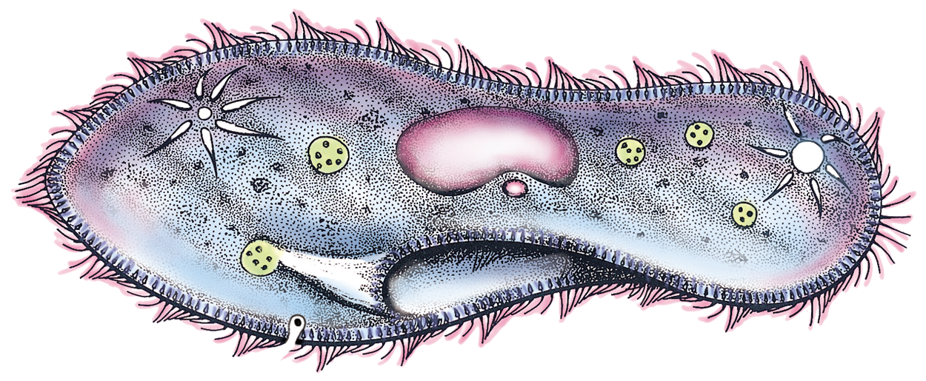
macronucleus
micronucleus

Slide 20
contractile vacuole
food vacuole
oral groove
mouth pore
gullet

Slide 21
Phylum Sporozoa

Slide 22
Characteristics
common name – sporozoans
heterotrophic
no special mode of locomotion
form spores
asexual & sexual reproduction
nutrition
all sporozoans are parasitic.
Example: Plasmodium

Slide 23
Malaria
caused by a sporozoan
Plasmodium
carried by a female mosquito
Anopheles
symptoms
chills and high fever
Anemia
kidney failure, brain damage

Slide 24
Phylum Zoomastigina

Slide 25
Characteristics
common name – zooflagellates
heterotrophic, most unicellular
some parasitic
flagella for movement
reproduction
asexual by binary fission
some sexual
Examples: Trichonympha,Trypanosoma, Giardia

Slide 26
African Sleeping Sickness
carried by the tsetse fly
symptoms
brain inflammation
mental lethargy
sleepiness
possibly death

