Slide 1
The Kingdom Protista
The Algae
Notes:
Background image courtesy of Dr. Margene Ranieri

Slide 2
Algal Characteristics
“grass of many waters”
microscopic, unicellular or colonial
no true tissues
generally photosynthetic
7 algal phyla
Notes:
Background image courtesy of Dr. Margene Ranieri

Slide 3
Plankton
tiny floating aquatic organisms
phytoplankton
tiny, floating photosynthetic organisms, predominantly algae
primary food-producing organism in aquatic environments
zooplankton
tiny, floating animals or protozoans

Slide 4
Uses for Algae
responsible for 70% of oxygen-producing photosynthesis
natural fertilizer
potash, iodine, nitrogen, & salt
source of vitamins & minerals
human food crop
thickener in foods like pudding, jellies, and ice cream
algin
aquaculture – farming of ponds, lakes and sea

Slide 5
Algal Structure
thallus
the basic unit of an alga
great variety from species to species
some unicellular, others multicellular
looks like leaves, stems, or roots
filament
a threadlike chain of cells joined end-to-end

Slide 6
Algal Structure
many algae are free-floating
non free-floating structures
holdfasts
cells that anchor algae to submerged objects
sessile
algae attached to something
air bladders
small air-filled spaces that cause a thallus to float

Slide 7
Algal Reproduction
Notes:
Background image courtesy of Dr. Margene Ranieri

Slide 8
Asexual Reproduction (Read page 265)
unicellular
new organisms formed by mitotic cell divisions
fragmentation
colony broken up by physical disturbances
zoospores
algae with flagella that swim away and establish new colonies

Slide 9
Sexual Reproduction (Read page 265)
3 types: conjugation, isogamete formation, heterogamete formation
conjugation
Two filaments come together.
A gamete from one cell migrates to another cell through the conjugation tube.
example: Spirogyra

Slide 10
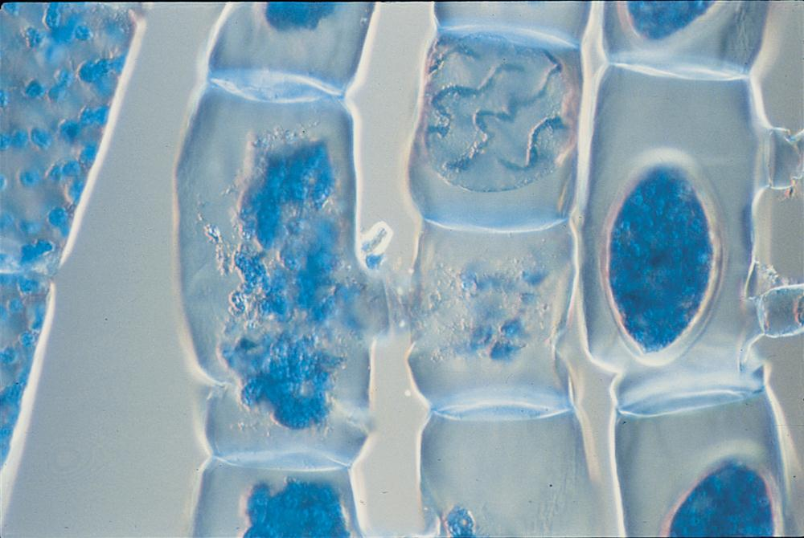
Notes:
Dr. Margene Ranieri

Slide 11
Sexual Reproduction (read page 265)
isogametes
alike gametes fuse together.
heterogametes
gametes that are different fuse together to form a zygote
oogoniium (ovum)
antheridium (sperm)

Slide 12
Algal Classification
Notes:
Background image courtesy of Dr. Margene Ranieri

Slide 13
Algal Classification
not classified as plants
grouped into phyla by
thallus form
type of chlorophyll they contain
cell wall composition
food storage
Notes:
Background image: Dr. Margene Ranieri

Slide 14
7 Algal Phyla (summary chart on page 267)
Euglenophyta
Chlorophyta
Chrysophyta
Bacillariophyta
Phaeophyta
Rhodophyta
Dinoflagellata

Slide 15
Phylum Euglenophyta “euglenoids”
unicellular
pigments: chlorophyll a and b, carotenoids
stores food as starch
no cell wall
protein rich pellicle

Slide 16
Genus Euglena (greatest taxonomic difficulties)
two anterior flagella for movement
euglenoid movement
movement in which the euglena draws up in a round ball and extends itself forward
pellicle
eyespot
nutrition
photosynthetic
saprophytic – absorbs dissolved food from environment
contractile vacuole
reproduction by binary fission
no known sexual reproduction
Show youtube video

Slide 17
Phylum Chlorophyta “green algae”
unicellular, colonial, and multicellular
pigments: chlorophylls a and b, carotenoids
stores food as starch
pyrenoid - organelle that stores starch
cellulose cell wall
one of the largest algal phyla
usually freshwater
Examples: Spirogyra, desmids, Ulothrix

Slide 18
Phylum Chrysophyta “golden algae”
mostly unicellular, some colonial
pigments: chlorophylls a and b, carotenoids
stores food as oils
cellulose cell wall
photosynthetic
multinucleate
mostly live in fresh water
Examples: Dinobryon, Vaucheria

Slide 19
Phylum Bacillariophyta “diatoms”
mostly unicellular, some colonial
pigments: chlorophylls a and c, carotenoids, xanthophylls
stores food as oils
silicon cell wall
important part of plankton
diatomaceous earth: a crumbly substance made of diatom shells
Uses: dynamite, filters, abrasives, absorbents

Slide 20
Phylum Phaeophyta “brown algae”
multicellular
pigments: chlorophylls a and c, fucoxanthin
store food as laminarin (complex carbohydrate)
cellulose and algin cell wall
almost all marine
Examples: Fucus, Kelp, Sargassum

Slide 21
Phylum Rhodophyta “red algae”
multicellular
pigments: phycobilins, carotenoids
stores food as starch
calcium carbonate, cellulose, and pectin cell walls
sexual reproduction
marine algae that help produce reefs and islands
used to produce agar a gelatinous substance used in growing bacteria
Examples: Chondrus, Corollina

Slide 22
Phylum Dinoflagellata “dinoflagellates”
unicellular
pigments: chlorophylls a and c, carotenoids
stores food as starch
cellulose cell wall
most are marine
two flagella
some bioluminescent (light producing)

