Slide 1
The Ectothermic Vertebrates
Introduction to Phylum Chordata

Slide 2
Characteristics
dorsal notochord
most is replaced by vertebrae
dorsal tubular nerve cord
“spinal cord”
pharyngeal pouches
aquatic chordates – gill slits
terrestrial chordates – structures of the lower face, neck, and upper chest

Slide 3
Phylum Chordata
Kingdom Animalia
Subphylum
Urochordata
Subphylum
Vertebrata (95%)
Subphylum
Cephalochordata

Slide 4
Phylum Chordata
Kingdom Animalia
Subphylum Vertebrata

Slide 5
Subphylum Vertebrata
cold-blooded
warm-blooded
ectothermic
endothermic
“outside”
“within”

Slide 6
Subphylum Vertebrata
ectothermic
endothermic
Agnatha
Chondrichthyes
Osteichthyes
Amphibia
Reptilia
Aves
Mammalia

Slide 7
The Vertebrates
Support & Movement

Slide 8
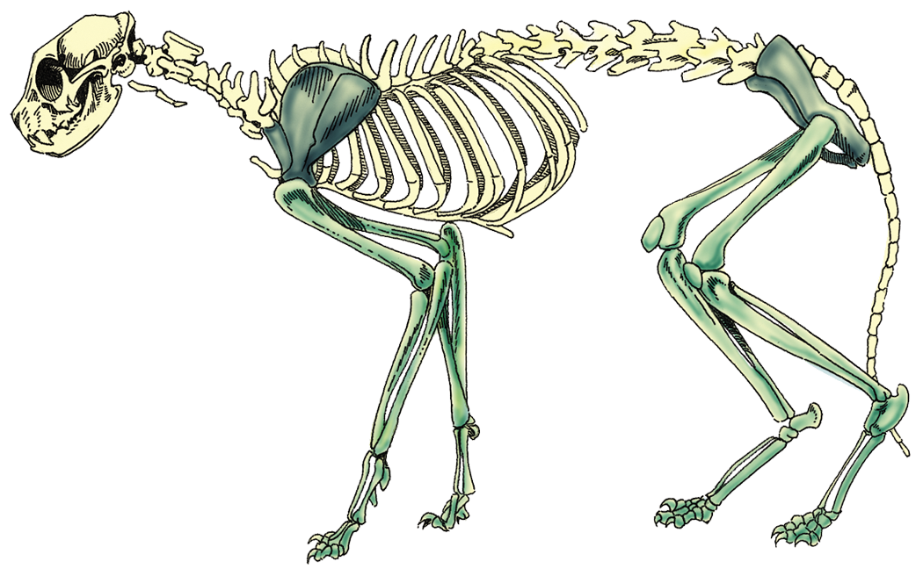
Endoskeleton
axial skeleton
vertebral column
skull
ribs

Slide 9
Endoskeleton
appendicular skeleton
pelvic girdle
pectoral girdle

Slide 10
The Vertebrates
Circulation & Excretion

Slide 11
Closed System
ventral heart
blood vessels
arteries
veins
capillaries

Slide 12
Hemoglobin
a red, oxygen-carrying pigment

Slide 13
Excretion
Most vertebrates have kidneys, which filter wastes from the blood.

Slide 14
The Vertebrates
Nutrition

Slide 15
Feeding Strategies
herbivorous
carnivorous
omnivorous

Slide 16
Alimentary Canal
food tube that extends from mouth to anus

Slide 17
The Vertebrates
Reproduction

Slide 18
Fertilization
external
internal

Slide 19
Development
oviparous
“ovi” = egg
“parous” = to give birth to
viviparous
“vive” = alive
nurtured within the mother

Slide 20
Development
oviparous
viviparous
ovoviviparous
live young
not nurtured directly by mother

Slide 21
The Vertebrates
Response

Slide 22
Parts of the Brain
olfactory lobes
receive impulses from the smell receptors of the nostrils
cerebrum
controls voluntary muscle activity
optic lobes
receive impulses fro the eyes
cerebellum
coordinates muscle activity and some involuntary activities
medulla oblongata
transports impulses to and from the spinal cord, including some reflexes

Slide 23
The Vertebrates
Behavior

Slide 24
Inborn Behavior
innate
reflex
automatic, involuntary response to a stimulus
instinct
more elaborate response to a stimulus

Slide 25
Conditioned Behavior
learned behavior
may or may not be induced by man

Slide 26
Intelligent Behavior
use of tools
problem solving
communication
Humans alone are made in God’s image!

