Slide 1
The Chemistry of Life
Basic Chemistry

Slide 2
Chemistry
2.1
the study of the composition and properties of matter and the energy transformations that accompany changes in the basic structure of matter

Slide 3
Matter
anything that occupies space and has mass

Slide 4
Matter
three states
composed of elements
pure substances that cannot be broken down into simpler substances by ordinary chemical reactions

Slide 5
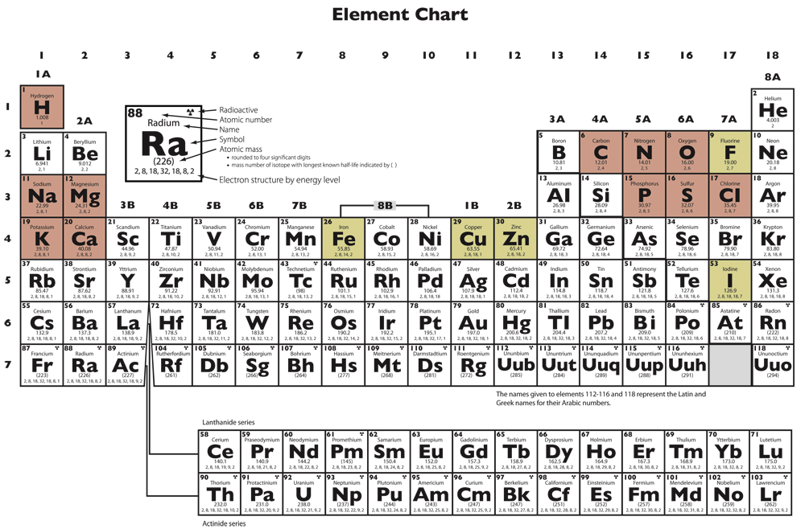
Periodic Table of the Elements

Slide 6
Matter
three states
composed of elements
Large amounts of these five elements are essential to life:
O, C, H, N, Ca

Slide 7
Matter
atom
the smallest unit of an element
composed of neutrons, protons, and electrons

Slide 8
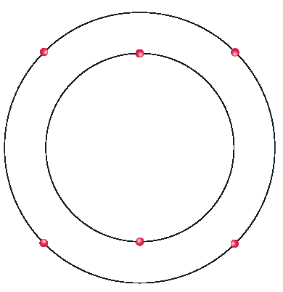
Carbon

Slide 9
Isotopes
atoms having the same number of protons but different numbers of neutrons

Slide 10
Carbon

Slide 11
Matter
ionic bond
a bond resulting from the attraction between oppositely charged ions
ion
an atom with an unequal number of protons & electrons

Slide 12
Ionic bonds
+
+
–

Slide 13
Matter
covalent bond
a bond between two atoms resulting from the sharing of electrons

Slide 14
Covalent bonds

Slide 15
Matter
compound
a substance made up of two or more elements (e.g., H₂O)

Slide 16
Molecule
the smallest unit of a compound that is still that compound in a natural state

Slide 17
Matter
hydrogen bond
a weak intermolecular attraction between a hydrogen atom of one molecule and a nitrogen, oxygen, or fluorine atom of another molecule
gives water some of its unique properties

Slide 18
Matter
compound
a substance made up of two or more elements (e.g., H₂O)
expressed by molecular and structural formulas

Slide 19
Molecular Formula
C₆H₁₂O₆
expresses the number and type of atoms

Slide 20
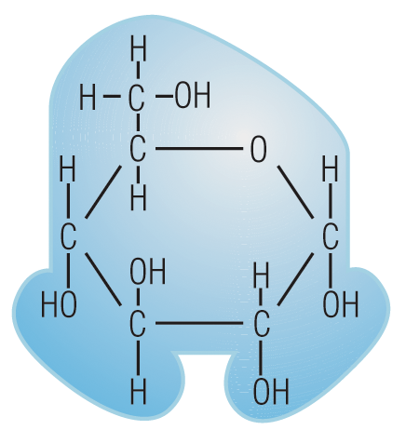
Structural Formula
ring form
linear form

Slide 21
Chemical Change
takes place when the atoms of a substance bond with different atoms or compounds

Slide 22
Chemical Change
takes place in definite proportions
forms new compounds or releases elements
involves energy

Slide 23
Physical Change
the process of altering the state of a substance, its appearance, or its combination with other substances

Slide 24
Physical Change
alters the state or the appearance of a substance
does not involve chemical bonding

Slide 25
Mixture
the combination of two substances without chemical bonding

Slide 26
What type of bonding results from giving and taking electrons?
covalent bonding
ionic bonding
metallic bonding
molecular bonding
elemental bonding

Slide 27
Compounds have the same properties as the elements that form them.
true
false

Slide 28
Energy
2.2
the ability to do work

Slide 29
Energy
kinetic energy
potential energy

Slide 30
Energy
kinetic energy
energy in motion
potential energy
stored energy

Slide 31
Can kinetic energy be converted into potential energy?
yes
no

Slide 32
Energy Changes
1st law of thermodynamics
Energy is neither created nor destroyed.
2nd law of thermodynamics
Whenever energy is used, some of it is wasted.

Slide 33
Entropy
the increase in randomness and loss of usable energy

Slide 34
Energy
kinetic energy
potential energy
kinetic molecular energy
ALL the molecules in matter are moving.

Slide 35
Energy
kinetic energy
potential energy
kinetic molecular energy
potential energy of a molecule

Slide 36
Chemical Reactions
endothermic
“endo” = within
absorb heat
A + B + energy C + D

Slide 37
Chemical Reactions
exothermic
“exo” = outside of
release heat
A + B C + D + energy

Slide 38
activation energy
the energy needed to start a chemical reaction

Slide 39
Chemical Reactions
catalyst
affects the rate of a reaction but is not consumed in the reaction
lowers the activation energy necessary for the reaction

Slide 40
Chemical Reactions
enzymes
organic catalysts
active site
substrate

Slide 41
Chemical Reactions
enzymes
organic catalysts

Slide 42
When two substances combine without chemical bonding, those substances form a
mixture.
compound.
molecule.
element.

Slide 43
Solutions Suspensions Colloids
2.3

Slide 44
Solution
a homogeneous mixture of one or more substances in another substance
“homo” = same

Slide 45
Solution
a homogeneous mixture of one or more substances in another substance
solute (dissolved)
solvent (dissolver)
concentration = ratio of the solute to the solvent

Slide 46
Suspension
the state of a substance when its particles are mixed but are not dissolved
particles settle out

Slide 47
Colloid
a mixture of fine particles that do not dissolve but do not settle out quickly
gel phase (semisolid)
sol phase (fluid)

Slide 48
Diffusion
net movement of molecules from an area of higher concentration to an area of lower concentration

Slide 49
Diffusion
driven by kinetic molecular energy
concentration gradient
difference between the numbers of one type of molecule in two adjacent areas
diffusion pressure

Slide 50
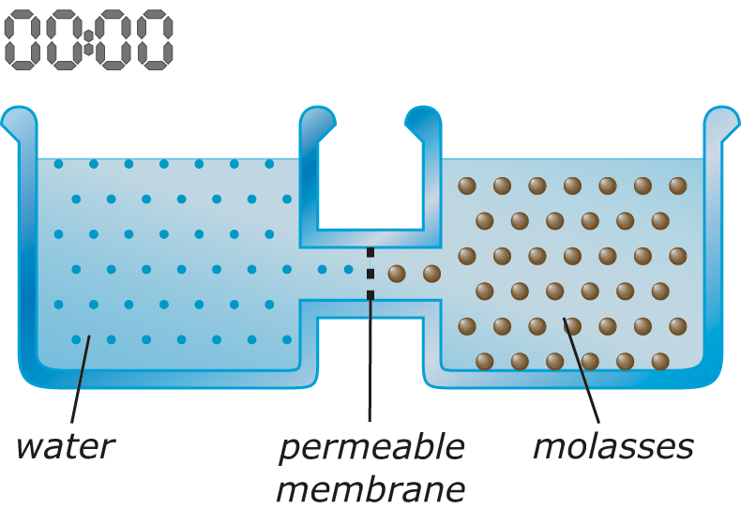

Slide 51
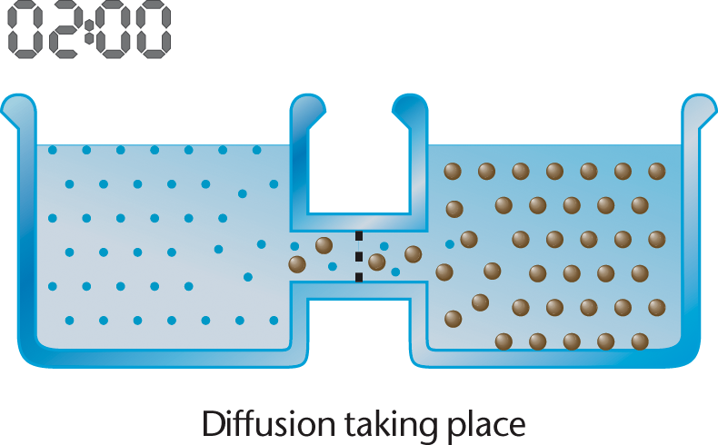

Slide 52
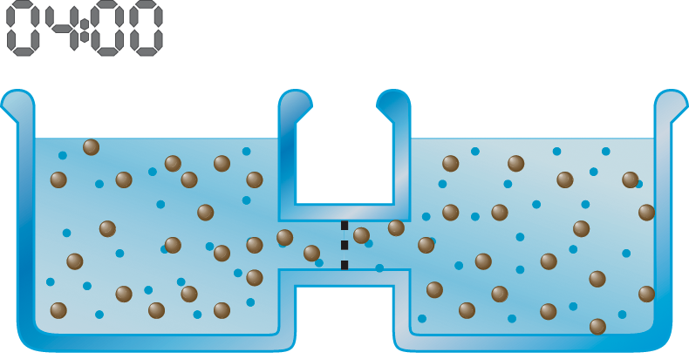

Slide 53
Osmosis
the diffusion of water through a
semipermeable
membrane

Slide 54
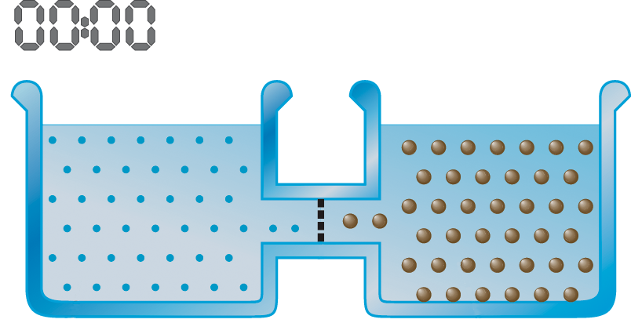

Slide 55
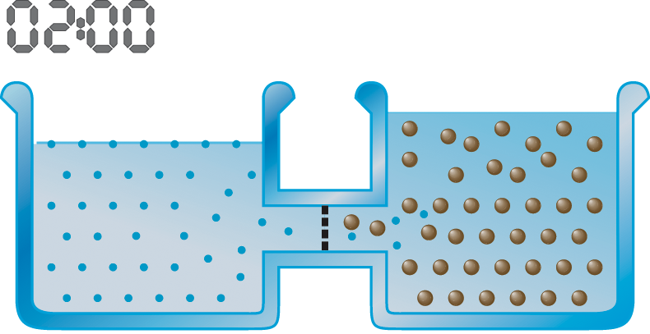

Slide 56
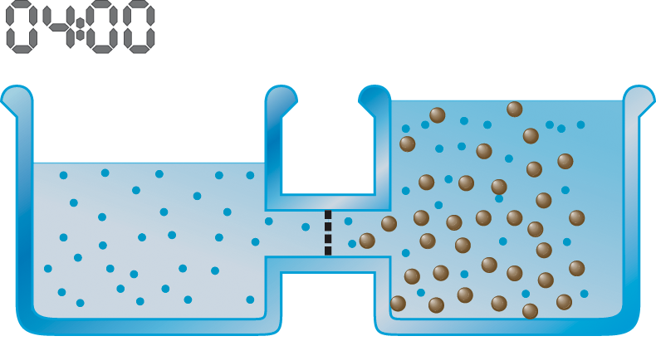

Slide 57
In sugar water, the sugar is the _____.
solute
solute
solvent
solution
suspension

Slide 58
What happens when a tea bag is placed in a cup of hot water?
an energy conversion
diffusion
osmosis
entropy

Slide 59
A membrane that selectively allows some molecules to pass through but not others is
perforated.
porous.
semipermeable.
permeable.

Slide 60
The “skin” of a raisin is semipermeable. Raisins placed in a beaker of water will
swell.
shrink.
stay the same size.

