Slide 1
The Chemistry of Life
Organic Chemistry

Slide 2
Organic Compounds
2.4
carbohydrates
lipids
proteins
nucleic acids

Slide 3
Biosynthesis
the putting together of substances by living things

Slide 4
Functions of Organic Compounds
structural
enzymatic
storage

Slide 5
Carbohydrates
2.5
monosaccharides
  single sugar
  glucose
disaccharides
  double sugar
  sucrose

Slide 6
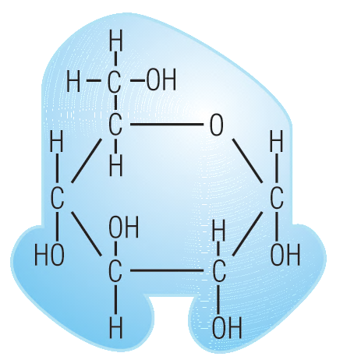
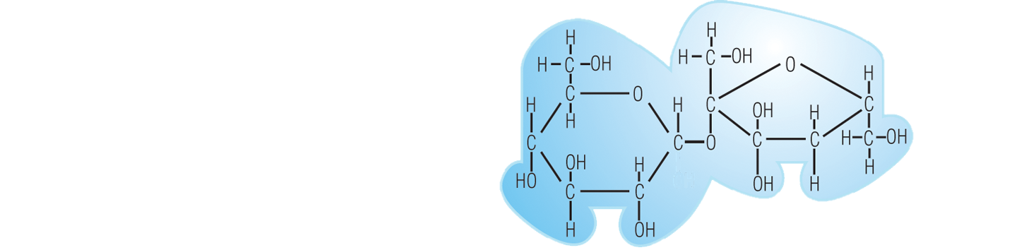
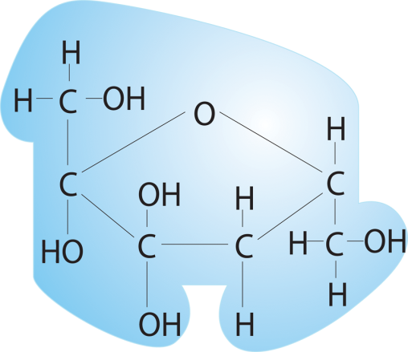
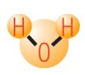

Dehydration Synthesis
glucose
sucrose
fructose

Slide 7
Hydrolysis
glucose
sucrose
fructose

Slide 8
Carbohydrates
polysaccharides
  starch
  glycogen
  cellulose
    bulk or roughage
  chitin

Slide 9
ORGANIC COMPOUNDS | FUNCTIONS
 | Structural | Enzymatic | Storage
 |  |  | Energy | Material | Information
Carbohydrates
Lipids
Proteins
Nucleic Acids
CARBOHYDRATES

Slide 10
Lipids
only slightly soluble in water but very soluble in other organic solvents
occupy less space than starches

Slide 11
Lipids
fatty acids
  found in animal tissue and dairy products
  store energy

Slide 12
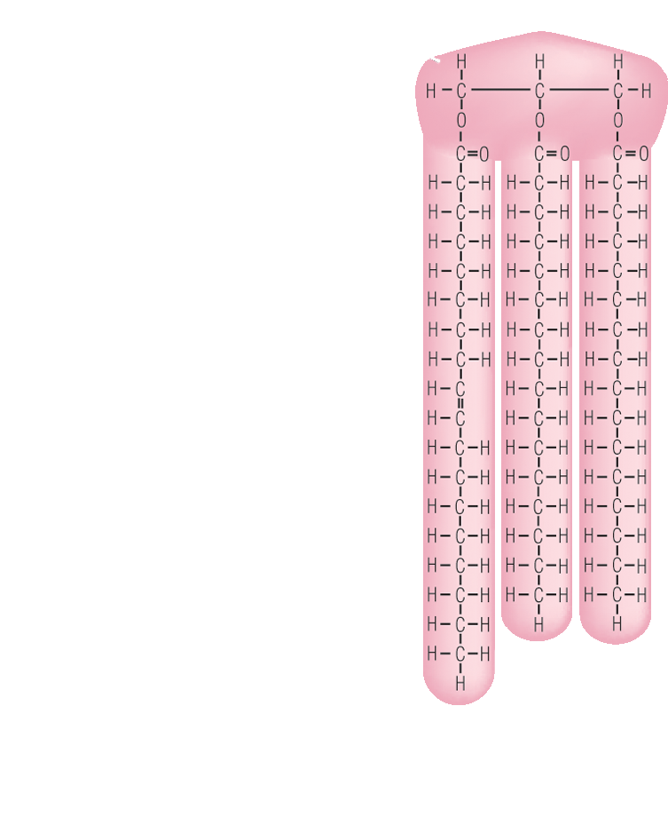

Slide 13
Lipids
fatty acids
  have hydrophilic and hydrophobic ends
    “philic” = love
    “phobic” = fear

Slide 14
Lipids
fatty acids
  saturated
    single bonds between carbon atoms
    solid at room temp.
      e.g., butter & lard

Slide 15
Lipids
fatty acids
  unsaturated
    double bond between one or more pairs of carbon atoms
    liquid at room temp.
      e.g., oils

Slide 16
Lipids
triglycerides
  most abundant type of lipid in the body
  three fatty acids with a molecule of glycerol

Slide 17
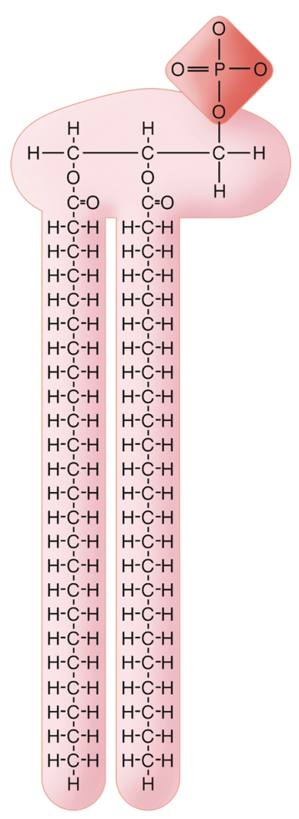
Lipids
phospholipids
  two fatty acids with a
  glycerol
  also have hydrophilic
  and hydrophobic ends

Slide 18
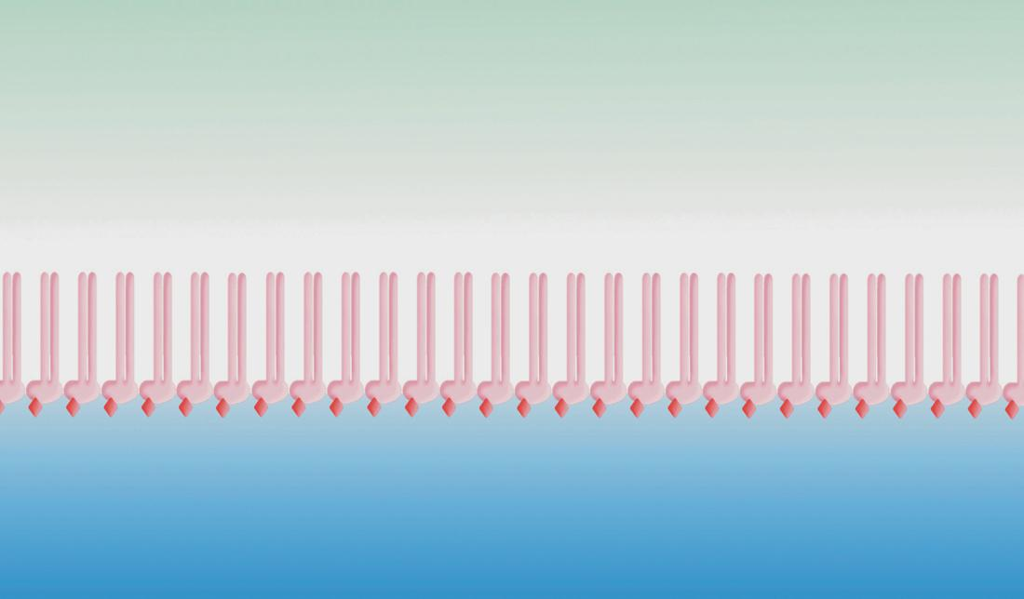

Slide 19
Lipids
phospholipids
  two fatty acids with a
  glycerol
  also have hydrophilic
  and hydrophobic ends
waxes

Slide 20
Lipids
steroids
  function as chemical
  messengers (hormones)
  e.g., cholesterol

Slide 21
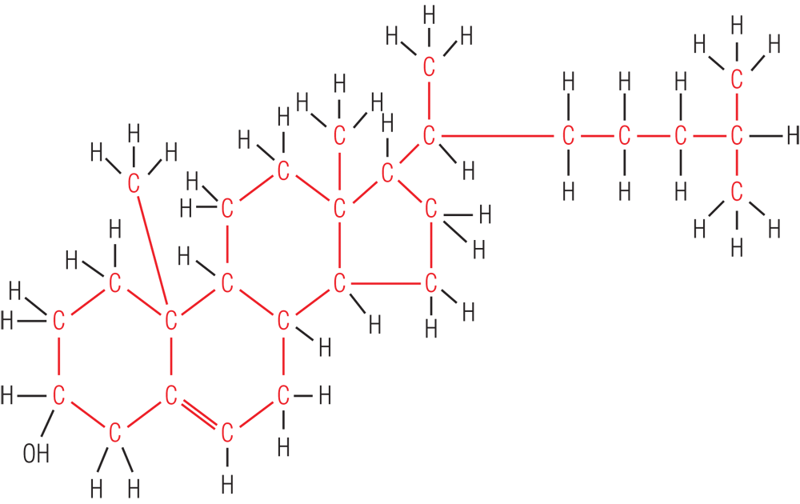
Lipids
steroids

Slide 22
ORGANIC COMPOUNDS | FUNCTIONS
 | Structural | Enzymatic | Storage
 |  |  | Energy | Material | Information
Carbohydrates
Lipids
Proteins
Nucleic Acids
LIPIDS

Slide 23
Proteins
2.6
made up of long chains of
amino acids
form polypeptide bonds

Slide 24
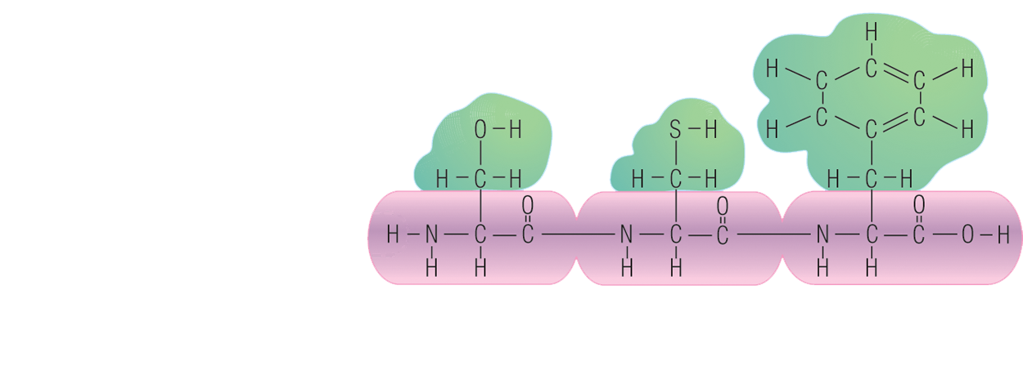
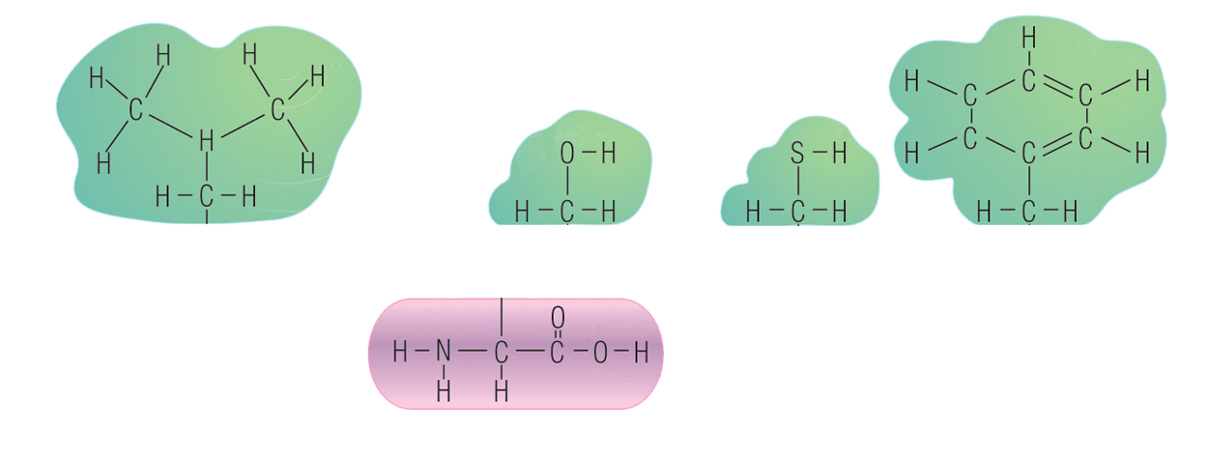

Slide 25
Proteins
made up of long chains of
amino acids
form polypeptide bonds
function as enzymes

Slide 26
ORGANIC COMPOUNDS | FUNCTIONS
 | Structural | Enzymatic | Storage
 |  |  | Energy | Material | Information
Carbohydrates
Lipids
Proteins
Nucleic Acids
PROTEINS

Slide 27
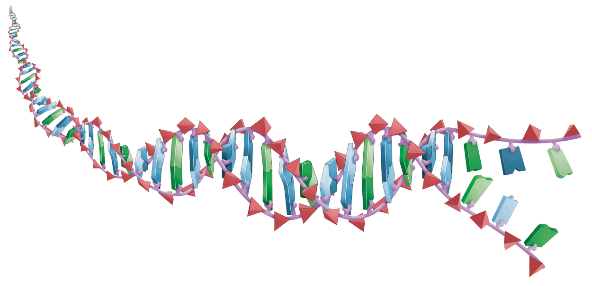
Nucleic Acids
material for heredity

Slide 28
Nucleic Acids
found in the nucleus
transmit information to the next generation of cells
contain information for manufacturing proteins
described by Watson and Crick

Slide 29
DNA
deoxyribonucleic acid
structure
  double helix
  twisted ladder of nucleotides

Slide 30
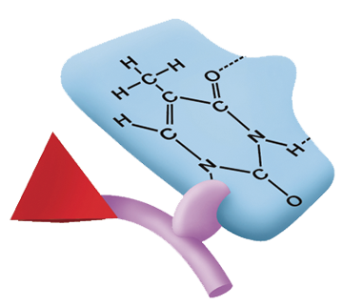
Nucleotide
sugar, phosphate, and a base
bases: adenine, thymine, cytosine, guanine

Slide 31
Replication
one DNA molecule becomes two DNA molecules

Slide 32
enzymes
enzyme

Slide 33
RNA
ribonucleic acid
sugar = ribose
single stranded
bases: cytosine, guanine, adenine, and uracil

Slide 34
Transcription
process by which DNA
forms RNA
RNA polymerase

Slide 35



Slide 36
ORGANIC COMPOUNDS | FUNCTIONS
 | Structural | Enzymatic | Storage
 |  |  | Energy | Material | Information
Carbohydrates
Lipids
Proteins
Nucleic Acids
NUCLEIC ACIDS

