Slide 1
Cellular Processes
Cellular Energy

Slide 2
Energy Relationships
4.1
autotroph (producers)
“auto” = self
“troph” = nourishment
Heterotroph (consumers)
“hetero” = others
“troph” = nourishment

Slide 3
What are you?
an autotroph
a heterotroph

Slide 4
Autotrophs
make their own food (organic, energy-containing substance) from an inorganic source
Examples include plants, algae, and some bacteria.
photosynthetic
chemosynthetic

Slide 5
Heterotrophs
depend on other organisms for their energy source
Examples include humans, animals, fungi, and most bacteria.

Slide 6
Photo
synthesis

Slide 7
Photosynthesis
4.2
the process of taking light energy and converting it into stored chemical energy

Slide 8
What is the ultimate source of energy?

Slide 9
Sun
the ultimate source of energy for living things

Slide 10
Photosynthesis
kinetic energy from the sun
potential energy in the form of a chemical (glucose)

Slide 11
Glucose is a
monosaccharide.
disaccharide.
polysaccharide.

Slide 12
ATP
adenosine triphosphate
adenosine
1
2
3
phosphates

Slide 13
Energy can be stored in the chemical bonds of a molecule.
true
false

Slide 14
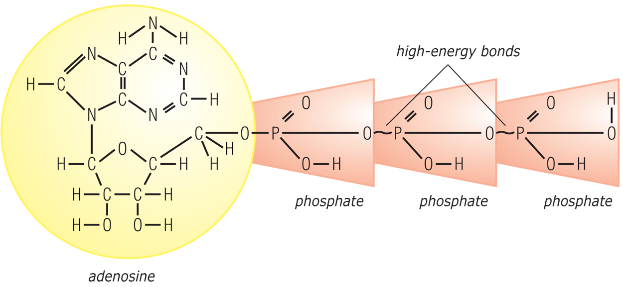
ATP
adenosine triphosphate

Slide 15
ADP
adenosine diphosphate
adenosine
1
2
energy
phosphates

Slide 16
ATP
adenosine triphosphate
represents stored energy
easily converted to ADP

Slide 17
ADP
adenosine diphosphate
represents released energy
easily converted back to ATP

Slide 18
ADP
ATP
adenosine
triphosphate
diphosphate
adenosine
1
2
3
energy

Slide 19
ADP
ATP
adenosine
triphosphate
diphosphate
adenosine
1
2
3
energy

Slide 20
ADP
ATP
adenosine
triphosphate
diphosphate
adenosine
1
2
3
energy

Slide 21
Usable Energy (pg 79)
ADP + P + energy =
ATP (stored energy)
ATP – P =
ADP (released energy)

Slide 22
Photo
synthesis

Slide 23
History (Facet pg 84)
van Helmont
A plant's substance does not come from the soil.
Priestley
Plants take in CO₂ and give off O₂.

Slide 24
History (Facet pg 84)
Ingenhousz
Plants require sunlight and water for proper growth.
Calvin
Photosynthesis occurs in phases.

Slide 25
Chlorophyll
primary catalyst of photosynthesis
green pigment in the grana of chloroplasts
produced by plant cells (requires iron and sunlight)
becomes activated by light energy

Slide 26
Other Plant Pigments
different types of chlorophyll (a, b, c, d)
other pigments also
chlorophyll a: the primary catalyst for photosynthesis

Slide 27
Light-Dependent Phase
Chlorophyll is energized.
Photolysis (splitting of water) occurs.
Oxygen from split water is released.

Slide 28
Light-Dependent Phase
The hydrogen & electrons from split water bind to a special electron carrier to be used later.
NADP⁺ NADPH
Remaining energy is used to change ADP into ATP.

Slide 29
Light-dependent Phase
In short, the light-dependent phase uses light energy to form NADPH and ATP and produces oxygen gas.

Slide 30
Light-Independent Phase
also called the Calvin Cycle
depends on the products of the light-dependent phase
occurs in the stroma of chloroplasts

Slide 31
Light-Independent Phase
Carbon dioxide binds to a chemical called RuBP. (5 carbon sugar)
The resulting compound is unstable and breaks into two molecules of PGA.

Slide 32
Light-Independent Phase
PGA is converted to PGAL (3 carbon sugar) using the hydrogen and electrons from NADPH.
The energy comes from ATP changing to ADP.

Slide 33
Light-Independent Phase
PGAL is used in two ways.
to form RuBP
to synthesize glucose
In short, the Calvin cycle produces sugar using the atoms from CO₂, energy from ATP, and the electrons and hydrogen ions provided by NADPH.

Slide 34
Conditions for Photosynthesis
proper wavelengths/intensity of light
sufficient carbon dioxide
proper temperatures
water supply

Slide 35
Balanced Equation
6 CO₂
+
6 H₂O
+
light energy
chlorophyll
C₆H₁₂O₆
+
6 O₂

Slide 36
What happens during photolysis?
Water is split.
Light is split.
Energy is stored.
Energy is released.

Slide 37
What is the catalyst that captures the light energy?
RuBP
glucose
chlorophyll
water

Slide 38
In which phase does photolysis occur?
light-dependent phase
light-independent phase

Slide 39
Which chemical is a CO₂ acceptor?
PGAL
NADPH
H₂O
RuBP

Slide 40
ADP is converted to ATP in the
light-dependent phase.
light-independent phase.

Slide 41
4.3
Cellular Respiration

Slide 42
Cellular Respiration
the breakdown of a food substance into usable cellular energy in the form of ATP

Slide 43
Photosynthesis
kinetic energy
stored chemical energy (C₆H₁₂O₆)

Slide 44
Cellular Respiration
stored chemical energy (C₆H₁₂O₆)
usable chemical energy

Slide 45
Cellular Respiration
aerobic
requires oxygen
anaerobic
does not require oxygen

Slide 46
Aerobic Cellular Respiration
C₆H₁₂O₆ + O₂
H₂O + CO₂ + energy (ATP)

Slide 47
Glycolysis
beginning for both types of cellular respiration
starts with glucose
does not require oxygen (anaerobic)
occurs in the cytoplasm

Slide 48
Glycolysis
breakdown of glucose into pyruvic acid, H⁺, and electrons
products are sent to the mitochondria
two net ATP

Slide 49
Aerobic Respiration
citric acid cycle (Krebs cycle)
pyruvic acid into citric acid
also produces H⁺ and electrons
two net ATP

Slide 50
Aerobic Respiration
hydrogen and electron transport system
occurs in the cristae of the mitochondria
forms ATP as electrons pass from one enzyme to another

Slide 51
Aerobic Respiration
hydrogen and electron transport system
ends as the hydrogen ions combine with oxygen to form water
32 net ATP

Slide 52
Energy Facts
Aerobic cellular respiration stores 50–60% of the energy from glucose in molecules of ATP.
Aerobic cellular respiration results in the net gain of 36-38 molecules of ATP.

Slide 53
Anaerobic Respiration
cellular fermentation
breakdown of food (glucose) without oxygen

Slide 54
Cellular Fermentation
Glycolysis forms pyruvic acid.
Pyruvic acid is converted into either alcohol or lactic acid.

Slide 55
Cellular Fermentation
alcoholic fermentation
bacteria
yeasts
lactic acid fermentation
bacteria
many animal cells

Slide 56
Energy Facts
Cellular fermentation supplies no ATP energy beyond glycolysis.
Cellular fermentation results in the net gain of two molecules of ATP.
Make cellular respiration chart

Slide 57
What is cellular respiration?
enzymatic breakdown of substances
exchange of oxygen and carbon dioxide with the environment
breakdown of food to release usable energy for the cell
synthesis of organic compounds

Slide 58
Glycolysis is anaerobic.
true
false

Slide 59
How many net ATP are produced during glycolysis?
2 ATP
4 ATP
32 ATP
36 ATP

