Slide 1
Cellular Processes
Cellular Metabolism & Protein Synthesis

Slide 2
Metabolism
4.4
the sum of all of a cell's life processes
controls how a cell behaves

Slide 3
Protein Synthesis

Slide 4
The Code of Life
DNA holds the code for the production of proteins.
The sequence of the four bases determines the sequence of amino acids.
Adenine, thymine, guanine, cytosine (AT, CG)

Slide 5
Codon
group of three bases
forms a code for a particular amino acid
there are 20 amino acids and 64 possible combinations

Slide 6
RNA Review
RNA is single-stranded.
Uracil replaces thymine.
RNA is formed from DNA during transcription.
Exons – part of mRNA that are actually read as codons
Introns – sections of tRNA that do not code and are removed

Slide 7
Types of RNA
messenger RNA = mRNA
transfer RNA = tRNA
ribosomal RNA = rRNA

Slide 8
mRNA
contains the actual code from transcription
carries the code from the DNA in the nucleus to the ribosomes in the cytoplasm

Slide 9
exon
intron
exon
intron
exon

Slide 10
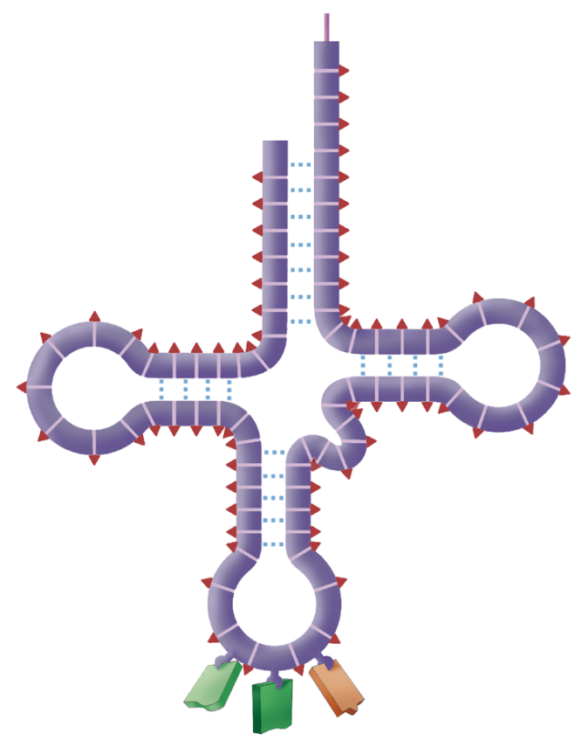
tRNA
transfers amino acids from the cytoplasm to ribosomes
contains the anticodon

Slide 11
Anticodon
triplet of nucleotides at the end of the tRNA molecule
pairs with a codon on mRNA in order to align the proper amino acid
anticodon

Slide 12
rRNA
combines with various proteins to make up the ribosomes
brings together the mRNA and tRNA

Slide 13
Translation
the process of forming a polypeptide chain of amino acids

Slide 14
Translation
The mRNA leaves the nucleus through a nuclear pore.
A ribosome lines up on one end of the mRNA.

Slide 15
Translation
The codon from mRNA and the anticodon from tRNA line up.
Once these two are lined up, the ribosome moves to the next codon.

Slide 16
Translation
The amino acid “hops” off of tRNA and bonds to the forming amino acid chain.
Once the amino acid bonds to the chain, the tRNA leaves the ribosome.

Slide 17
Translation
initiator (start) codon
marks the beginning of the chain
AUG
terminator (stop) codon
marks the end of the chain
UAA, UAG, UGA

Slide 18
Translation
A single strand of mRNA may have several ribosomes reading it simultaneously.
A strand of mRNA is used more than once.

Slide 19
Metabolic Rate
4.5
rate at which an organism carries on its life processes
key to homeostasis
Things that affect rate
Degree of activity
Age
Sleep
Health
Environment
Quantity of light
Water
Vitamins
Temperature
Some people just have a higher/lower metabolism than others

Slide 20
Metabolic Rate
anabolism
building molecules to store energy
catabolism
breaking down molecules to release energy

Slide 21
Proteins are made up of long chains of
triglycerides.
monosaccharides.
amino acids.
nucleic acids.

Slide 22
Which of the following is NOT one of the bases found in DNA?
adenine
thymine
uracil
cytosine
guanine

Slide 23
Which of the following bases are paired correctly?
cytosine - guanine
guanine - adenine
adenine - cytosine
cytosine - thymine

Slide 24
DNA is located primarily in the
cytoplasm.
ER.
Golgi apparatus.
vesicles.
nucleus.

Slide 25
Protein synthesis occurs in the
mitochondria.
ribosomes.
lysosomes.
Golgi bodies.
plastids.

Slide 26
Unlike DNA, RNA is a single strand of nucleotides.
true
false

Slide 27
Which of the following is NOT one of the bases found in RNA?
adenine
thymine
uracil
cytosine
guanine

Slide 28
If mRNA has the codon UAG, what is its anticodon?
GCA
AUC
CUA
ATC

