Slide 1
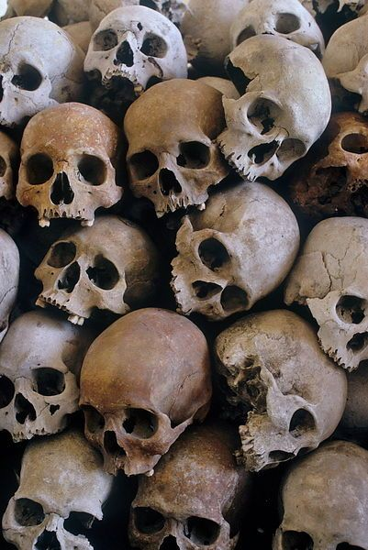
FORENSIC
ANTHROPOLOGY
Let the bones tell the story!

Slide 2
CHAPTER 14 VOCABULARY
biological profile
diaphysis
epiphysis
forensic anthropology
growth plate (epiphyseal plate)
joints
ossification
osteoporosis
skeletal trauma analysis

Slide 3
INTRODUCTION
Anthropology – the study of the origin, behavior, social, cultural, and physical development of humans
Forensic anthropology – applied anthropology that specializes in the changes and variations in the human skeleton for the purpose of legal inquiry
Kathy Reichs (2.40) https://www.youtube.com/watch?v=L101Bvj0lAA

Slide 4
INTRODUCTION
A forensic anthropologist may provide basic identification information of skeletonized or badly decomposed remains (biological profile). From a whole bone or part of a bone, the scientist may be able to determine:
  an age range
  sex
  race
  approximate height
  cause of death, disease, or anomaly

Slide 5
HISTORICAL DEVELOPMENT
In 1878, The Identification of the Human Skeleton: A Medicolegal Study was published.
In 1895, the first known use of craniofacial superimposition was used to identify the remains composer Johann Sebastian Bach.
In 1932, the FBI opened its first crime lab.
In 1977, the American Board of Forensic Anthropology (ABFA) was established.
In 2014, an anthropology subcommittee of OSAC was established to standardize recovery and analysis of human remains.

Slide 6
CHARACTERISTICS OF BONE
Bones
  provide the framework for our bodies
  anchor our muscles to allow movement
  protect our vital organs
A joint is the location where bones meet.
  cartilage – wraps the ends of the bones for protection
  ligaments – bands of tissue connecting two or more bones
  tendons – connect muscle to bone

Slide 7
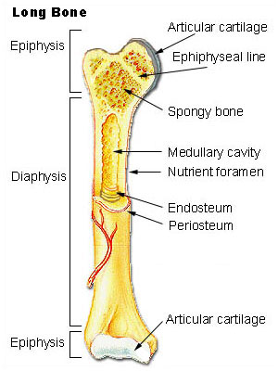
NUMBER & DEVELOPMENT OF BONES
A baby has 270 bones.
Adults have 206 bones.
For some bones, ossification takes more than 50 years.
  epiphysis – the “caps’ of the long bones
  diaphysis – shafts of the bones
  epiphyseal plate (growth plate) – cartilaginous area between the caps and shaft

Slide 8
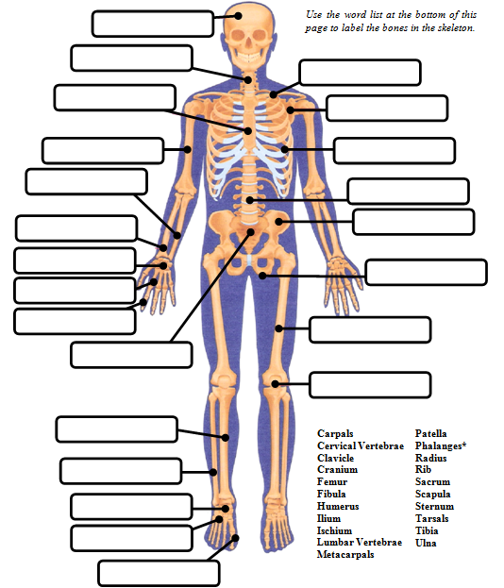
Directions:
Identify the bones in the skeleton. One label will be used twice!
Cranium
Cervical Vertebrae
Clavicle
Sternum
Scapula
Humerus
Ribs
Ulna
Lumbar Vertebrae
Radius
Ilium
Carpals
Ishium
Metacarpals
Phalanges
Femur
Sacrum
Patella
Tibia
Fibula
Tarsals
Metatarsals
Phalanges

Slide 9
Quick Quiz – Give the common name for each bone.
I should have known it was going to be one of those days, when I had stepped out of bed and stubbed my (1) PHLANGE on the night stand. While hopping up and down on one (2) METATARSAL and grasping the other, I slipped and fell onto my right shoulder breaking my (3) CLAVICLE. As I crawled on my (4) METACARPALS and (5) PATELLAS to my bed, I felt my (6) CRANIUM begin to ache. I found my phone and let my (7) PHLANGES do the walking as I called my friend to come help me out. My friend answered the phone with a loud scream; my (8) MANDIBLE dropped, I asked what had happened, and he replied that he had been startled by the ringing phone, fell out of bed landed on his (9) COCCYX. Following that while racing to the phone he hit his (10) TIBIA on a stool. I should have known it was going to be one of those days.
TOES
2. FOOT
3. COLLAR BONE
4. HANDS
5. KNEES
6. SKULL or HEAD
7. FINGERS
8. LOWER JAW
9. TAIL BONE
10. SHIN

Slide 10
BONES AND BIOLOGICAL PROFILES
Bones contain a "diary” of injuries, disease, and nutritional deficiencies.
  broken bones
  osteoarthritis
  osteoporosis
  rickets – lack of vitamin d
  severe anemia – lack of iron
  cancer

Slide 11
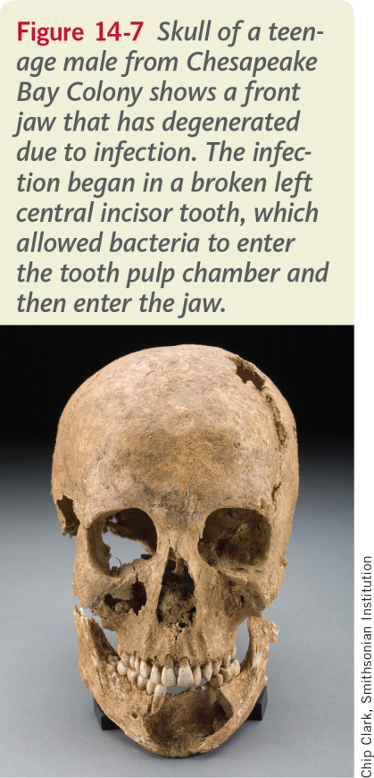
BONES AND GEOGRAPHY
Bones indicate were you have eaten your food.
  strontium
  carbon-13
  carbon-12

Slide 12
HOW TO DISTINGUISH MALES FROM FEMALES
First question asked – male or female?
The overall appearance of the adult female’s skeleton tends to be more slender than that of an adult male’s skeleton.
Muscles tend to be more developed in the male.
The determination of sex by skeletal remains can only be done if the deceased is passed puberty.

Slide 13
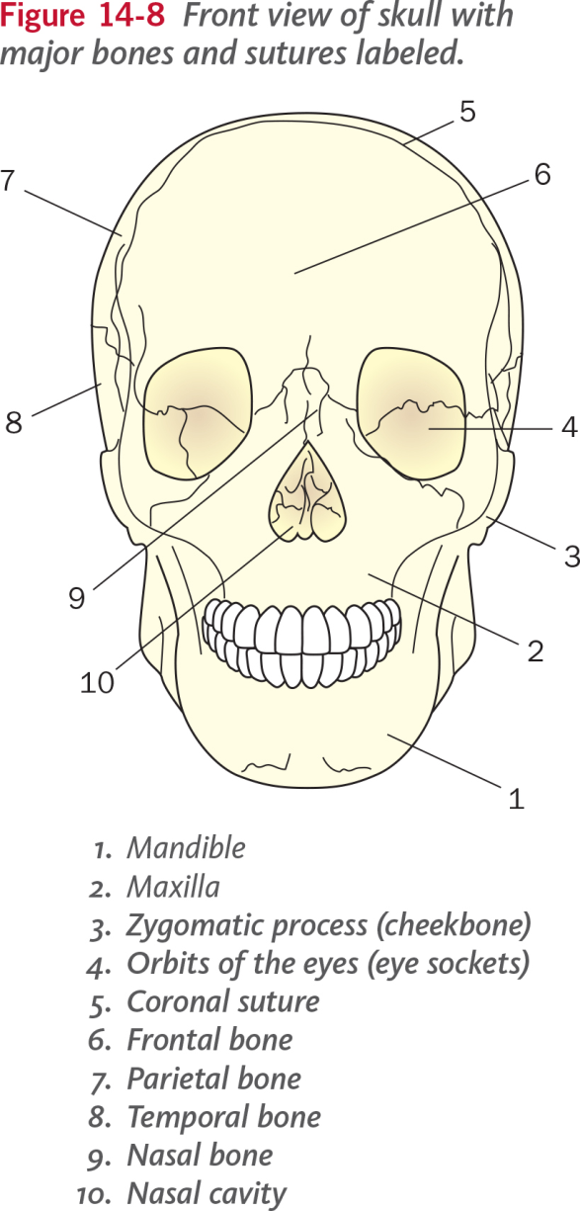
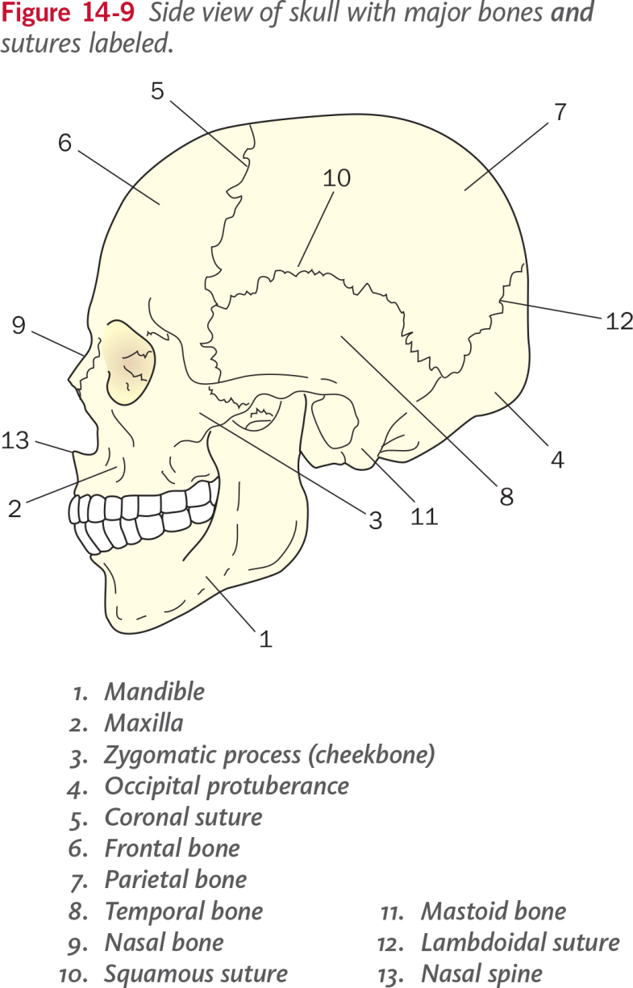
HOW TO DISTINGUISH MALES FROM FEMALES - SKULL

Slide 14
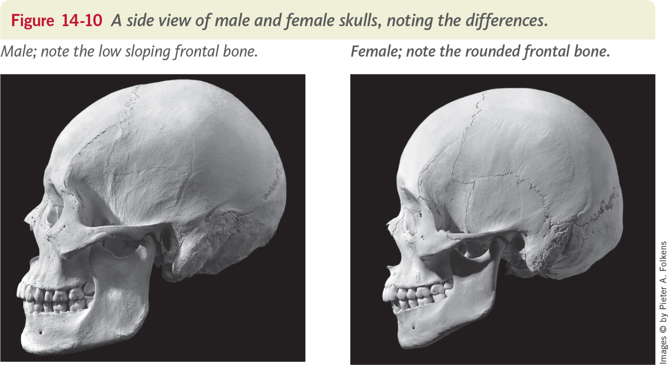
HOW TO DISTINGUISH MALES FROM FEMALES - SKULL

Slide 15
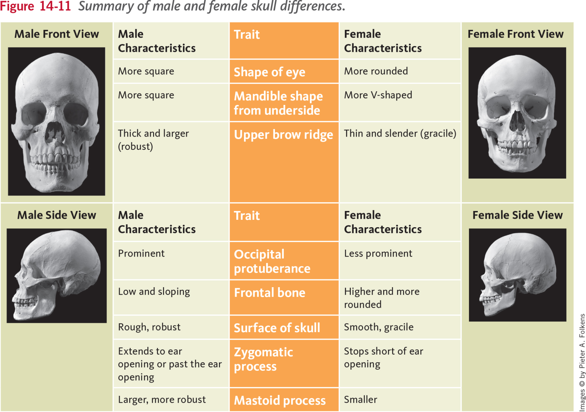
HOW TO DISTINGUISH MALES FROM FEMALES - SKULL

Slide 16
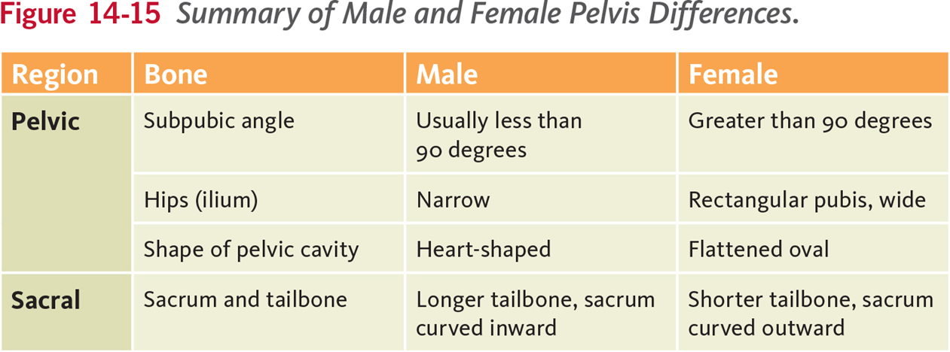
HOW TO DISTINGUISH MALES FROM FEMALES – PELVIS
Examining the pelvis is one of the most reliable methods of determining the sex of an adult skeleton.

Slide 17
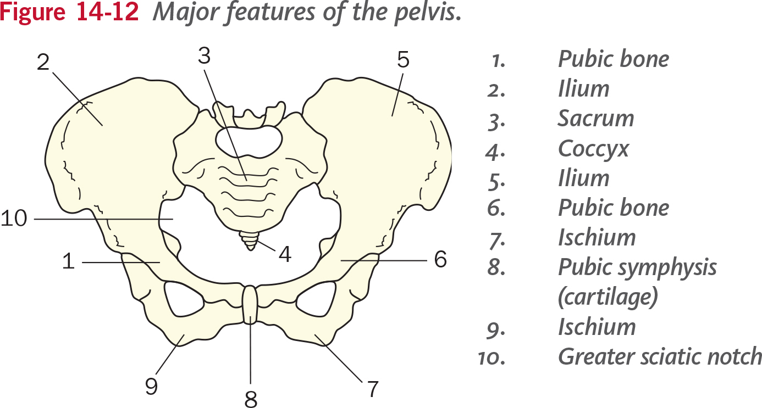
HOW TO DISTINGUISH MALES FROM FEMALES – PELVIS

Slide 18
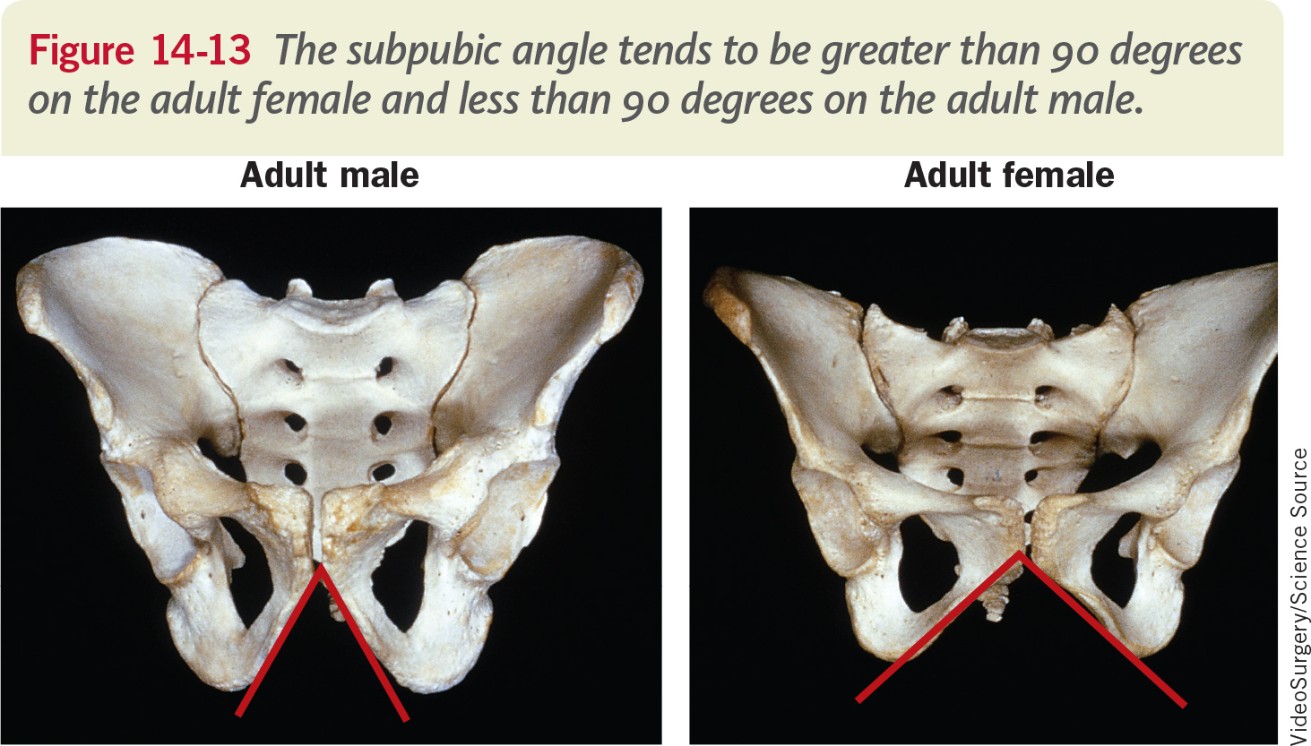
HOW TO DISTINGUISH MALES FROM FEMALES – PELVIS

Slide 19
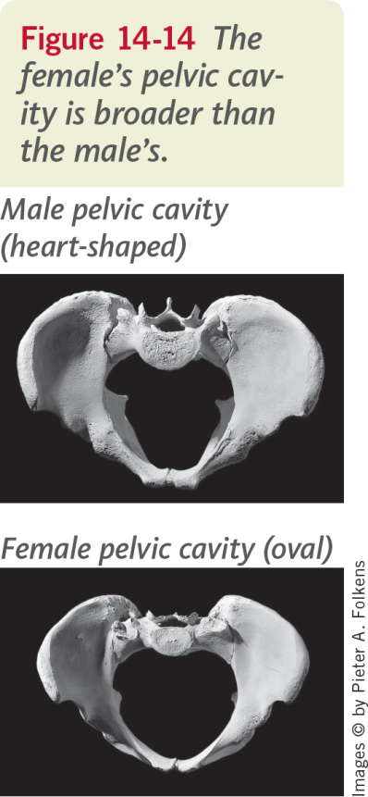
HOW TO DISTINGUISH MALES FROM FEMALES – PELVIS
To distinguish between the male and female pelvis, compare the following:
  subpubic angle
  length, width, shape, and angle of the sacrum
  width of the ilieum
  angle of the sciatic notch

Slide 20
AGE DETERMINATION
Most estimations come from:
  teeth
  epiphyses - growth plates on long bones
  pubic symphysis
  cranial sutures: the three major cranial sutures appear as distinct lines in youth and gradually close from the inside out.
Investigators always use an age range because of the variation in people and how they age. The investigator does not want to eliminate any possibilities for identification.

Slide 21
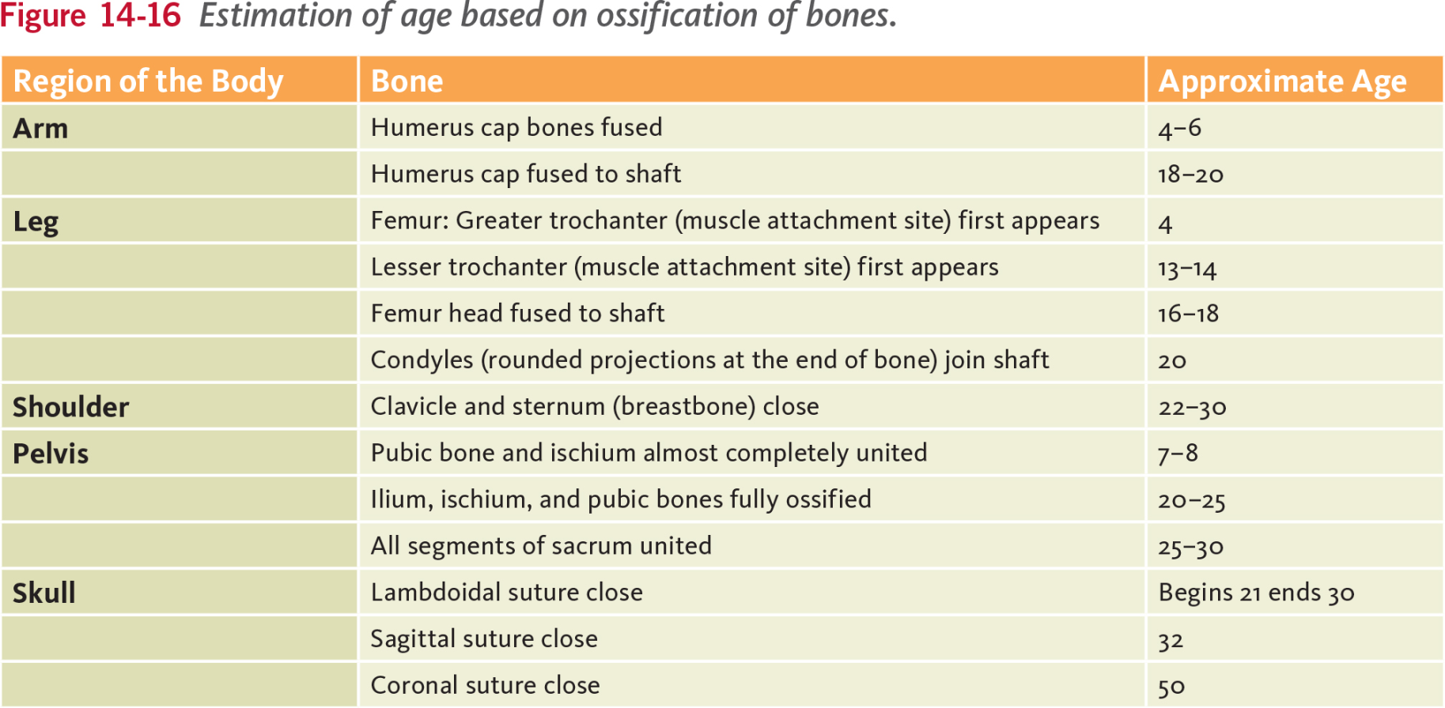
AGE DETERMINATION – OSSIFICATION

Slide 22
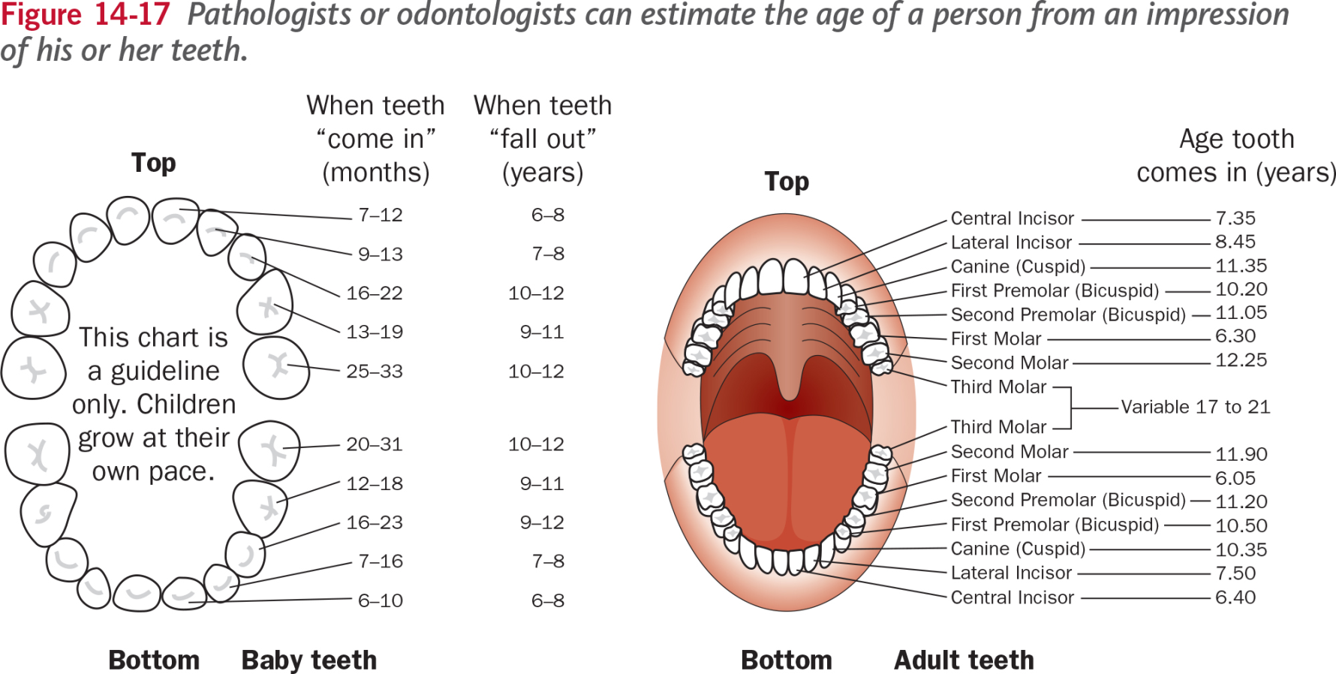
AGE DETERMINATION – TEETH

Slide 23
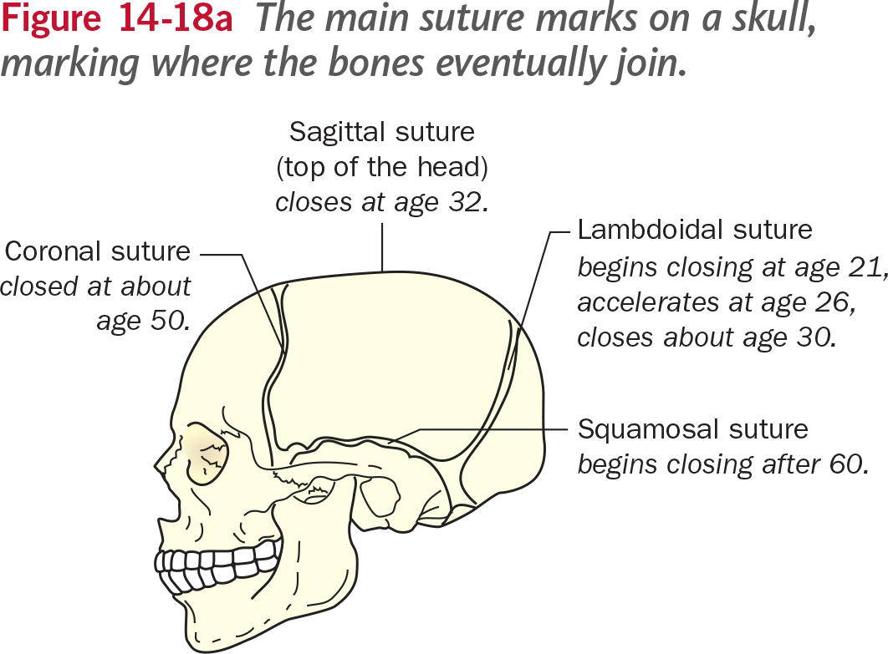
AGE DETERMINATION –
SKULL SUTURE MARKS

Slide 24
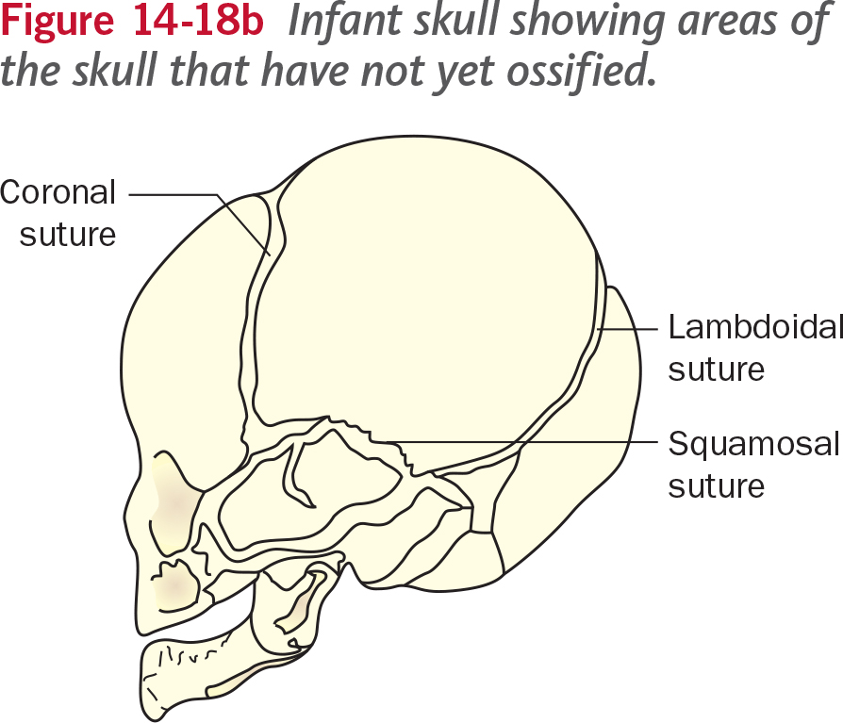
AGE DETERMINATION –
SKULL SUTURE MARKS

Slide 25
DETERMINING ANCESTRY
Determining ancestry from skeletal remains is difficult
  shape of eye sockets
  shape of nasal cavity
  nasal index – ratio of width of the nasal opening to the height of the opening x 100
  prognathism – projection of the upper jaw and/or the lower jaw beyond the face

Slide 26
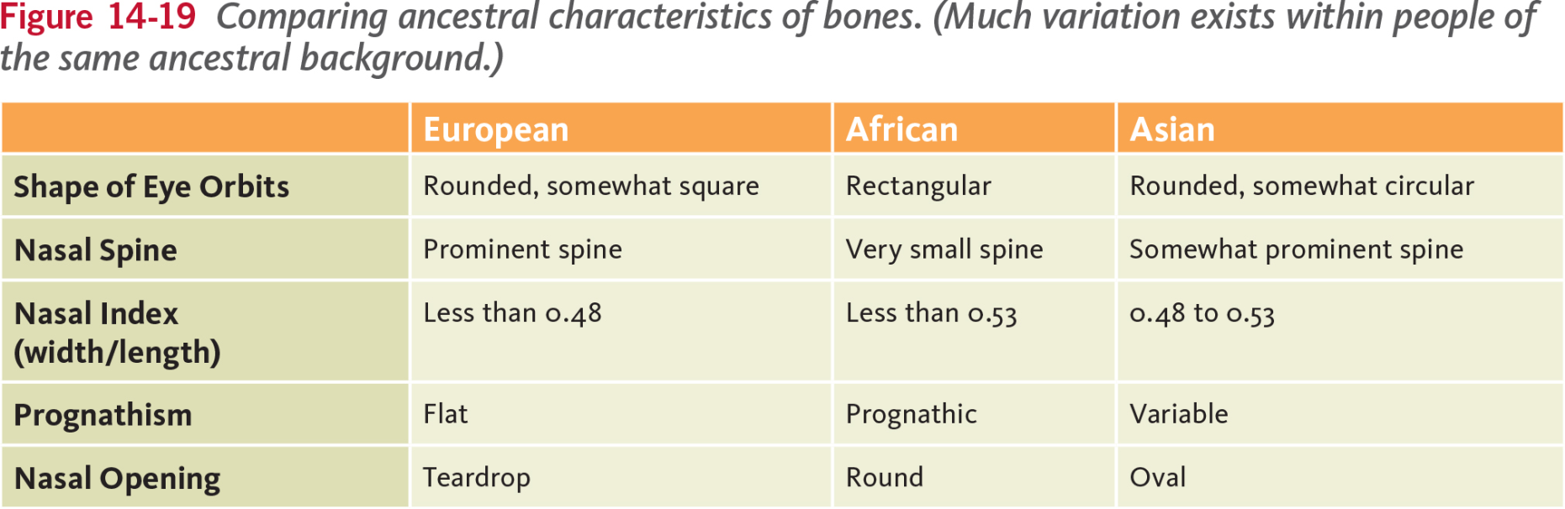
DETERMINING ANCESTRY

Slide 27
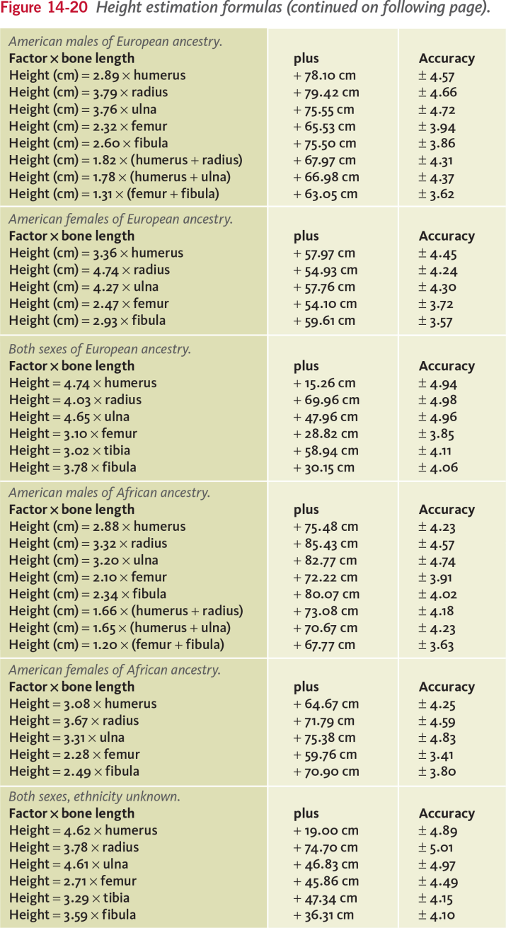
ESTIMATING HEIGHT
Many databases have been established that use mathematical relationships to calculate height from long bones

Slide 28
SKELETAL TRAUMA ANALYSIS
Skeletal trauma analysis is the process by which a forensic anthropologist attempts to distinguish between damage to bones made during life and damage to bones caused by the environment in organisms after death.
Living bone is stronger and more flexible than dried-out dead bone
Weapons leave distinguishing patterns
  sharp-force trauma
  blunt-force trauma
  gunshot wounds

Slide 29
EXAMINING REMAINS
Questions a forensic anthropologist may ask:
Is a fragment a bone?
Is it a human or animal bone?
Which bone is it?
Does the gravesite contain remains from one person or more?
How long have the remains been buried?
Were the markings on the bones made before death (antemortem) or after death (postmortem)

Slide 30
SKELETAL ANALYSIS AND IDENTIFICATION
Comparative Radiography
Non-imaged Records Comparison
DNA Analysis
Photographic or Video Superimposition
Craniofacial Reconstruction

Slide 31
FACIAL RECONSTRUCTION
Purpose is to give proportion to facial features
After determining the sex, age, and race of an individual, facial features can be built upon a skull to assist in identification. (math formulas and computer databases create facial mask) Erasers are used to make tissue depths at various points on the skull. Clay is used to build around these markers and facial features are molded.

Slide 32
STEPS IN FACIAL RECONSTRUCTION
With a Skull:
  establish age, sex and race
  plot landmarks for tissue thickness
  plot origin and insertion points for muscles
  plot landmarks for facial features
  select a dataset and mount markers for tissue thickness
  mount the eyes
  model muscles on skull
  add fatty tissue around eyes and lacrimal glands
  add eyelids
  add the nose
  add the parotid gland
  add the ears
  cover all with layers of skin
  detail the face

Slide 33
THE BODY FARM
Bill Bass is a forensic anthropologist who has assisted law enforcement with hundreds of cases. He established the world’s first and only laboratory devoted to the study of human decomposition at the University of Tennessee’s Anthropology Research Facility.
The nickname of a two and a half acre research facility in Tennessee developed in 1980 by Bill Bass where bodies are placed in various conditions and allowed to decompose. Its main purpose is to observe and understand the processes and timetable of postmortem decay. Over the years it has helped to improve the ability to determine "time since death" in murder cases.
Hic locus est ubi mortui viveuntes docent.
  This is the place where the dead teach the living.

