Slide 1
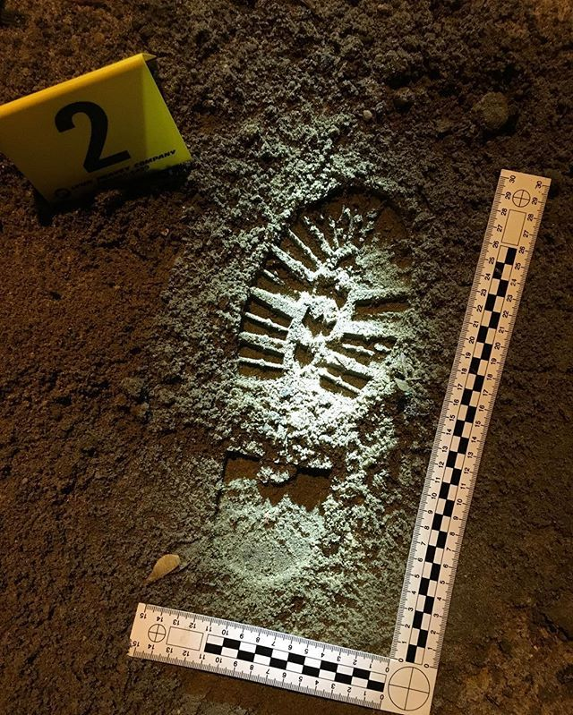
Casts and Impressions

Slide 2
Chapter 16 Vocabulary
groove (of a tire)
latent impression
patent impression
plastic impression
rib (of a tire)
sole
track width
tread
turning diameter
wheelbase

Slide 3
Types of Impressions
Patent – visible, two-dimensional impression produced as an object moves through soil, dust, paint, blood, or other fine particles
Latent – hidden to the eye, but can be visualized through the use of special dusting and electrostatic techniques or chemical developers; made from oils, fine soil, and other minute debris
Plastic – three dimensional imprints. Can be left in soft materials, such as snow, mud, soil, or soap
Easily lost (strong wind, change in weather)

Slide 4
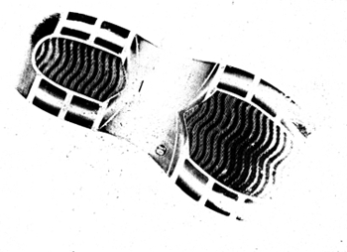
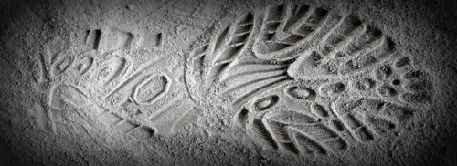
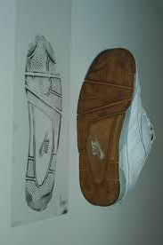
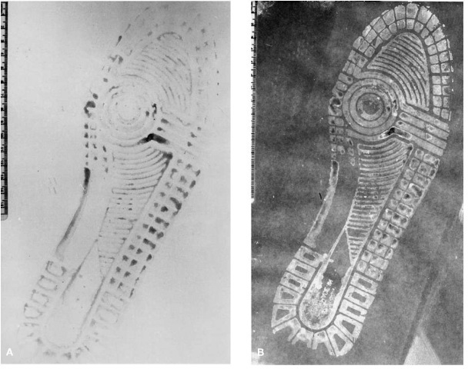
Patent Impressions

Slide 5
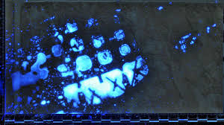
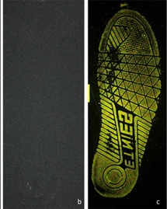
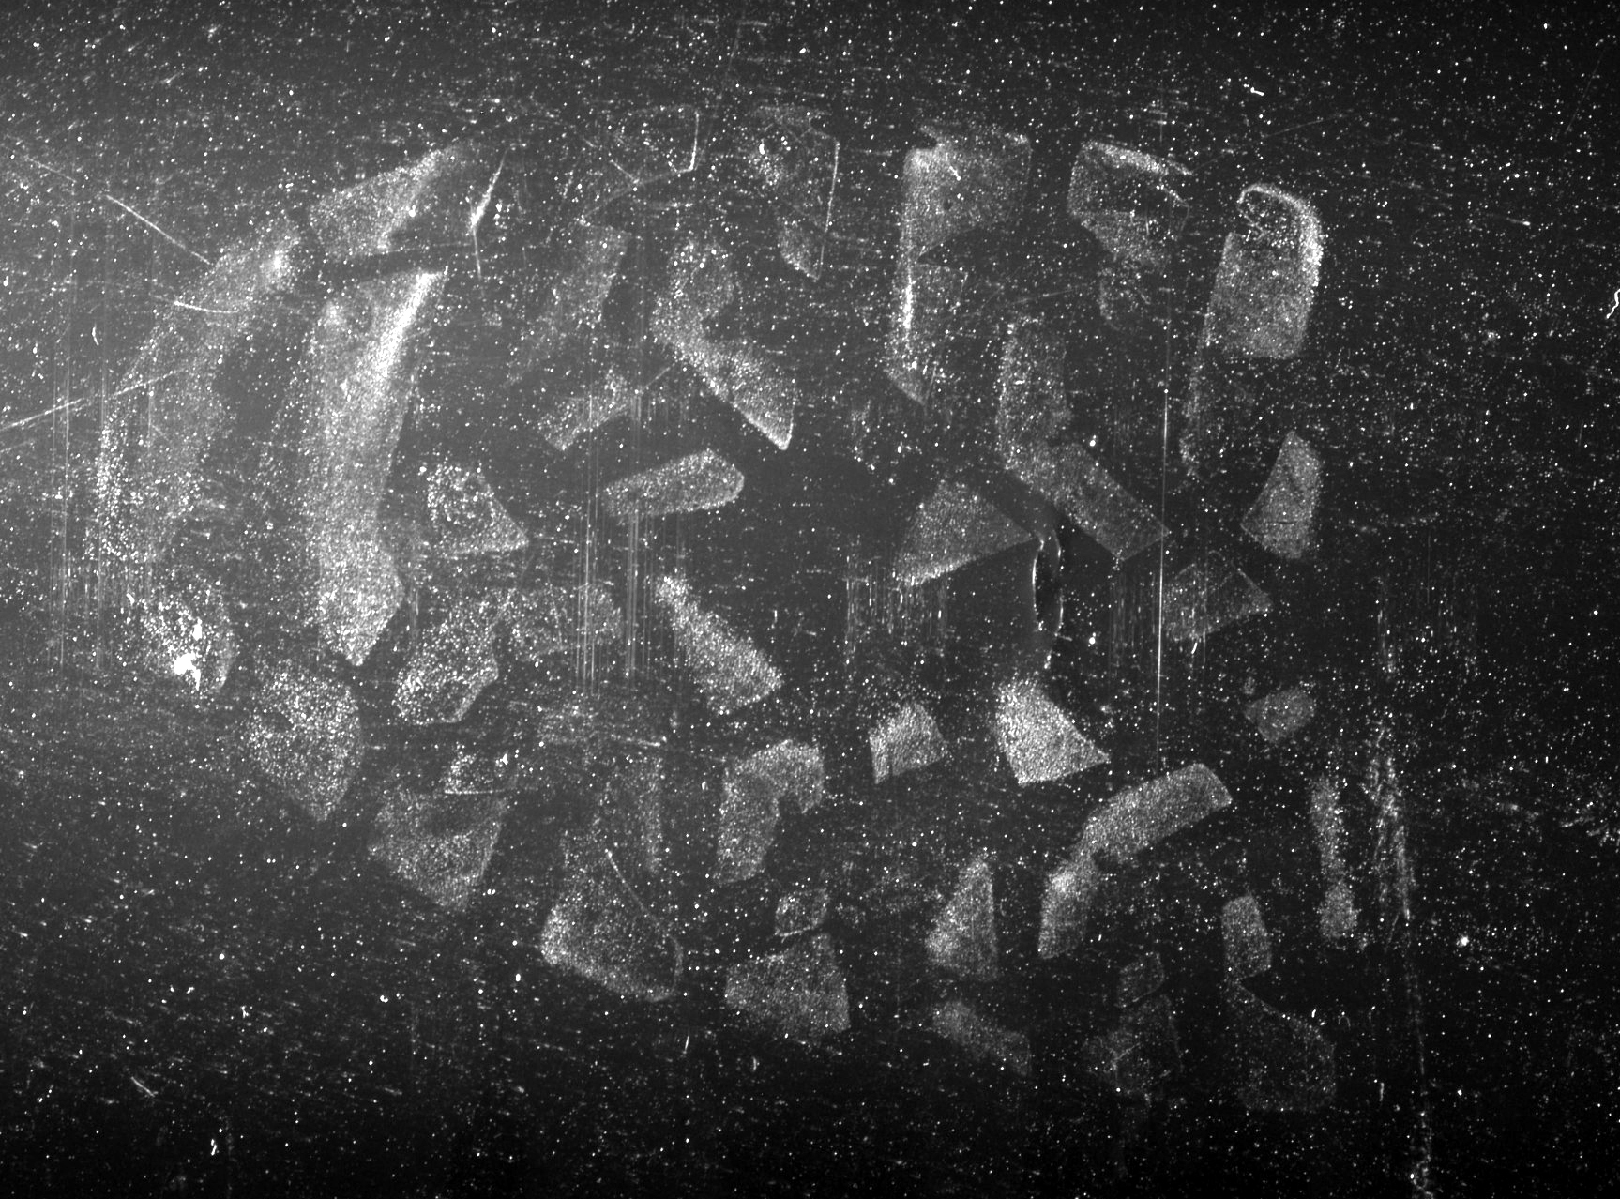
Latent Impressions

Slide 6
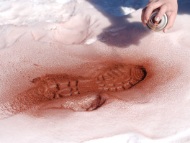
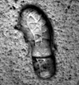
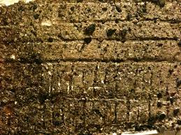
Plastic Impressions

Slide 7
Are Impressions Individual or Class evidence?
Depending on how it is made
Class
a tread pattern may identify brand and size of shoe or tire
Individual
a split on a shoe sole or unusual wear on a tire
dental work with history

Slide 8
Shoe/Foot Impressions
What were the entrance and exit route?
How many people were at the crime scene?
Is there evidence of any confrontation or disturbance within the crime scene?
Is there evidence of anyone sustaining injuries?

Slide 9
Shoe/Foot Impressions
Size of shoe – height
Depth of impression – weight
Type of shoe – job, gender
Brand of shoe – $
Barefoot? – Reveals a lot!
SICAR (Shoeprint Image Capture and Retrieval) – database of manufacturers and tread patterns
multiple manufacturers use the same generic sole pattern (can complicate things)

Slide 10
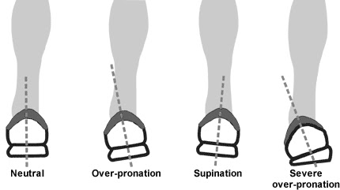
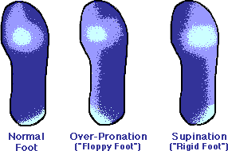
Shoe Wear Patterns
Individualizes evidence
How a person walks (toes or heels)
Body weight
Walks straight, toes point in, toes pointed out
Shape of the foot and wearer’s activities
Surface on which the person usually walks

Slide 11
Gait and Tracks
Multiple prints together tells an investigator about the person’s gait, or walking habits.
Asymmetrical gait – one foot is angled differently from the other or one foot makes a deeper impression than the other
Limp or injury
Person is carrying a heavy weight
Length of stride
Longer strides – running rather than walking
Help in recreation
Number of people at the crime scene
Reveals the movements at the crime scene
Entrance and exit

Slide 12
Collecting Shoe Impression Evidence
Photograph impressions
Take BEFORE anyone touches and ASAP!
Fill viewfinder with entire impression
Camera should be perpendicular to impression
Take more shots from different angles (at least 2) with and without measuring devices
Place ruler and ID next to impression
Look for ways to avoid glare and reflections
If impression is light, spray it with color-contrasting paint

Slide 13
Collecting Shoe Impression Evidence
Lifting Latent Impressions to make them visible
Luminol to make bloody footprints visible so you can photograph them
Dusting (like for a fingerprint)
Electrostatic lifting
Apply an electrostatic charge to piece of lifting film
Place film over impression
Film picks up and holds the dust of the latent print
Can be used on paper, carpet, wood, linoleum, pavement
Gel lifting
Dust with powder, press gel onto impression, lift
Used on uneven surfaces and best used on oily or moist impressions

Slide 14
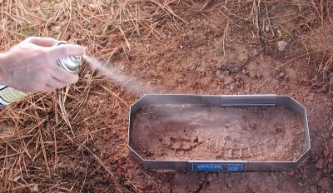
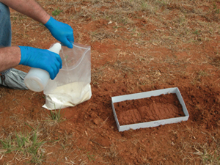
Collecting Shoe Impression Evidence
Casting Plastic Impressions
Cast = a 3D preservation of an impression
Use Plaster of Paris for most casts
Use Dental Stone (a type of wax) for impressions in snow, it generates less heat

Slide 15
Foot Length, Shoe Size, and Height
The length and width of the shoe vary by the shoe type.
There is a general correlation between height and foot size.

Slide 16
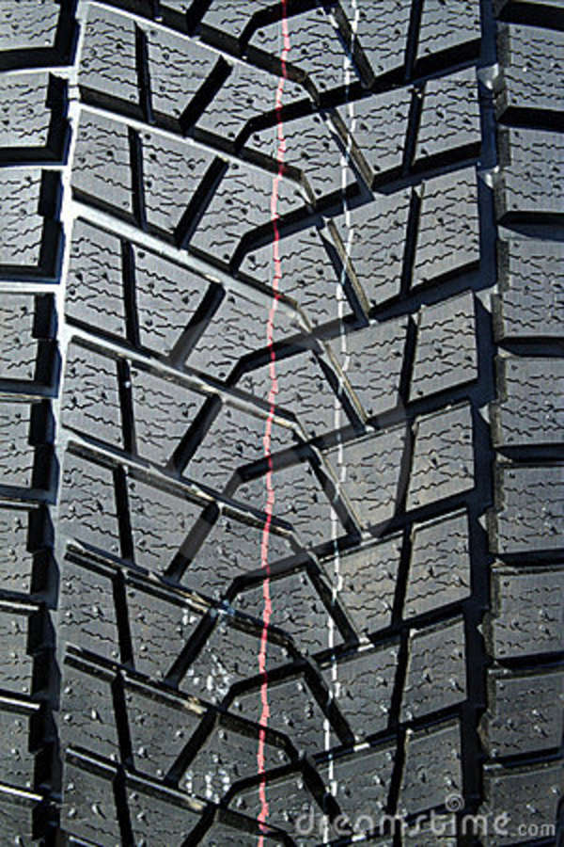
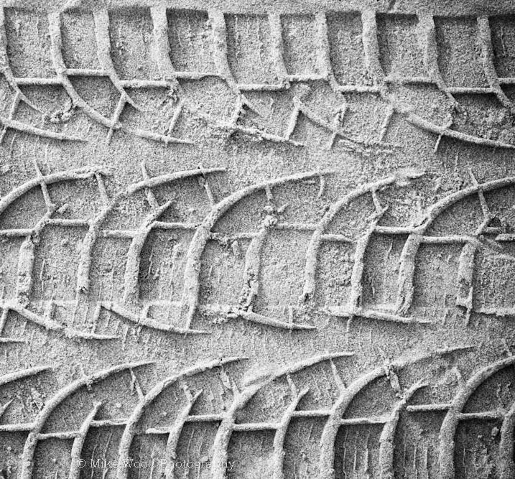
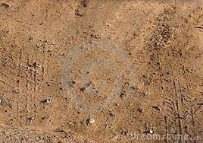
Tire Treads and Impressions
Investigators examine two characteristics:
Tread pattern and measurements to identify the type of tire and perhaps the make and model of the car
Nature of the impression to determine how the vehicle was driven, tire condition, level of inflation, etc.

Slide 17
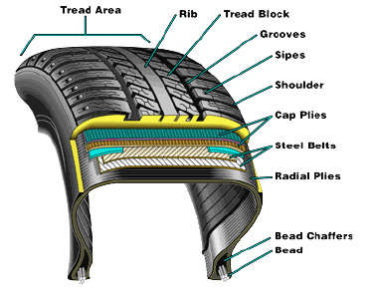
The Anatomy of a Tire
Tire’s tread surface is divided into ribs (ridges, elevated regions) and grooves (indentations)
Purpose is to channel water away and provide traction as the surface makes contact with the road
Width and angle of the grooves are engineered to perform best on a specific surface

Slide 18
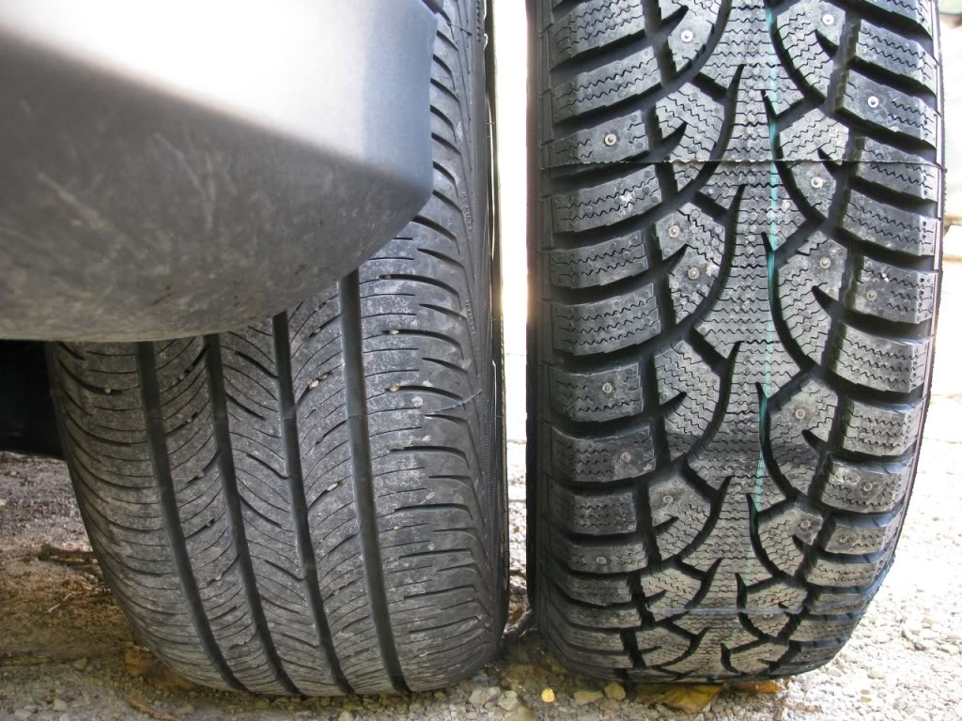
Recording Tread Impressions
Tread patterns are symmetrical
Ribs (the ridge of the tire) and grooves are counted across
Unique characteristics are noted (imperfections, pebble embedded in the grooves)
Tire impression of the suspect’s vehicle is made (paint tire, drive over smooth pavement)

Slide 19
Identifying a Vehicle Wheel Base and Track Width
Wheel Base and Track Width Measurements may help identify make and model
Wheel Base- is the distance from the center of the front axle to the center of the rear axle
Track Width- is the distance from the center of a tire on the passenger side of vehicle to the center of a tire on the driver side of the vehicle
The front and rear track width measurements may differ

Slide 20
Measuring Track Width

Slide 21
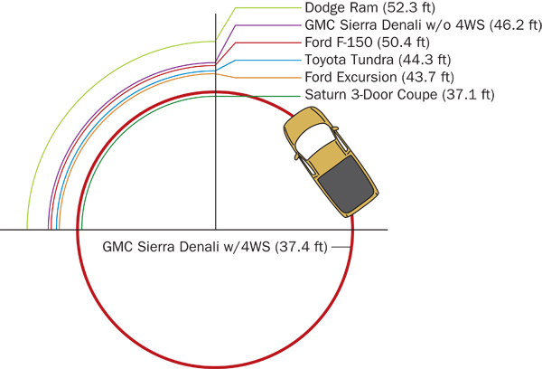
Identifying a Vehicle Turning Diameter
Also commonly known as turning radius
Imprint Seen when cars make U turns
How tight a circle can be driven by vehicle?
Longer wheel base equals a longer turning diameter

Slide 22
Establishing Car Movements
Vegetation disturbed as a vehicle entered or left a road
Patterns of debris cast off by a moving vehicle
Splash patterns created as a vehicle moved through a puddle of water (or another substance) of from a wet to dry pavement
Substance transfer, such as oil leakage from vehicle to pavement or soil (The drips are father apart as the vehicle accelerates.)
Tire marks on the pavement or ground.

Slide 23
Accident Reconstruction
The goal of accident reconstruction is to determine:
What happened
When it happened
Where it happened
Why it happened
Who was involved
Who was at fault

Slide 24
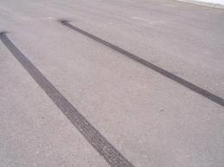
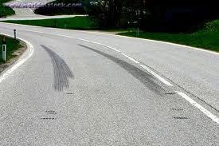
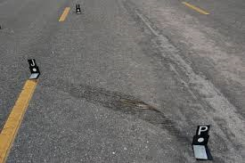
Accident Reconstruction
Skid Marks
Formed when someone breaks suddenly and lock the brakes
Provides evidence of the distance brakes were applied
Calculation of velocity (speed) can be made from skid marks
Tires melt on road due to extreme temps caused by friction, audible squeal and often smoke occurs
Yaw Marks
Produced when vehicle travels in a curved path faster than the vehicle can handle and skids
Tires melt on road due to extreme temps caused by friction, audible squeal and often smoke occurs
Tire Scrub
Produced by overloaded or damaged tire during or immediately after impact
Usually curved, irregular in width
Determines area of impact

Slide 25
Dental Impressions/Evidence
Can be used to identify remains of deceased
Can be used in profiling and identifying a suspect from unique patterns or bite marks left at the scene of a crime

Slide 26
Dental Impressions
Dental Impressions, like fingerprints, are generally considered to be individual evidence
Factors leading to individuality of teeth
Number of teeth/Missing teeth
Coloration of teeth
Size of teeth
Alignment of teeth and distance between teeth
Unique fillings, crowns, caps
Overall condition of teeth (breakage/chipped teeth, grinded teeth ect…)

Slide 27
Dental Impressions
32 total teeth (***including 4 wisdom teeth)
16 teeth on top and bottom in adults
Central incisors (2) – front, cutting
Lateral incisors(2) – both sides of central incisors, cutting
Canines (2) – cutting and tearing
First premolar (2) - hybrid
Second premolar (2) - hybrid
First molar (2) – chewing and grinding
Second molar (2) – chewing and grinding
3rd molar, wisdom teeth (2)- ***can be variable, not everyone has them
Genetics
Surgical Removal

Slide 28
Bite Mark Comparisons
Up to 76 points of comparison
Places where locations on bite where impressions are often detailed
Comparison includes:
Dental chipping, surface indentations, distances between teeth, alignment of teeth, angle of mouth arch, absence of teeth
Bite mark should be photographed with ruler included as soon as possible
Bite mark should be swabbed, may contain DNA from saliva
American Board of Forensic Odontology (ABFO) estimates error rate as high as 63%, Innocence Project as high as 91%
To be presented in court at least 2 forensic odontologists must agree on the identification

