Slide 1
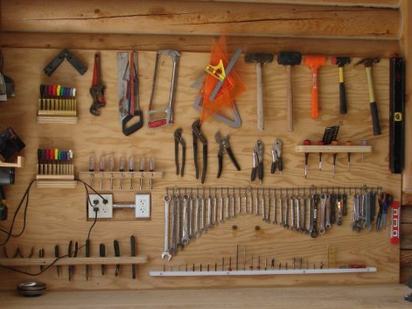
TOOL MARKS

Slide 2
CHAPTER 17 VOCABULARY
abrasion mark
cutting mark
indentation mark
tool mark

Slide 3
Introduction
Tool mark—any impression, abrasion, or cut made when contact occurs between a tool and an object
An example of physical evidence
Even mass-produced tools have minor differences
The impressions can link the tool to a crime scene and potentially to the owner

Slide 4
Tools and Crime Scenes
Tools:
increase our ability to handle manual tasks, but can also be used in crimes
How can a tool used in a crime lead investigators to the criminal?
Why is ownership of a tool used in a crime circumstantial evidence?

Slide 5
Tool Mark Impressions
Indentation Marks
Result when a tool is pressed against a softer surface
Tools usually leave distinctive marks
The hardness of a tool influences the resulting marks left in the softer object
May indicate the size of the tool used in a crime

Slide 6
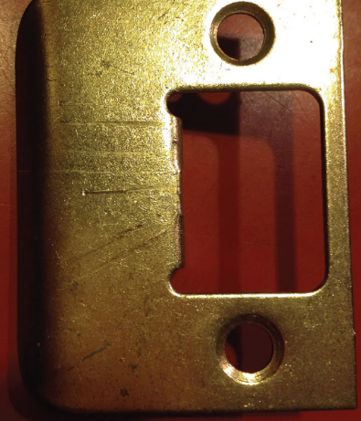
Tool Mark Impressions
Abrasion Marks
An object’s surface can be ground or worn away by a tool when they slide across each other
The harder object causes abrasions (scratches) on the softer surface
Indentation and abrasion marks sometimes occur at the same time

Slide 7
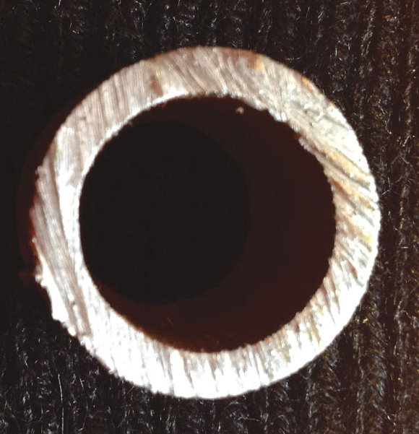
Tool Mark Impressions
Cutting Marks
Edged instruments can penetrate a softer object and separate it into parts
Cut marks are produced along the edge as a surface is cut
The type of saw blade used to dismember a body can be determined by examining the cut surface of the bone

Slide 8
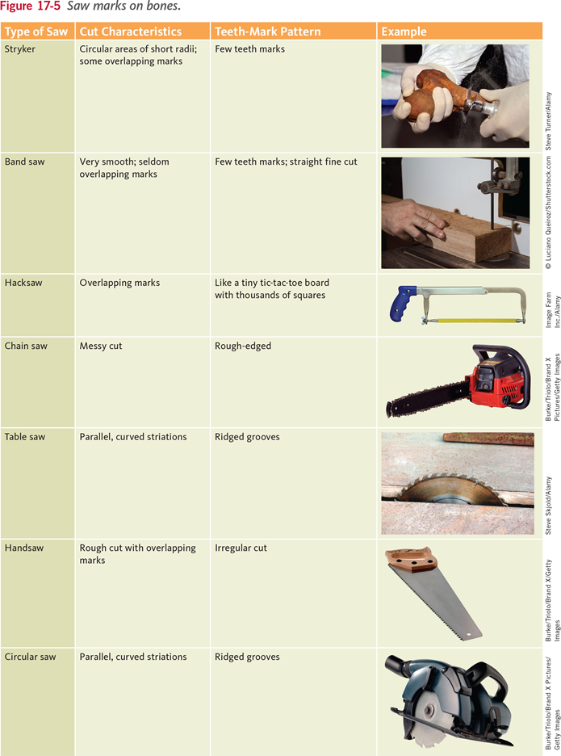
Tool Mark Impressions
Examples of Cut Marks on Bones

Slide 9
Tool Mark Impressions
Examples of Cut Marks on Bones

Slide 10
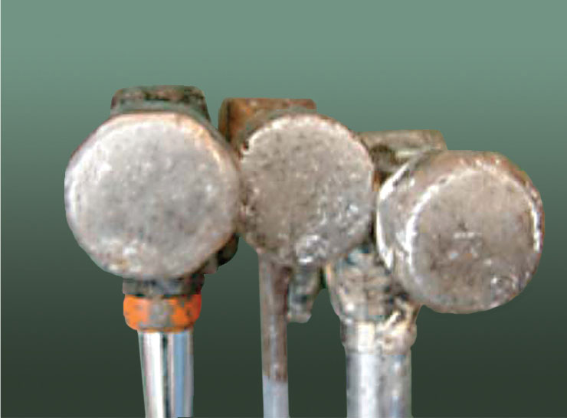
Tool Surface Characteristics
Tools change over time as they are used repeatedly.
Oxidation, or rusting of tools, as well as uneven sharpening, are additional characteristics that help distinguish a tool mark.

Slide 11
Tool Mark Evidence
Some experts specialize in tool mark investigations
Evidence can include:
tool marks at the scene
the tool if left behind

Slide 12
Documenting the Evidence
Collect tool mark evidence when possible
Photograph the evidence with a measuring device to show scale
indirect lighting (oblique) is preferred because it casts shadows and highlights details
Measure the size of the impression

Slide 13
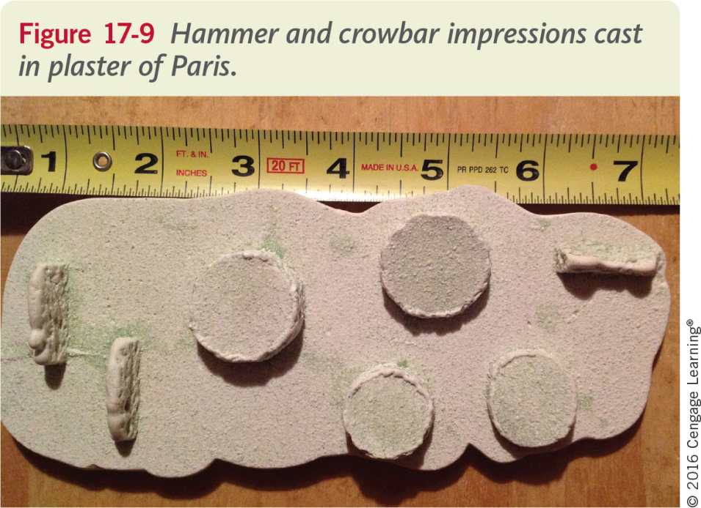
Documenting the Evidence
Castings preserve tool mark impressions
silicone or rubber-based casting materials
Cast impressions retain the unique indentation marks made by a specific tool

Slide 14
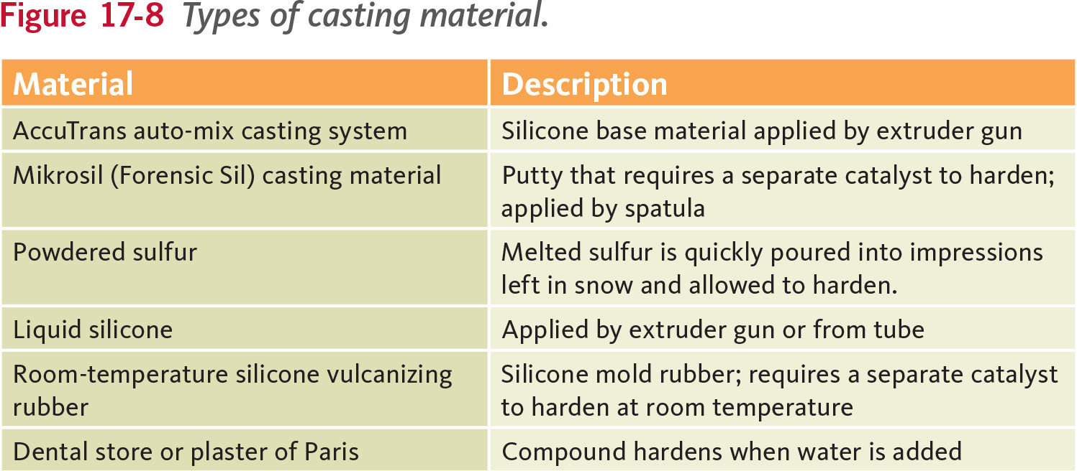
Documenting the Evidence

Slide 15
Collecting and Preserving a Sample
Correctly label evidence
Wrap small objects with clean paper and place them in small containers or plastic bags
Pack large objects in cartons or boxes
Record—who, where, when, and why
Maintain the chain of custody!!

Slide 16
Analyzing Tool Mark Evidence
Crime-scene tool marks and suspect tools are never fitted together. This may compromise the integrity of the evidence.
Instead, compare impressions from the crime scene and impressions made from the suspected tool
Serial numbers can possibly reveal the store where the tool was purchased.

Slide 17
Tool Mark Identification Technology
Laboratory tool mark analysis identifies:
major characteristics defining the type of tool used in a crime
unique characteristics that might distinguish between the same kinds of tools
Forensic comparison microscopes examine tool mark characteristics that match a suspect tool

Slide 18
Tool Mark Evidence in the Courtroom
Courts now require more than visual pattern comparisons
Tool mark databases (with images acquired by forensic comparison microscopes)
Algorithms to statistically analyze tool mark patterns
Scanning tools measure the depth or height of tool marks and make a contour map.
Same techniques used for ballistics/firearms examinations

Slide 19
Tool Mark Evidence in the Courtroom
The tool mark witness prepares a written report to present to a jury.
When available, provide:
Original evidence
Castings
Magnified images of tool mark comparisons
Such evidence may link a series of crimes

