Slide 1
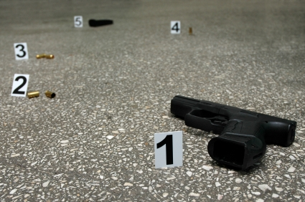
Firearms & Ballistics

Slide 2
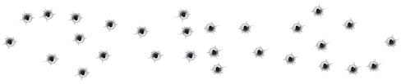
Chapter 18 Vocabulary
ballistics
breech
bullet
caliber
cartridge
firearm
gunshot residue
lands
grooves
pistol
revolver
rifle
rifling
trajectory

Slide 3
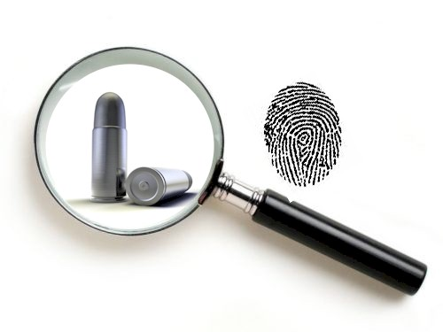
Ballistics
the study of projectiles in flight; includes the launch and behavior of the projectile
Forensic Ballistics
Forensic ballistics is the scientific analysis or interpretation of all ballistic related evidence with the purpose of interpreting and establishing the facts in a shooting related crime
Forensics of Firearms (2.28) https://www.youtube.com/watch?v=RBifOqXTU4o

Slide 4
What Can Ballistic Evidence Tell Us?
Ballistic evidence helps explain:
What type of firearm was used.
The caliber of the bullet.
The number of bullets fired.
Where the shooter was standing.
The angle of impact.
Whether a weapon was fired recently.
If a firearm was used in previous crimes.

Slide 5
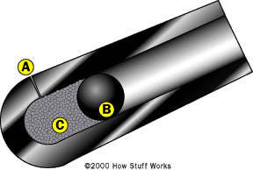
History Of Gunpowder & Firearms
Gunpowder was invented over 1000 years ago by the Chinese
The first type of firearm was a cannon, which was a tube with some gunpowder (C) in one end that had a fuse coming out (A) and then plugged with a cannonball (B). When the fuse was lit, the gunpowder exploded, causing the ball to shoot out

Slide 6
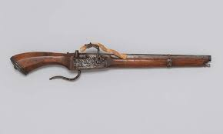
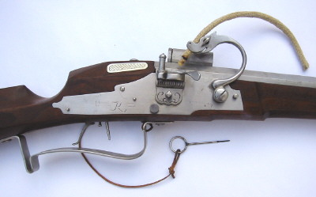
History Of Gunpowder & Firearms
The first guns were called muzzle-loading matchlocks (1475) that used wicks to ignite the gunpowder and send a bullet out just like a cannon
Some matchlock guns even allowed for multiple “bullets,” but each one had its own fuse to light.

Slide 7
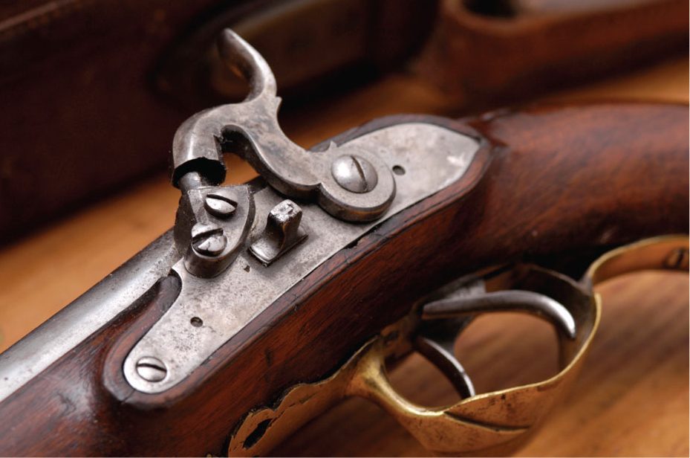
History Of Gunpowder & Firearms
At the beginning of the 1600s, flintlock firearms began to be used.
Around 1820, percussion-cap firearms replaced flintlock firearms.
1992 FBI established Drugfire Database
1996 US Bureau of Alcohol, Tobacco, and Firearms (ATF) established database
2000, FBI and ATF merged to avoid confusion and formed the National Integrated Ballistic Information Network (NIBIN)

Slide 8
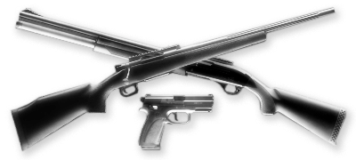
History Of Gunpowder & Firearms
Guns today are broken down into two categories; long guns and handguns… and there are lots of different types.

Slide 9
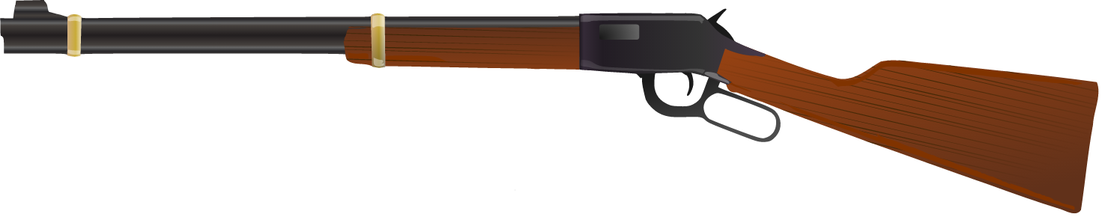
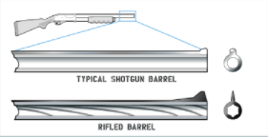
Long Guns – Requires 2 Hands
Long Guns
Rifles
Fire bullets
Inside is rifled
Shot Guns
Fire pellets or slugs
Inside is smooth
The longer the barrel the greater the accuracy!

Slide 10
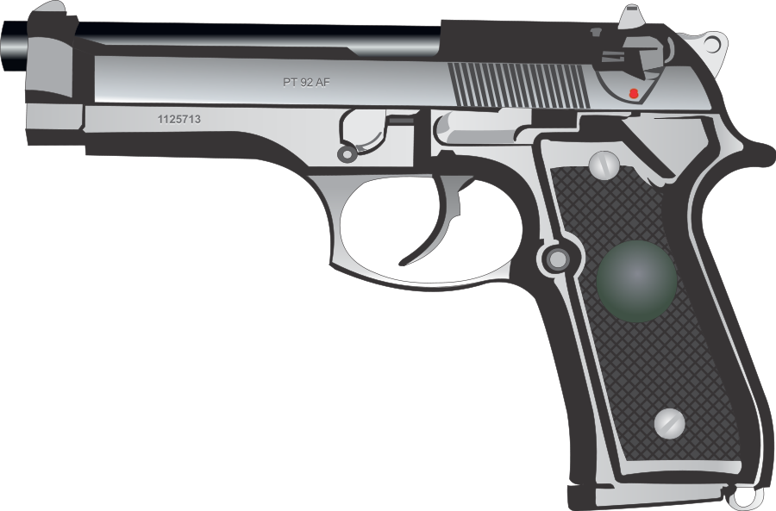
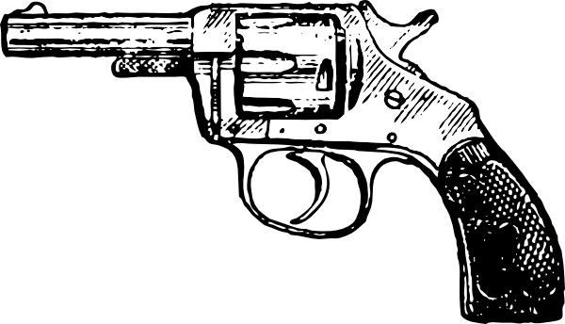
Handguns – Can Be Held
In One Hand
Handguns
Pistols
Ammo is contained in a magazine
Revolvers
Ammo is contained in a revolving cylinder

Slide 11
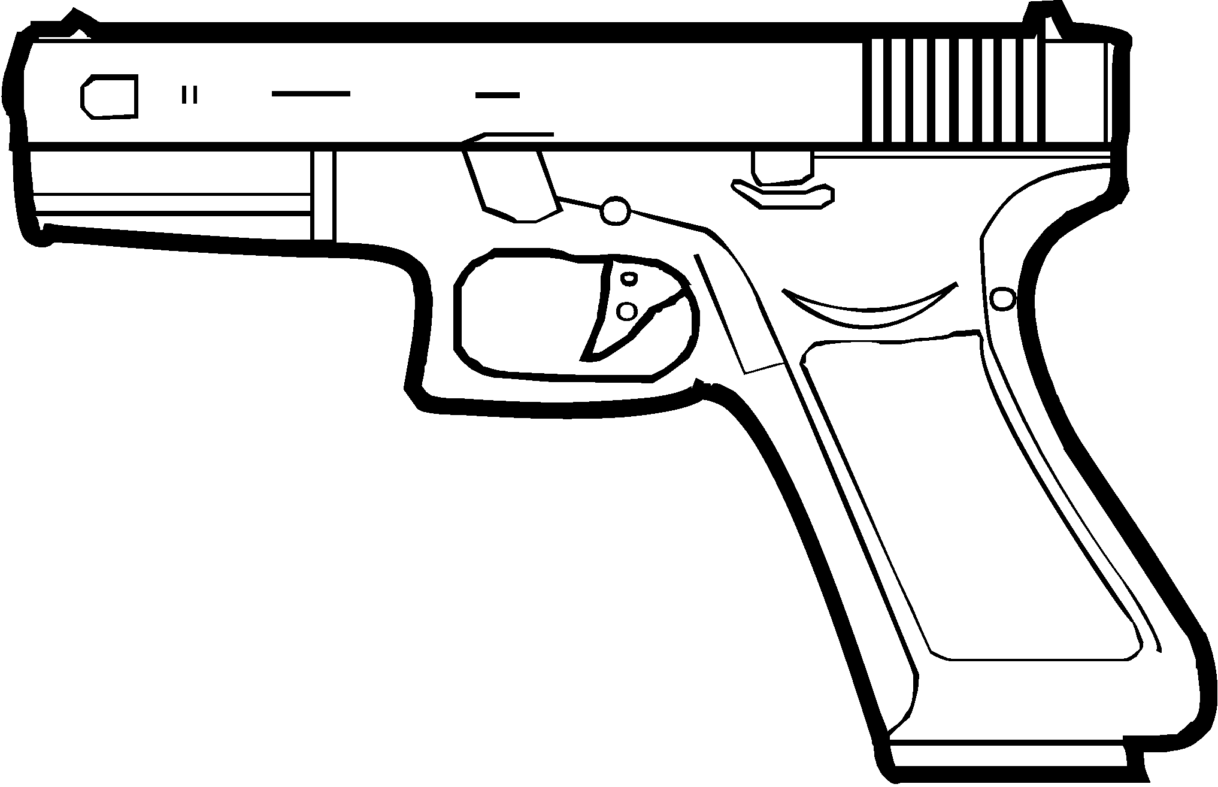
Guns Can Be Classified On How Bullets Come Out When Fired
Single-Action
Action must be loaded before each pull of the trigger. Each pull results in only one round coming out.
Semi-Automatic
Action only needs to be loaded before the first shot and will then fire another round with each pull of the trigger
Fully Automatic
One pull of the trigger results in a continuous burst, releasing more than one round at a time
Types of Guns (2.28) https://www.youtube.com/watch?v=gunNXngtOKo

Slide 12
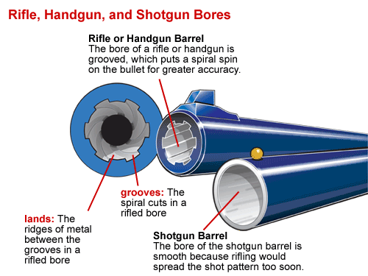
Each Rifled Gun Barrel Is Unique

Slide 13
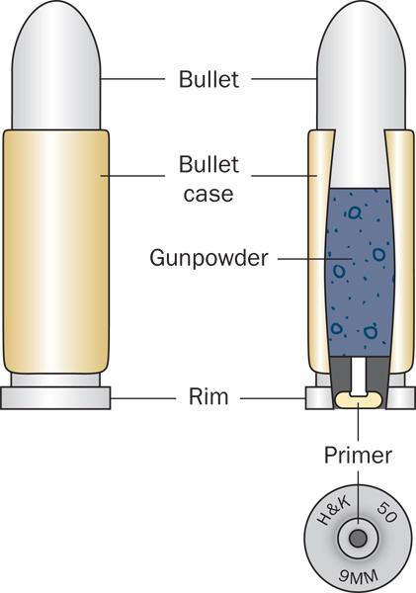
Bullets And Cartridges
Cartridge contains:
  Primer powder
  Gunpowder
  Bullet
  Casing material that holds them altogether

Slide 14
Anatomy Of A Cartridge
Bullet
  Metal-jacketed, hollow-pointed, or plastic-coated
Primer Powder
  Initiates the contained explosion
Headstamp
  Identifies the caliber and manufacturer

Slide 15
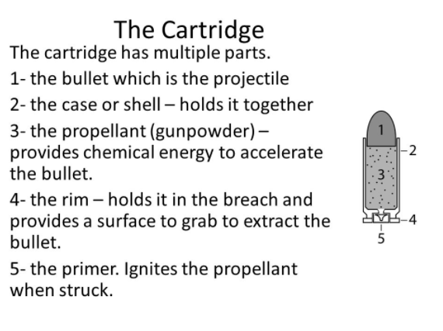
The Cartridge

Slide 16
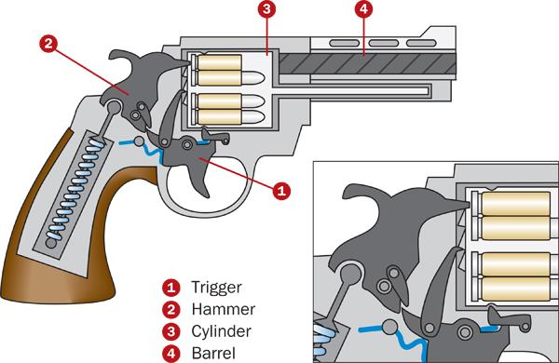
Parts Of A Firearm

Slide 17
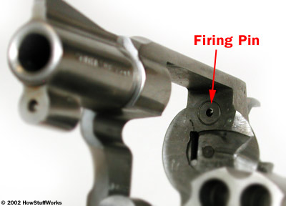
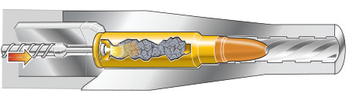
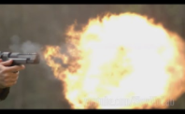
How A Firearm Works
When the trigger is pulled, the firing pin hits the base of the cartridge, igniting the primer powder
This causes a spark that makes the gunpowder explode, forcing the bullet down the path of least resistance (the barrel)
The bullet follows the lands and grooves in the barrel, which causes it to come out spinning

Slide 18
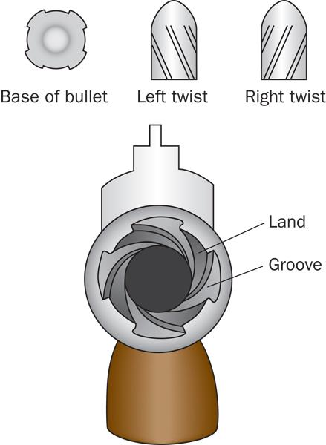
Rifling, Lands, And Grooves
Just like a football spirals through the air, ridges (lands) and grooves in the barrel of a firearm cause a bullet to spin to improve accuracy
As the bullet travels through the barrel, a unique pattern is left on the bullet, called rifling.
Rifling is like a fingerprint because the pattern is unique only to the firearm
How a Firearm Works (1.46) https://www.youtube.com/watch?v=rJMXXuGhINE

Slide 19
3 Categories Of Ballistics
Forensic Ballistics is divided into three categories:
Internal Ballistics
  the study of the processes that occur inside a firearm when a shot is fired
External Ballistics
  the study of the projectile’s flight from the time it leaves the muzzle of the barrel until it hits the target
Terminal Ballistics
  the study of what happens when the projectile hits its target, “wound ballistics”

Slide 20
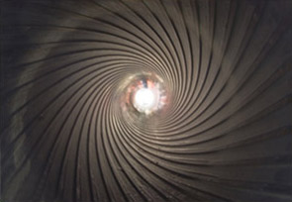
Internal Ballistics
Internal Ballistics helps to determine:
If a particular bullet came from a particular gun based on microscopic examination and comparison of the markings on spent ammunition.
The causes of accidental discharge or misfire
Basically anything that happens from the time the trigger is pulled until the bullet comes out of the barrel

Slide 21
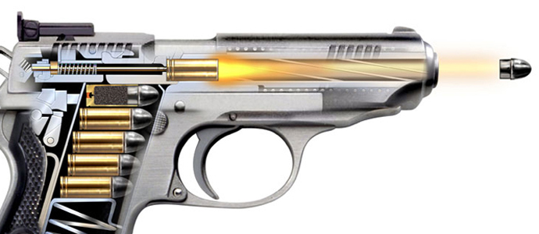
External Ballistics
External Ballistics helps to determine:
The trajectory of a projectile
The maximum range of a firearm

Slide 22
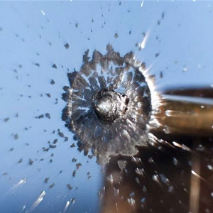
Terminal Ballistics
Terminal Ballistics helps to determine:
The caliber and type of bullet that caused a wound or damage
The distance between the shooter and the victim
The ricochet possibilities of fired projectiles
The damage/wounds caused by various projectiles

Slide 23
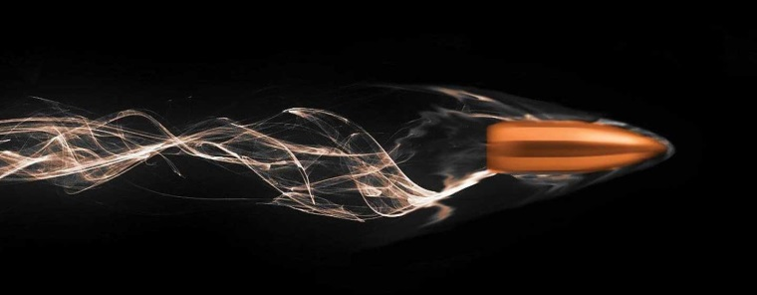
What Is A Bullet?
A “bullet” refers to the projectile(s) which actually exits the barrel of the gun when fired
Bullets vary in shape and composition
There are many different types of bullets
Most types are variations on three main shapes & three basic compositions

Slide 24
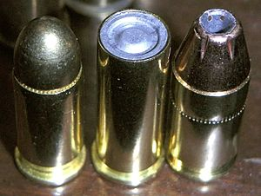
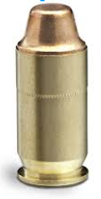
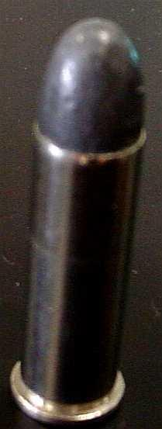
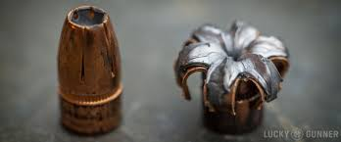
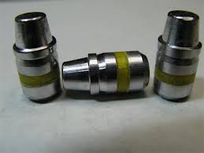
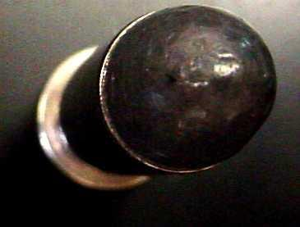
Main Types Of Bullets
Round Nose | Hollow Point | Wadcutter
Cheapest to make Loads easily Maximum Penetration | Spreads (mushrooms) on impact to cause damage Least Penetration | Made to rip holes in paper Used as a practice shot Minimum penetration

Slide 25
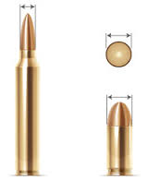
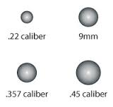
Bullet Caliber
Bullets (and their cartridges) are named by caliber and length
Caliber – the measure of the diameter of the cartridge.
  i.e. .223, .25, .357, .38, .44, & .45.
    They are measured in hundredths of an inch.
    So .45-caliber cartridge is 45/100 (almost ½ inch).
Because the bullet moves through the barrel, the caliber
of the ammunition should match the firearm that shoots it.

Slide 26
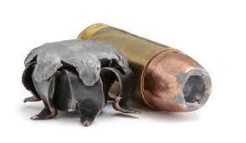
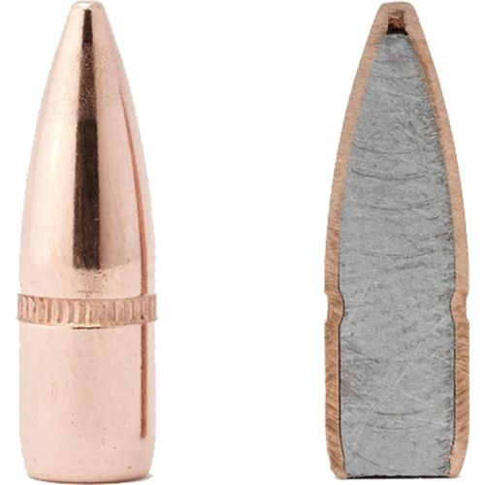
What Are Bullets Made Of?
Most bullets are made of lead because it is cheap, soft, dense, and easily moldable
Some bullets are covered in a copper coating because copper improves exit velocity and holds the shape. We call this a jacket.
Half jacket is a lead bullet partially covered in copper. Lead mushrooms and copper increases velocity.
Full metal jacket is a lead bullet completely covered in copper

Slide 27
How Are Bullets Used In Forensics?
When a gun is fired, the rifling of a barrel leaves unique marks on a bullet, called a ballistic “fingerprint”
Looking at these marks can help CSIs compare bullets and spent casings to those that came from a suspected weapon.

Slide 28
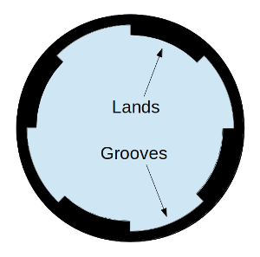
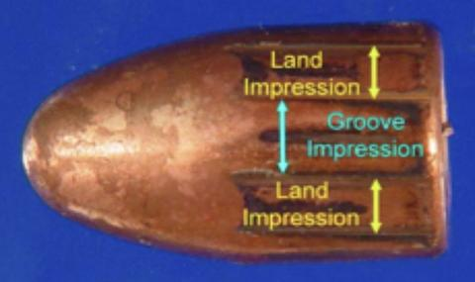
How Are Bullets Used In Forensics?
Fired bullets have a unique “fingerprint”
  Bullets can be matched to a gun by looking at the lands and grooves in the barrel.

Slide 29
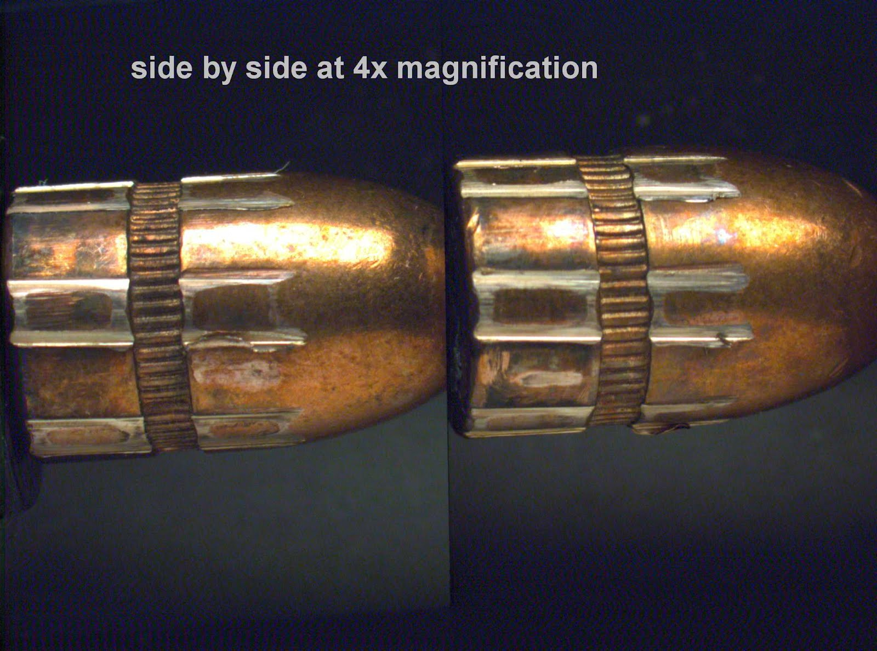
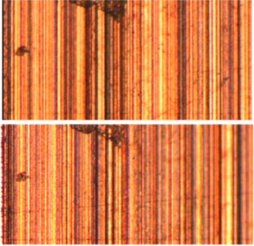
How Are Bullets Used In Forensics?
Comparing bullets can determine if they came from the same firearm
  A comparison microscope can show two bullets side by side

Slide 30
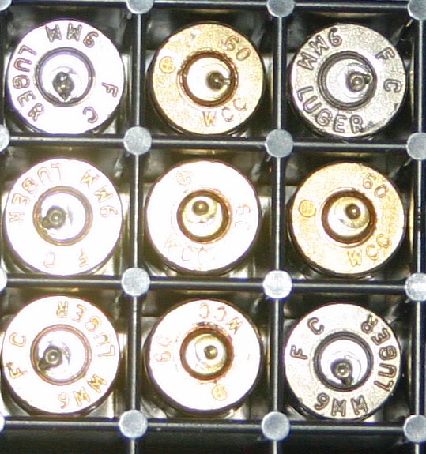
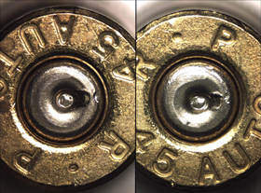
How Are Bullets Used In Forensics?
Firing pin marks can also be compared
  The firing pin makes a unique mark on the spent casing of the cartridge. These can be compared in the same way

Slide 31
Cartridge Markings
All moving components contact the cartridge rather than the bullet and can leave useful impressions on shell cartridges.
Cartridge Case Individual Characteristics:
  Breech face marks
  Firing pin impressions
  Chamber marks
  Extractor marks
  Ejector marks

Slide 32
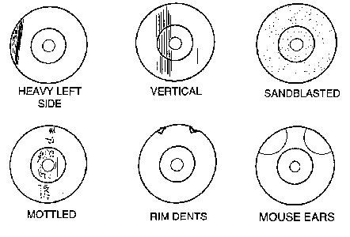
Breech Marks
When a cartridge is fired, the explosion forces the bullet down the barrel and the shell casing is forced back against the breech.
This leaves impressions unique to the individual gun’s breech on the shell casing.

Slide 33
Firing Pin Marks
In order to fire the cartridge, the primer must first be ignited. To accomplish this a firing pin strikes the center ring of the cartridge.
This will in turn leave a distinct impression that is unique to the firing pin of that particular gun.

Slide 34
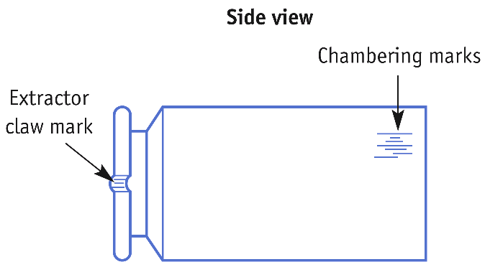
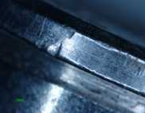
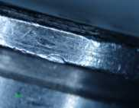
Chamber Marks

Slide 35
Extracting Pin &
Ejector Marks
The extracting pin and ejector throw the spent shell casing from the chamber of the gun.
These leave marks on the shell casing that are unique to those parts on that particular firearm.

Slide 36
Serial Number Restoration
When a serial number is stamped into a gun, the metal underneath the number is compressed & hardened.
If the number is filed-off, the hardened area may still be present.
By using an acid solution the metal can be slowly eaten away.
  In this process the softer metal will be eaten away first and the number may reappear.

Slide 37
Firearms Evidence
Individual:
Striations
Firing pin marks
Breech marks
Extractor marks
Ejector marks
Chamber marks
Class:
Bullet type
Bullet caliber
Bullet weight
Lands and grooves
Rifling
Cartridge case
Head stamp

Slide 38
Firearms Evidence Collection
AFTER lots of pictures…
Make sure it is unloaded!!!!!
DO NOT put a pencil into a barrel. Why?
Revolvers
  Indicate location of fired & unfired ammunition
Automatics
  Check magazine for number of rounds
  Fingerprint magazine
Place ID tag on trigger guard

Slide 39
Firearms Evidence Collection
Ammunition
  Write on base or nose
  Package in pill box or envelope
  Wrap in tissue to protect
Clothing
  Protect & preserve any residue
  Air dry if wet
  Package separately in paper bags
Establish CHAIN OF CUSTODY

Slide 40
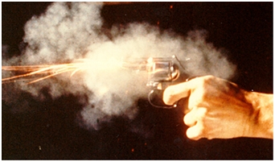
External Ballistics
Gunshot Residue
Since gunpowder explodes when a firearm is fired, smoke and particles of that explosion get all over nearby surfaces
We call this gunshot residue (GSR)
GSR can leave evidence on the shooter and is very difficult to get rid of. They usually contain nitrates (also lead, barium, and antimony), which are sticky particles that can be detected even after washing the hands

Slide 41
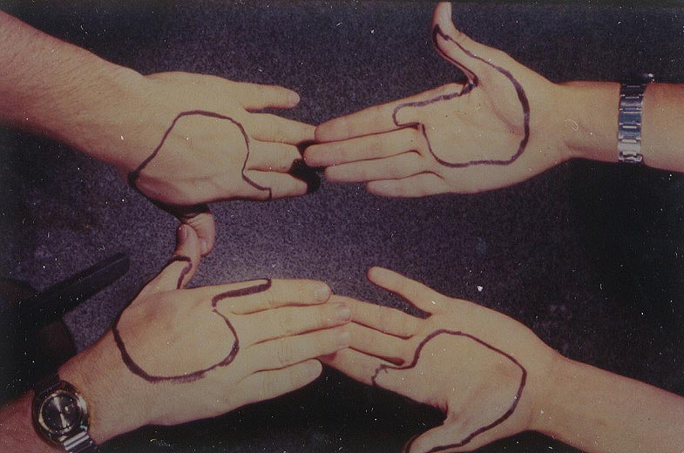
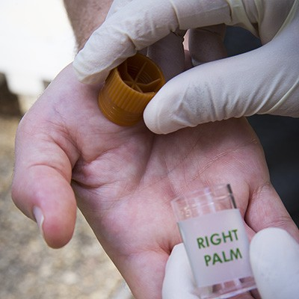
Gunshot Residue Test
Investigators will test a suspect’s hands to determine if GSR is present
  Gneiss Test
  Preferred method today is use of the scanning electron microscope and X-ray spectrometry
The areas most likely to have GSR are outlined.

Slide 42
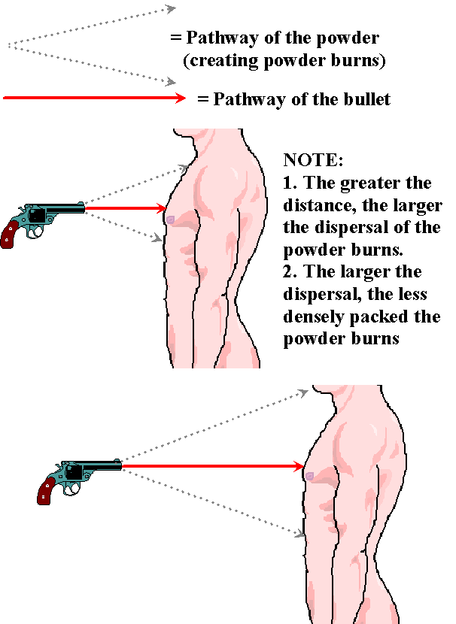
Where is GSR Found?
Traces of GSR can be found:
  On the shooter
  (hand, arm, face, hair, clothes)
  On the victim
  On nearby surfaces
The pattern of GSR can also help
determine the distance from the
shooter to the victim.

Slide 43
Bullet Trajectory
Suppose a victim was shot on level ground by a sniper from some particular height from a building. Is it possible to calculate the angle of trajectory of a shooter if you know the following:
Horizontal distance between the victim and the shooter.
The height of the building above the wound (Location of the shooter in the building)
Draw a picture of what this situation might look like
Bullet Trajectory (2.38) https://www.youtube.com/watch?v=VqOqZBRZsj8

Slide 44
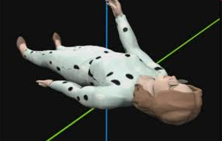

Reference Points
Reference points can be bullet holes in victims, objects, walls, etc.
The best reference points involve an entry
and an exit point
High concentrations of GSR or spent casings can also be reference points, but they are not quite as specific

Slide 45

Reference Points
We can determine things about trajectory if we have reference points along the bullet’s flight path, like an entry and exit wound
What does this picture tell us?
Bullet entrance
Bullet exit

Slide 46
Finding Trajectory
Using…GEOMETRY!
There are two types of trajectory problems
1. You know the angle of the bullet and the distance of the shooter… like if you know a bullet came from a certain side of a building and you want to know what floor it came from.
2. You only know the angle of the bullet...this is harder and you need to use the tan function of your calculator. This could tell you how tall the shooter was, etc.
WE will work examples IN CLASS!!

Slide 47

Terminal Ballistics
What happens to bullets when they hit a target?
Depending on what the bullet and target are made of will determine what happens to the bullet and the target
Most bullets mushroom when they hit a target

Slide 48
Gunshot Wounds
Looking at the entry and exit wounds are important in determining what happened at the crime scene
Gunshot wounds can tell a lot about a crime, such as:
  The angle from which the shot came
  The distance of the shooter
  The type of firearm used
  Validity of an eyewitness account

Slide 49
Gunshot Wounds
Evidence from gunshot wounds can help investigators determine the distance between the shooter and the victim
There are 4 ranges
  Contact (barrel to skin)
  Close Range (2-12 inches)
  Intermediate Range (1-3 feet)
  Distant (more than 3 feet)

Slide 50
Gunshot Wounds
The seriousness of gunshot wounds depends on 5 things
  Speed of the bullet
  Distance from the shooter
  Type of tissue involved
  Path of the bullet (goes through or bounces around in body)
  Type of bullet

Slide 51


Contact Wounds
When the barrel of the gun is against the skin, the inside of the wound will be burned, but not the surrounding skin
Contact wound to the head can result in a “star” pattern caused by the blowback of gases caused by the skull
Sometimes you can see the round burn mark from the barrel surrounding the entry point

Slide 52


Close Range Bullet Wounds
A shot is considered close range when the gun is inches away
Characterized by burn marks AROUND (not in) the wound caused by completely burned gunpowder. This is called “sooting” or “fouling” and can be washed off

Slide 53


Intermediate Range
Bullet Wounds
A shot is from intermediate range when the gun is 1’-3’ away
Intermediate range wounds are characterized by “stippling,” which is when burning and unburned powder become embedded in the skin around the wound

Slide 54


Long Range
Bullet Wounds
A shot is distant when the gun is more than 3’ away
Long range wounds have no stippling or fouling

