Slide 1
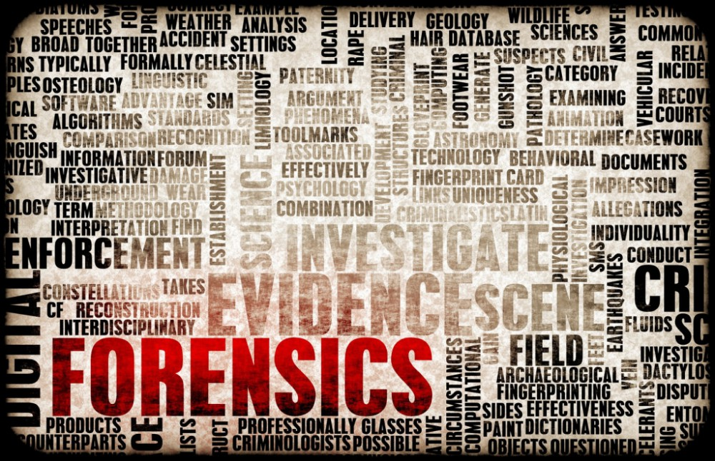
CHAPTER
CHAPTER 1 – OBSERVATION SKILLS

Slide 2
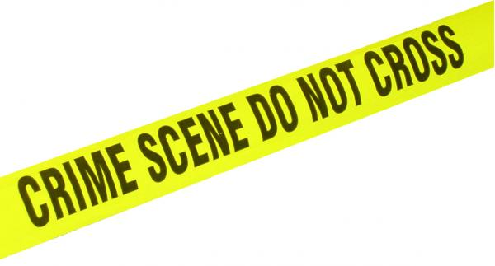
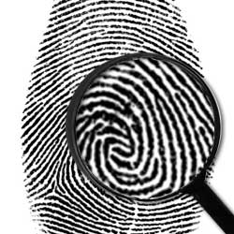
Chapter 1 Vocabulary
analytical skills
deductive reasoning
eyewitness
fact
forensic
logical
observations
opinion
perception
testimonial evidence*
memory*
*not in textbook

Slide 3
Crime Scene Basics
Most important tool of the forensic investigator
The ability to observe, interpret, and report observations clearly without making judgements

Slide 4
What is Observation?
We gather information around us all the time
Sight, taste, hearing, smell, and touch
Why are we not aware of everything that is going on?
Our brains filter, “sensory adaptation”
We pay attention to what we think is important
Paying attention to your surroundings require conscious effort

Slide 5
Perception
Perception is how a person interprets something that they see, hear, etc.
Perception is limited, faulty, not always accurate, and does not always reflect reality
Our brains fill in information that is not really there
Missing words in a sentence
Scrambled words being able to be read
Our brains use previous knowledge
Pink implies strawberry flavoring
People stick with what they think they saw, even if they have be shown that it is impossible
Understanding our limitations helps to improve our observation skills

Slide 6
Observations by Witnesses
Perceptions of witness can be faulty, even though they may be convinced of what they saw
Our emotional state influences our ability to see and hear what is happening around us
Upset, happy, or depressed - unlikely to notice surroundings
Anxiety and fear can interfere with an accurate memory
Bystanders not involved in a crime can provide valuable evidence

Slide 7
Observations by Witnesses
Other factors that affect observation
Whether you are alone or with a group
The number of people/animals in the area
The type of activity that is going on
How much activity is occurring around you

Slide 8
Eyewitness Accounts
Eyewitness accounts of crime-scene events vary from one person to another
Testimonial evidence - oral or written statements given to police or testimony in court by persons who witnessed an event
Observations depends on
Level of interest
Stress
Concentration
Distractions present
Prejudices
Personal beliefs
Motives
Memory – how much time has passed?

Slide 9
Eyewitness Accounts
Memory - the faculty in which the mind stores and recalls information
How reliable is your memory?

Slide 10
Eyewitness Accuracy
Factors that influence eyewitness accuracy
Age and Race
People are better at recognizing faces of their own race
Impairment
Drugs or alcohol?
Time since recall
Amount of time spent watching the scene
Familiarity with environment
People have better recall when they know their surroundings
Influence by other witnesses, investigators, and/or media

Slide 11
Innocence Project
Founded in 1992 by Barry C. Scheck and Peter J. Neufeld
At Benjamin N. Cardozo School of Law at Yeshiva University in New York
The purpose is to reexamine post-conviction causes using DNA evidence to provide conclusive proof of guilt or innocence
Found that faulty eyewitness accounts contributed up to 87% of those wrongful convictions
Testimony of an eyewitness can be very powerful, we must be aware of the possible shortcomings!

Slide 12
Innocence Project
Investigators must determine between what is fact or opinion
What did the witness actually see (fact), not what they thought happened (opinion).
After witness examination, the investigators try to put together the events (facts) in a logical pattern

Slide 13
How to be a Good Observer
Apply what we know about how the brain processes information!
We know that we are not naturally inclined to pay attention to all of the details of our surroundings.
Make a conscious effort to examine systematically!
Start at one end, run your eyes over every space.
We know that we are naturally inclined to filter out information we assume is unimportant.
We do not know what is important…observe everything! Turn off your filters, be “robotic”

Slide 14
How to be a Good Observer
We know that we are naturally inclined to interpret what we see, to look for patterns, and make connections.
Gather information but do not jump to conclusions!
Interpretation is for after all the information is gathered.
We know that our memories are faulty
Write down and photograph as much as possible!
Verbal testimony without proper documentation is not allowed.

Slide 15
What Forensic Scientists Do
CSI Effect Article
Forensic Science:
Is concerned with uncovering evidence
Uses science to help resolve legal matters (crimes)
Forensic Investigator
Not interested in making the suspect look guilty
Collects and examines physical evidence
Reports results to law enforcement
Possibly testifies in court

Slide 16
What Forensic Scientists Do
Find, examine, and evaluate evidence from crime scenes
Apply scientific knowledge to analyze the crime scene
By a good communicator who is able to convince the jury that their analysis is reliable and accurate
Use analytical skills and deductive reasoning

Slide 17
What Forensic Scientists Do
Forensic Science
Career Project or
Innocence Project!!
Due October 3rd!

