Slide 1
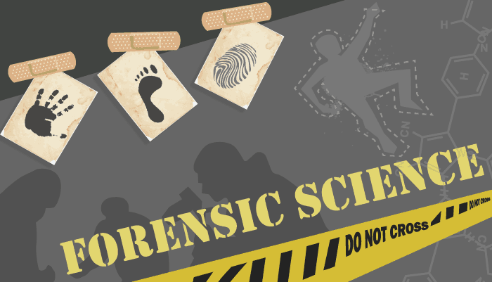
CHAPTER 2 - CRIME
CHAPTER 2 –
CRIME SCENE INVESTIGATION AND EVIDENCE COLLECTION

Slide 2
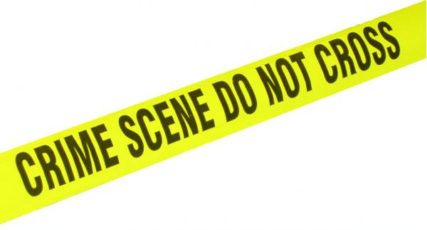
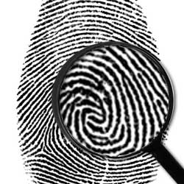
Chapter 2 Vocabulary
chain of custody
circumstantial evidence
class evidence
crime scene investigation
crime scene reconstruction
datum point
direct evidence
first responder
individual evidence
Locard’s Principle of Exchange
paper bindle
primary crime scene
secondary crime scene
trace evidence
triangulation

Slide 3
Crime Scene Basics
Crime Scene Investigation Goals
To recognize, document, photograph, and collect evidence at the scene of a crime
Solving the crime depends on piecing together the evidence to form a picture of what happened

Slide 4
Principle of Exchange
Whenever two people come into contact with each other (or object) a physical transfer occurs
The transferred material is trace evidence
Examples
Pet hair on clothes or rugs
Hair on brushes
Fingerprints on a glass
Soil tracked into homes/buildings on shoes
A drop of blood on a t-shirt
A used facial tissue
Paint chips
Broken glass fragments
Fiber from clothes

Slide 5
Principle of Exchange
Dr. Edmond Locard
First person to notice the trace evidence
Director of the first forensic lab in Lyon, France
Locard’s Principle of Exchange
Two parts
First, when a person comes into contact with an object/person a cross-transfer of physical evidence can occur
Second, the intensity, duration, and nature of the entities in contact determine the extent of the transfer (more transfer if longer contact)
Exchanges do not provide clues to WHEN the exchange occurred

Slide 6
Why is Evidence Important?
May prove that a crime has been committed
Establish key elements of a crime
Link a suspect with a crime scene or a victim
Establish the identity of a victim or suspect
Corroborate verbal witness testimony
Exonerate the innocent
Give detectives leads to work with in the case

Slide 7
Types of Evidence
Direct Evidence
Firsthand observations
Eyewitness account
Confessions
Police dashboard video cameras

Slide 8
Types of Evidence
Circumstantial Evidence
Indirect evidence
Implies fact, but does not prove it
Example – Suspect’s gun at site of shooting, does not prove the suspect was there
Can be Physical
Fingerprints
Footprints
Shoe prints
Tire impression
Tool marks
Glass
Soil
Fibers
Weapons
Bullets and shell casings

Slide 9
Types of Evidence
Circumstantial Evidence
Can be Biological
DNA in tissue
Bodily fluids
Hair
Plants
Pollen
Natural fibers
Physical circumstantial evidence reduces the suspects to a smaller group, but biological can narrow the group to a single individual.
Trace evidence is a type of circumstantial evidence

Slide 10
Types of Evidence
Class Evidence
Narrows an identity to a group of persons or things
Individual Evidence
Narrows an identity to a single person or thing
Usually a fingerprint or DNA

Slide 11
Types of Evidence
Complete Identifying Evidence Station Cards
12 Stations
Complete the Following Worksheets:
Characterizing your Shoe
Robbery
Exploration Activities
Matching Pieces of Paper

Slide 12
Crime Scene Investigation Team
Legal and scientific professionals who work together to solve crimes
Police officers
Usually first on crime scene
Secure the crime scene and direct activity
Calls District Attorney for search warrant
Crime scene investigators (CSI)
Document the crime scene in detail
Collect physical evidence
Record data
Sketch scene
Take photos

Slide 13
Crime Scene Investigation Team
Medical examiners (coroners)
Determine the manner of death
Natural, accidental, homicide, suicide, undetermined
Detectives
Interview witnesses
Talk to crime scene investigators about evidence
Scientific specialists
Entomologists, forensics scientists, forensic psychologist, etc.

Slide 14
The Seven S’s of Crime Scene Investigation
Secure the Scene
Separate the Witnesses
Scan the Scene
See the Scene
Sketch the Scene
Search for Evidence
Secure and Collect Evidence

Slide 15
The Seven S’s of Crime Scene Investigation
Watch this video on the order of things that the CSIs do as they process a crime scene
(12 minutes)
https://www.youtube.com/watch?v=ur1GxXZGnNI

Slide 16
The Seven S’s of Crime Scene Investigation
Securing the Scene
Responsibility of the first responding law enforcement officer (first responder)
First Priority – Safety of all individuals in the area
Second Priority – Preservation of evidence
First Responder
Restricts all unauthorized persons from entering scene to avoid transfer, loss, or contamination of evidence
Keeps a security log of all those who visit the crime scene
May request more officers or various teams of experts be sent to crime scene

Slide 17
The Seven S’s of Crime Scene Investigation
Separating the Witnesses – Third Priority
Witnesses cannot talk to each other!
Witness accounts are compared, they cannot work together to create a story
Questions to ask a witness:
When did the crime occur?
Who notified law enforcement?
Who is the victim?
Can the perpetrator be identified?
What did you see happen?
Where were you when you observed the crime scene?

Slide 18
The Seven S’s of Crime Scene Investigation
Scanning the Scene (1st walkthrough – no touching!)
Where should pictures be taken?
Priorities assigned
Primary Crime Scene
Location of the crime
Secondary Crime Scene
Movement to a new location

Slide 19
The Seven S’s of Crime Scene Investigation
Seeing the Scene (2nd walkthrough – still no touching!)
Lots of Photos!
Overall Area
Close-ups with and without measuring ruler
Triangulation should be included in the photos
A mathematical method of calculating the location of an object from the locations of other objects (usually one of which is fixed)

Slide 20
The Seven S’s of Crime Scene Investigation
Sketching the Scene (During 2nd walkthrough)
An accurate sketch needs to note the position of the remains and other evidence
All objects should be measured from two immovable landmarks
North should be labeled
Distance scale provided
Doors, windows, furniture should all be included
Outdoors
Trees, vehicles, hedges, and other structures should be include
A more accurate, final copy is presented for court
Usually with a specialized software

Slide 21
The Seven S’s of Crime Scene Investigation
Sketching the Scene (During 2nd walkthrough)
Lab – Crime Scene Sketch

Slide 22
The Seven S’s of Crime Scene Investigation
Searching for Evidence (touching!)
Type of search pattern varies depending on the size of the area to be searched and the number of investigators
Single investigators: grid, linear, spiral
Group of investigators: linear, zone, quadrant
All evidence is photographed, sketched, labeled, and documented
Flashlights or blacklights can be used to locate hair, fibers, or body fluids
Thermal, satellite, and ground-penetrating radar can be used to locate remains

Slide 23
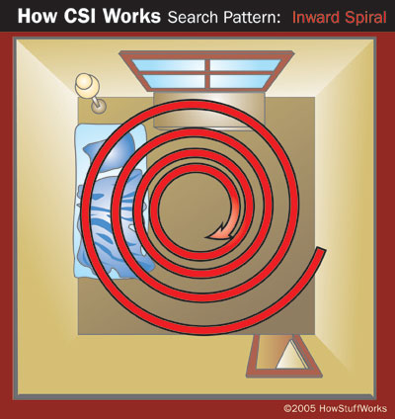
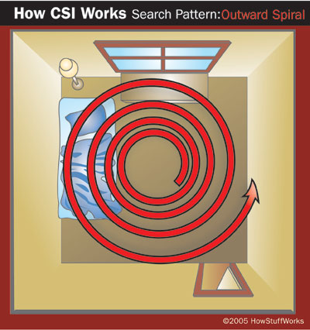
Crime Scene Search Patterns
Inward Spiral Search
Start at the perimeter of the scene and works towards the center
Good to use when there is only one CSI at the scene
Outward Spiral Search
CSI starts in the center of the room (or at the body) and moves outward
Good when there is only one CSI and a body

Slide 24
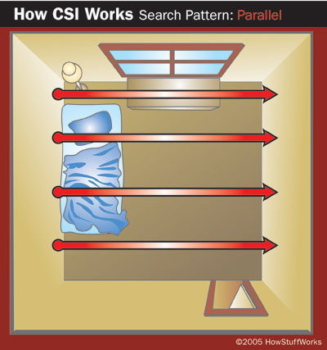
Crime Scene Search Patterns
Parallel/Linear Search
All CSIs form a line
Walk in a straight line at the same pace
From one end of the crime scene to another
Several CSIs looking for big evidence

Slide 25
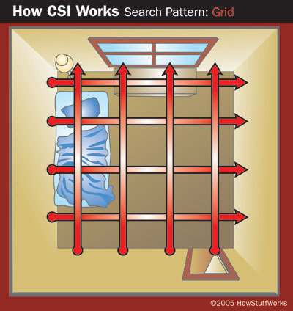
Crime Scene Search Patterns
Grid Search
To parallel searches; perpendicular to one and other
Performed one after another
Group of CSIs; looking for all sized evidence

Slide 26
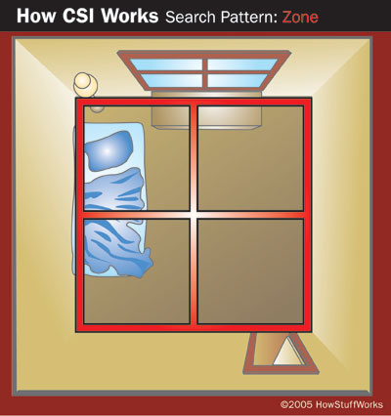
Crime Scene Search Patterns
Zone/Quadrant Search:
Divide the scene into sectors
Each team member takes a sector
Usually at least one switch
Several CSIs large crime scene

Slide 27
The Seven S’s of Crime Scene Investigation
Securing and Collecting Evidence
All evidence needs to be properly packaged, sealed, and labeled
Liquids and Arson
Stored in airtight, unbreakable containers
Moist biological/wet
Stored in breathable contains so the evidence can dry out, reducing the change of mold contamination
Once dry it is packaged in a paper bindle and then placed in a plastic or paper container
Outer container is sealed with tape and labeled with the signature of the collector written across the tape

Slide 28
The Seven S’s of Crime Scene Investigation
Securing and Collecting Evidence
Evidence logs and chain of custody document must be attached to all evidence containers
Evidence log includes:
Case number
Item inventory number
Description of the evidence
Name of suspect
Name of victim
Date and time of recovery
Signature of person recovering the evidence
Signature of any witnesses present during collection

Slide 29
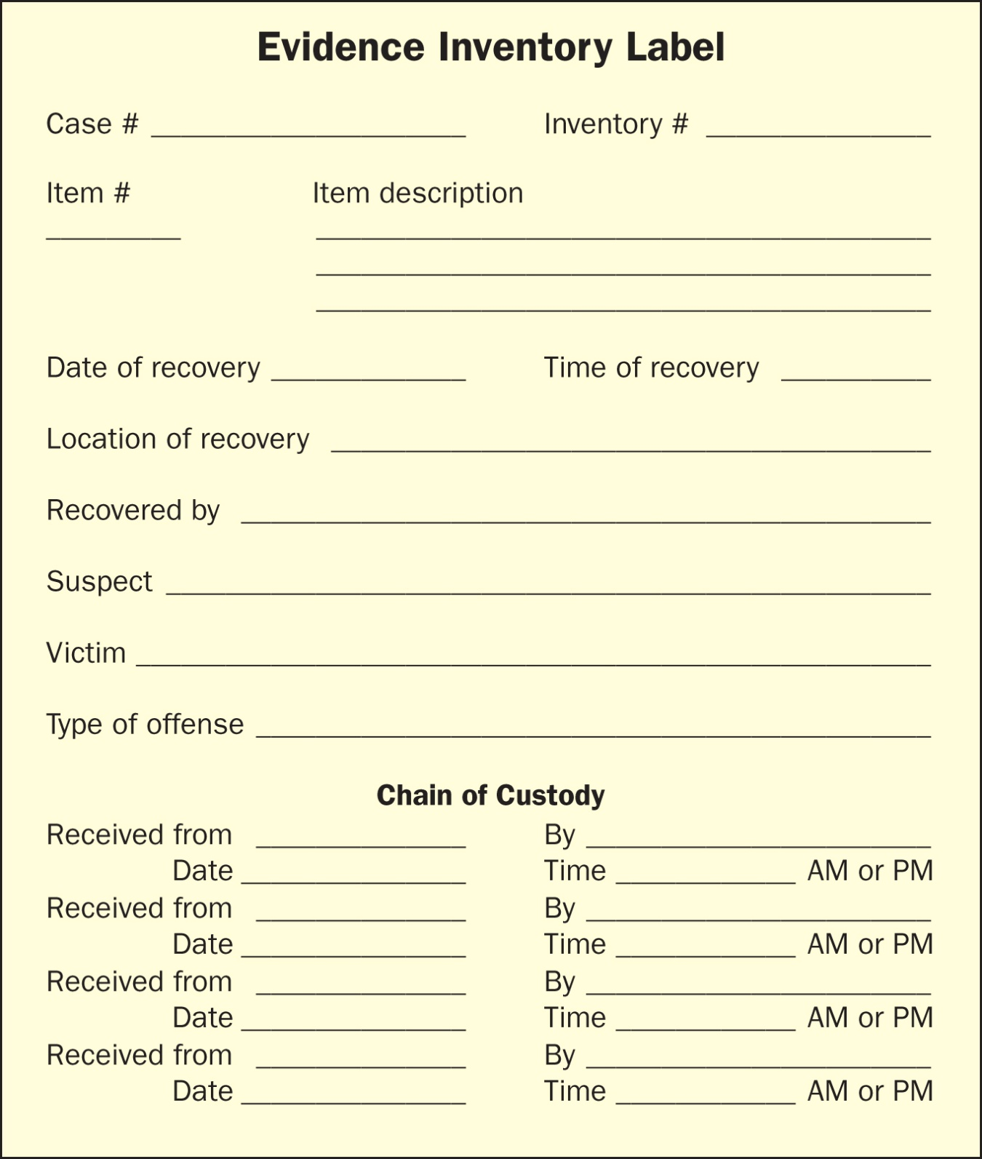

Slide 30
The Seven S’s of Crime Scene Investigation
Securing and Collecting Evidence
Packaging Evidence – Paper Bindle
Ideal for small, dry, trace evidence
Steps for creating a paper bindle (Show me)
Choose appropriate size sheet of clean paper
Place evidence in the center of the paper
Fold the left and right sides in, fold in the top and bottom
Insert the top flap into the bottom flap, tape the bindle closed
Place the bindle inside plastic/paper evidence bag, fold the bag closed.
Place a seal over the folded edge of the evidence bag
Collector writes name over the folded edge

Slide 31
The Seven S’s of Crime Scene Investigation
Securing and Collecting Evidence
Packaging Evidence – Other Evidence
For ALL Trace Evidence
Use tweezer, plastic containers, filter vacuum device, biohazard kits
Wear: gloves, mask, booties
Body Fluid Collection
Try to get enough for slide tests
Get samples from anyone in the house, including the victim

Slide 32
The Seven S’s of Crime Scene Investigation
Securing and Collecting Evidence
Packaging Evidence – Other Evidence
Hair and Fibers
Obtain from victim and anyone in the house
Hair tells:
Race
What part of the body it came from
What animal it came from

Slide 33
The Seven S’s of Crime Scene Investigation
Securing and Collecting Evidence
Packaging Evidence – Other Evidence
Fingerprints
Use: powder, tape, cards, magnifying glass, superglue
Samples from everyone!
Impressions:
Casting kit
Samples from all shoes in the house

Slide 34
The Seven S’s of Crime Scene Investigation
Securing and Collecting Evidence
Packaging Evidence – Other Evidence
Firearms
Collect casings
Make molds of any holes
Collect gun
Collect any weapons in the house for comparison
Documents
Collect any diaries, phonebooks, answering machines, etc.

Slide 35
The Seven S’s of Crime Scene Investigation
Securing and Collecting Evidence
Packaging Evidence – Preserving Chain of Custody
After evidence is collected and sealed properly it gets signed over to the person transporting it
That person signs it over to the lab
When a technician opens the evidence they must reseal it after tests
The original packaging is enclosed in the new packaging which is signed over the seal

Slide 36
Mapping the Outdoor Crime Scene
Datum Points and Subdatum Points
When possible, establish a permanent, fixed point of reference (datum point)
All measurements and directions can established from the datum point to a corner stake (subdatum) of the crime scene
You will use GEOMETRY!
Four right angles
Confirm by using the Pythagorean Theorem
Use angles and direction
+ above ground
- below ground

Slide 37
Crime Scenes Involving a Body
If there is a dead body, start the examination there
Take lots of notes and pictures. Visual first, no touching!
Clothing
Stained or marked? Where did the stains comes from?
Bunched up? If yes, the body could have been moved
Obvious redress? Were clothes put on or changed after death?
On Body Itself
Bruises? Cuts?
Defensive Wounds?
Injuries showing cause of death?
Injuries that do not jive with cause of death?
Anything missing? Tan marks? Jewelry removed?

Slide 38
Crime Scenes Involving a Body
Has the body been moved?
Blood pools that defy gravity?
Blood smears?
No blood and there should be?
Stains that just don’t make sense.
Can the time of death be determined?
Insects on the body? Cal forensic entomologist.
Take ambient temperature and body temperature (not very accurate)
All of this has been done without touching the body
Now flip the body over and do it again.

Slide 39
Crime Scenes Involving a Body
Fingerprints will be taken at scene or ME’s office
Body is moved
Wrapped in cloth
Hands and feet put in paper bags
CSI usually attends the autopsy

Slide 40
Crime Scene Reconstruction
Involves forming a hypothesis of the sequence of events from before the crime through its commission
Must use both witness testimony and evidence
Like putting together a puzzle, you have to figure out where all the pieces go
Evidence does not lie, but it could have been staged to deliberately throw investigators off
Investigators need to maintain an open mind when examining the evidence

Slide 41
Commonly Staged Crime Scenes
Arson
A red flag
Fire is often used to cover up another crime
Fire destroys evidence, but not all evidence
Suicide
Victim is murdered, but the murderer stages it to look like a suicide
Motives vary but usually this is a personal murder
Some motives: insurance money, unhappy marriage, robbery
Burglary
Sometimes people fake break-ins for insurance money
Or to make a personal murder look like a random act

Slide 42
Commonly Staged Crime Scenes
When determining if a crime scene has been staged:
Initially treat all deaths as homicides
Are the type(s) of wounds on the victim consistent with the suspected weapon employed?
Could the wounds be easily self-inflicted?
Establish a profile of the victim through interviews with friends and family
Evaluate the behavior of the victim before the event
Evaluate the behavior of any suspects before the event
Corroborate statements with evidential facts
Reconstruct the event

