Slide 1
Introduction to Cells
The Structure of Cells

Slide 2
3.1
Cyto
cyto
logy
logos
+
“cell”
“study of”

Slide 3
1665 Robert Hook’s Micrographia
1674 A. van Leeuwenhoek
1833 R. Brown
1838 M. Schleiden
1839 T. Schwann
1855 Virchow
cork cells
1st living
nucleus
plants
animals
cells from other cells

Slide 4
The Cell Theory
Cells are the basic unit of all living things.
Cells perform all the functions of living things.
Cells come from the reproduction of existing cells.

Slide 5
Processes of the Cell (look at chart on page 58)
excretion
egestion
secretion
homeostasis
reproduction
absorption
digestion
synthesis
respiration
movement
irritability

Slide 6
Cellular Organization
3.2
unicellular
multicellular

Slide 7
Cellular Organization
unicellular
consists of only one cell
examples include bacteria, many protozoans, and some algae & fungi

Slide 8
Cellular Organization
multicellular
organism made of many cells
colonial
a group of similar cells living together that could exist separately
examples include many algae and fungi

Slide 9
Multicellular Levels
tissues
groups of similar cells
organs
groups of tissues
systems
groups of organs
Write the full level of organization

Slide 10
Structures of the Cell
3.3
Currently cell anatomy can be divided into 3 broad categories
boundaries
cytoplasm
nucleus

Slide 11
Organelle
a structure inside the cell that performs a specific function

Slide 12
Types of Cells
prokaryotic
lack a true nucleus
have only non-membrane-bound organelles

Slide 13
Types of Cells
eukaryotic
“true nucleus”
have membrane-bound and non-membrane-bound organelles

Slide 14
non-membrane-bound organelles
membrane-bound organelles
membrane-bound nucleus
nucleoid region

Slide 15
Cell Boundaries
cell membrane
outermost boundary
surrounds every cell
composed of lipids and proteins
lipid bilayer (phospholipids)
hydrophilic & hydrophobic ends

Slide 16
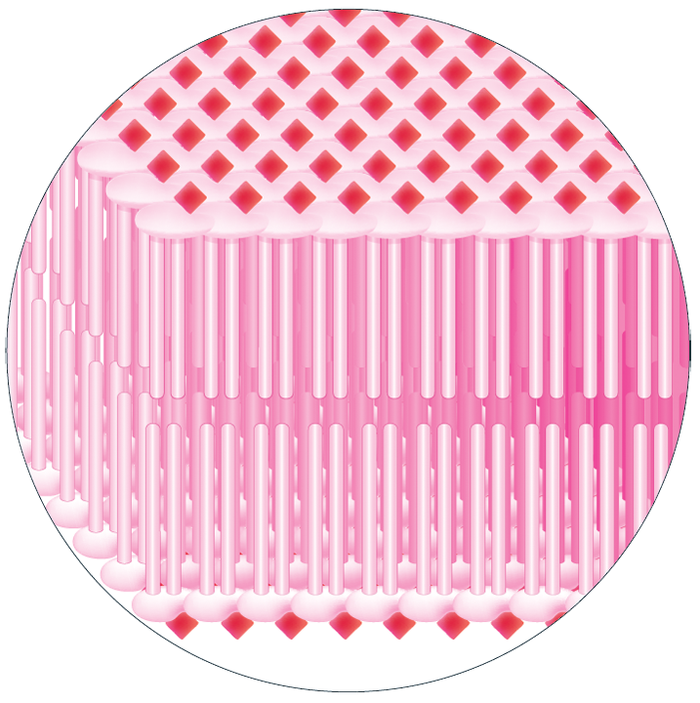
lipid bilayer

Slide 17
Cell Boundaries
cell wall
primarily composed of cellulose
plants, algae, fungi, many protozoans and bacteria

Slide 18
Cell Boundaries
capsule or sheath
many unicellular and colonial organisms
extra protection

Slide 19
Cytoplasm
all of the material within the cell membrane except the nucleus

Slide 20
Cytoplasmic Organelles (Diagram/Function Quiz pages 62-63)

Slide 21
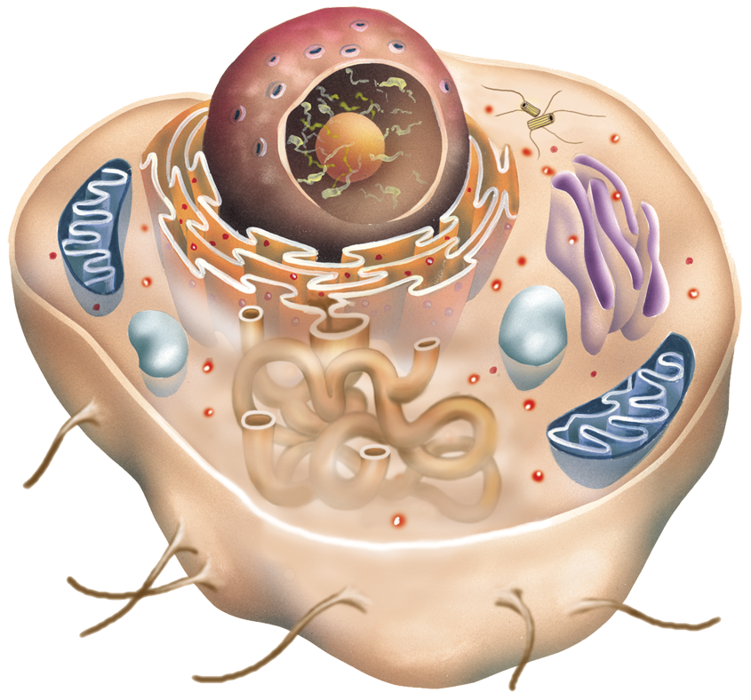
Animal Cell

Slide 22
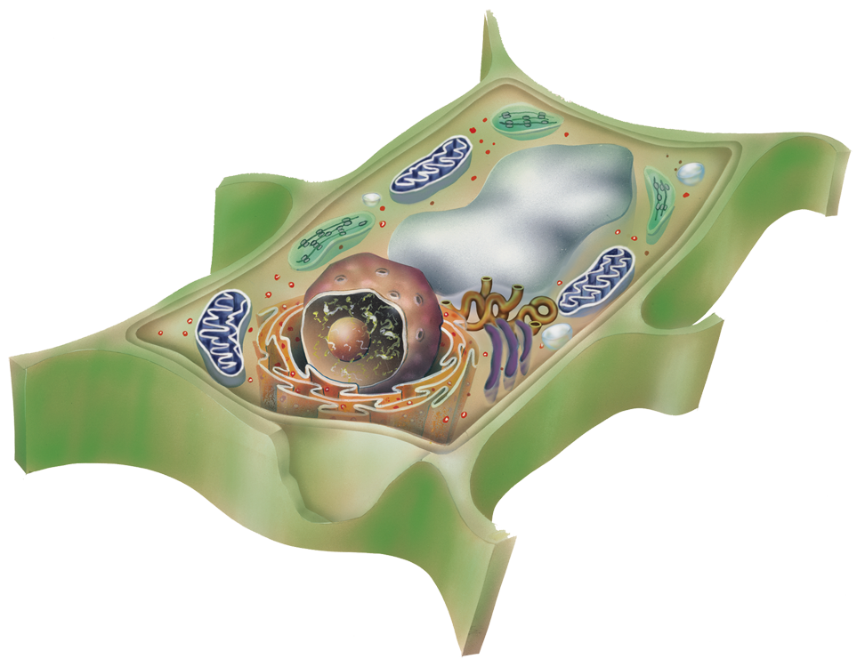
Plant Cell

Slide 23
Mitochondria
“powerhouse of the cell”
center of cellular respiration
cristae
folds of the inner membrane
contain enzymes for cellular respiration

Slide 24
Ribosomes
non-membrane-bound organelles functioning as “protein factories”

Slide 25
Endoplasmic Reticulum
often called “ER”
folds of membranes running throughout the cytoplasm
rough & smooth
channel & synthesis

Slide 26
Golgi apparatus
composed of flat, curved membrane-covered sacs
synthesis & secretion

Slide 27
Lysosomes
contain enzymes for digestion
destroy old or useless cell structures
“garbage disposals”

Slide 28
Cytoskeleton
the system of fibers within the cell that provides structure for the cell
microtubules
centrosome
microfilaments

Slide 29
Flagella and cilia
flagellum
long, whip-like structure
motility
cilia
short, hair-like structures
motility

Slide 30
Plastids
found in the cells of plants and algae but not in animal cells
leucoplasts
“leuco” = clear
storehouse for plant products

Slide 31
Plastids
found in the cells of plants and algae but not in animal cells
leucoplasts
chromoplasts
“chromo” = color
contain pigments

Slide 32
Chloroplast
important in photosynthesis
thylakoids
flattened sacs inside the chloroplast
organized into stacks called grana (granum, sing.)

Slide 33
Vacuoles
membrane-bound sacs for storage
vesicle = a small vacuole

Slide 34
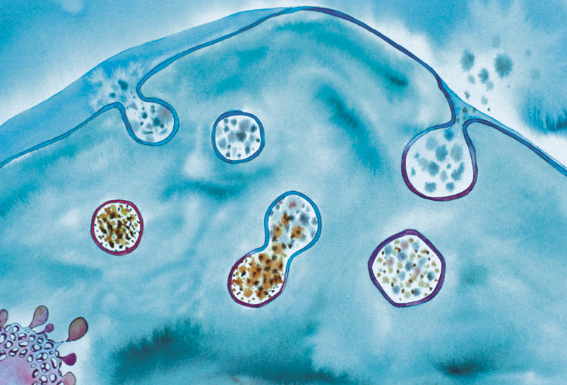
Vacuole Function
food ingestion
(a)
(c)
(b)

Slide 35
Vacuole Function
food ingestion
waste egestion
central maintains turgor pressure in plant cells

Slide 36
Vacuole Function
contractile removes extra water from unicellular organisms
secretion secretes

Slide 37
Nucleus
”control center”
nuclear envelope
chromatin material
nucleolus
concentrated RNA
ribosome synthesis

Slide 38
A secretion vacuole would probably be formed by a
ribosome.
Golgi apparatus.
mitochondria.
lysosome.

Slide 39
Secretion involves
removing nonsoluble wastes.
removing soluble wastes.
moving substances into the cell.
releasing substances from the cell.

Slide 40
What contains enzymes for digestion?
ribosomes
smooth ER
Golgi apparatus
lysosomes

Slide 41
_________ synthesize proteins.
Ribosomes
Mitochondria
Ribosomes
Leucoplasts
Chromoplasts

Slide 42
The breakdown of food to release energy for the cell
respiration
synthesis
absorption

Slide 43
Function in cellular respiration
mitochondria
plastids
rough ER
smooth ER

Slide 44
Which structures are found in plant cells but not in animal cells?
cell wall
central vacuole
chloroplasts
choices a and c
all the above

Slide 45
Introduction to Cells
Cells and Their Environment

Slide 46
Homeostasis
3.4
a dynamic equilibrium

Slide 47
Temperature
optimal point
optimal range
range of tolerance
limit of tolerance

Slide 48
TEMPERATURE
range of tolerance
optimal range
optimal point

Slide 49
All cells are surrounded by solutions.

Slide 50
Environment of Cells
isotonic
hypotonic
hypertonic
equal
under or beneath
over or beyond

Slide 51
Isotonic Solution
The concentration of solutes & water in the solution equals the concentration of solutes and water inside the cell.
Red blood cells are an example.

Slide 52
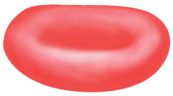
Isotonic Solution

Slide 53
Hypotonic Solution
The concentration of solutes is lower in the solution than inside the cell.

Slide 54
Hypotonic Solution

Slide 55
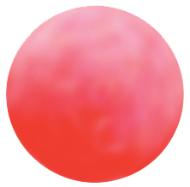
Hypotonic Solution

Slide 56
Cells in Hypotonic Environments
gain water too quickly
may have structures to prevent cytolysis
cell wall
contractile vacuole

Slide 57
Cytolysis
the bursting of a cell due to internal water pressure

Slide 58
Hypertonic Solution
The ratio of solutes to water is higher in the solution than inside the cell.

Slide 59
Hypertonic Solution

Slide 60
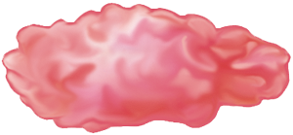
Hypertonic Solution

Slide 61
Cells in Hypertonic Environments
lose water too quickly
usually have difficulty dealing with this type of environment

Slide 62
Plasmolysis
the collapse of a cell due to loss of water

Slide 63
transport of substances into cells
3.5

Slide 64
The cell membrane is semipermeable, or selectively permeable.

Slide 65
Passive Transport
movement of molecules with the concentration gradient
does not require energy
example: osmosis/diffusion

Slide 66
Passive Transport
factors affecting transport
concentration
size and weight
shape
charge
fat-solubility
composition of the membrane

Slide 67
Passive Transport
facilitated diffusion
requires a transport protein
(1)
(2)
(3)
(4)

Slide 68
Active Transport
movement of molecules against the concentration gradient
requires energy
(1)
(2)
(3)
(4)
(5)

Slide 69
Type of Transport
Concentration Gradient?
Energy Required?
Membrane Protein?
Passive
With
No
No
Facilitated Diffusion
With
No
Yes
Active
Against
Yes
Yes

Slide 70
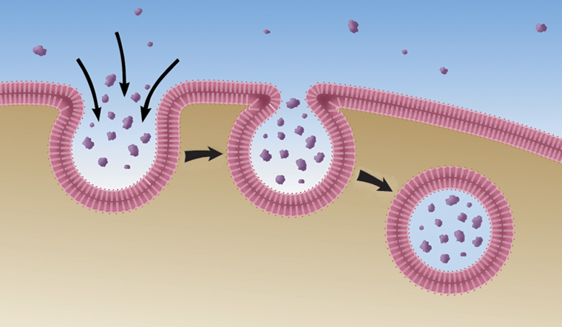
Endocytosis
transport of bulk substances into cells
two types
phagocytosis: solids
pinocytosis: fluids

Slide 71
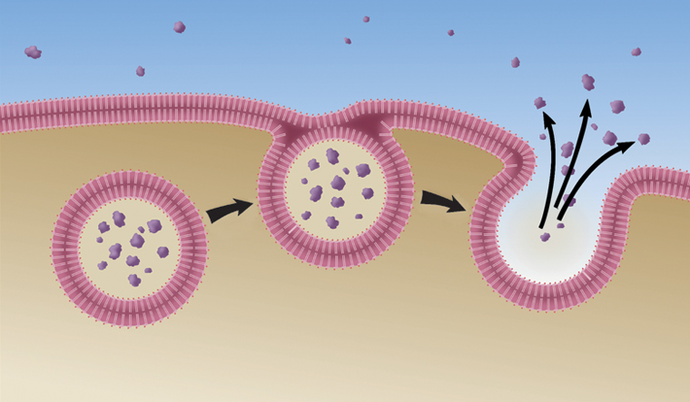
Exocytosis
vacuoles fuse with the cell membrane to release contents outside the cell
accomplishes secretion, excretion, or egestion

Slide 72
Osmosis is the diffusion of _____ through a _____________ membrane.
water
semipermeable
water, permeable
water, semipermeable
any liquid, permeable
any liquid, semipermeable

Slide 73
Homeostasis
maintaining a steady state
moving substances within the cell
forming new cells
responding to external factors

Slide 74
When a cell is in an isotonic environment, the concentration gradient is high.
true
false

Slide 75
In osmosis and diffusion, molecules move from a high to a low concentration.
true
false

