Slide 1
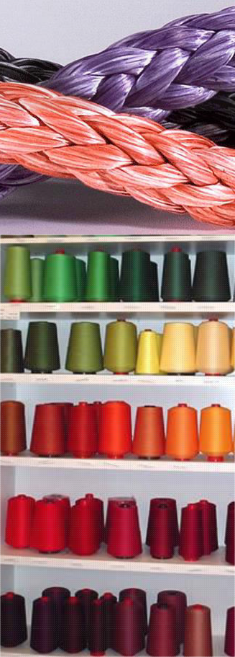

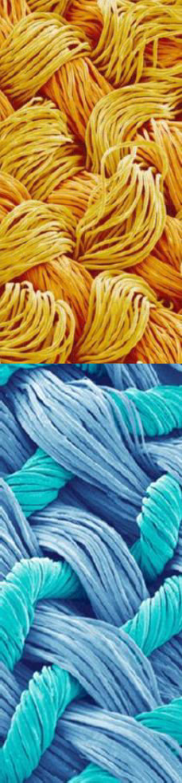

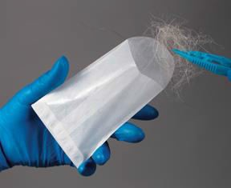
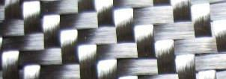
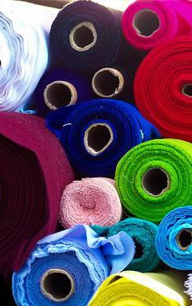
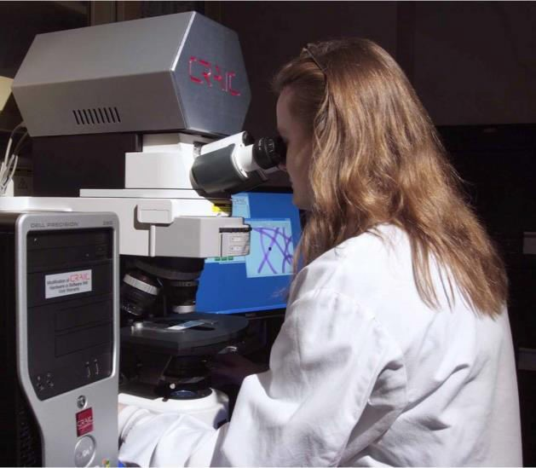
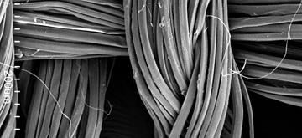

Slide 2
Chapter 4 Vocabulary
amorphous
crystalline
direct transfer
fiber
mineral fiber
monomer
natural fiber
polymer
secondary transfer
synthetic fiber
textile
warp
weft
yarn

Slide 3
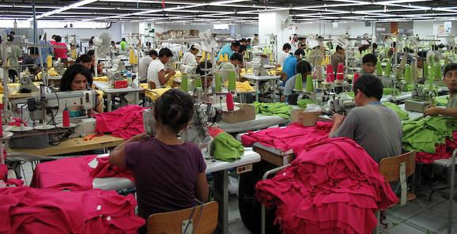
Because textiles are mass-produced, they are considered class evidence. It is difficult to trace a fiber back to a specific source, yet fiber evidence is still important evidence because it creates links between victims, suspects, and locations.
Fibers can come from clothing, coats, carpet, furniture,
curtains, bedding, insulation, rope, etc.

Slide 4


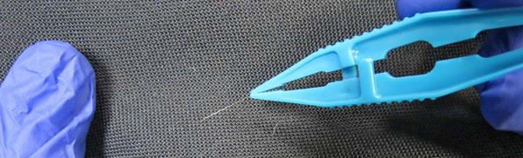
Fibers may be transferred directly from victim to suspect or suspect to victim, this is called direct transfer.
However, an individual may have fibers on them that they picked up from the environment and then transfers to the other person during contact, this is called secondary transfer.

Slide 5
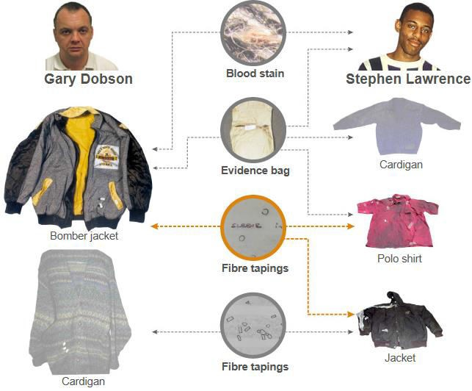
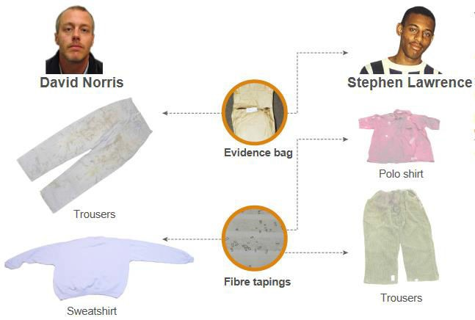
Case that used Fiber Evidence: April 1993
An eighteen-year-old is stabbed to death in an unprovoked attack by a gang of white youths as he waits at a bus stop in south-east London, with his friend.
Tiny fragments of new evidence emerged in 2007 as scientists conducted a massive "cold case review".
They re-examined clothing taken from the two defendants, Gary Dobson and David Norris, starting a process that eventually led to a guilty verdict for both men in January 2012. The Stephen Lawrence murder trial boiled down to three things; blood, fibers and hair.

Slide 6

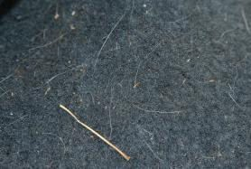
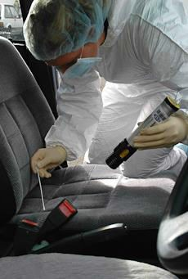
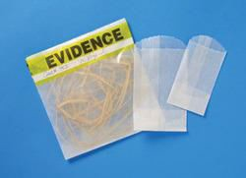
Early collection of fibers is critical; most fiber evidence (95%) falls off or is lost from a crime scene within 24 hours.

Slide 7

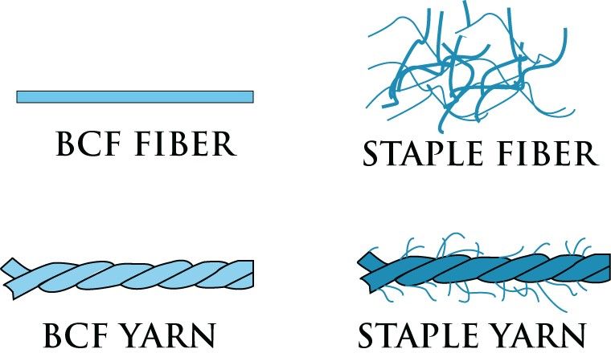
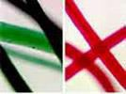
When using fiber as evidence, forensic scientists want to determine the following:
  Type of fiber – composition and uniqueness
  Fiber color – first step of matching fiber to location. Later, scientists can test to see if dyes used also match.
  Number of fibers found – usually the more found the easier the match. More fibers also suggest more violent crime or longer period of contact.

Slide 8
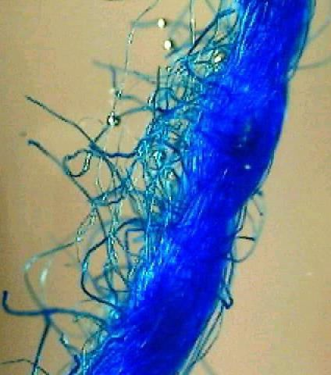
Where the fiber was found – can you place the suspect at
the scene or to the victim?
Textile fiber originated from – What is the source of the fiber?
Are there multiple types of fibers – several types of fibers can be more supportive.
Type of crime committed
– If forensic scientists know the crime, they have a better idea of what kind of fiber transfer to look for. Examples- rape, kidnapping, breaking and entering, etc.
Time between crime and fiber discovery – passage of time greatly reduces the value of fiber evidence.

Slide 9
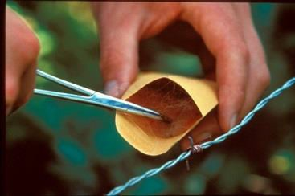
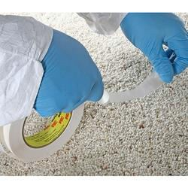
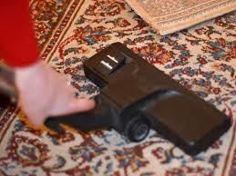
Collection of Fibers
Visual search first.
Use of forceps or sticky tape for small areas.
Vacuums for larger areas.
Removed fibers should be folded into a paper bindle then in a coin envelope, which can be sealed and marked.
Each garment should be-laid on a clean sheet of paper, and separately rolled up in the paper. Bag clothing items individually in paper bags. Make sure that different items are not placed on the same surface before being bagged.
Recording where fibers were found is critical for evidence to be admissible in court.
Control samples are important also. Known samples should be taken from all possible sources for comparison.

Slide 10
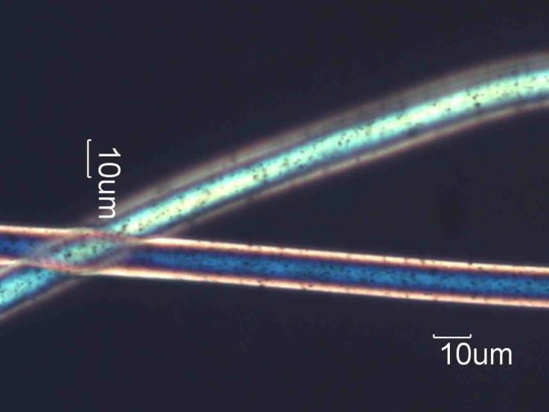
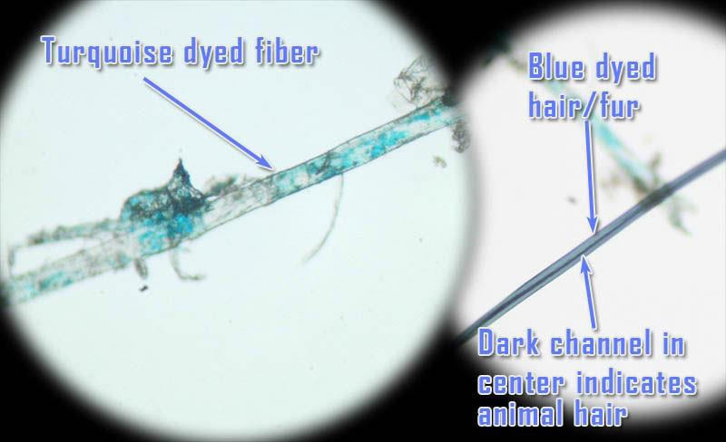
Testing Fibers
First identify the type of fiber and its characteristics using a microscope. Try to identify the color, texture, diameter, shape pattern, cross section appearance, etc.
  If there is a limited amount of fiber found at the crime scene, it is important scientists do not perform tests that will damage the evidence.

Slide 11
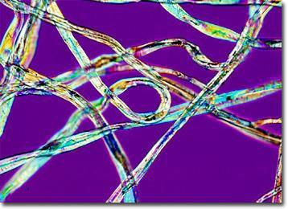
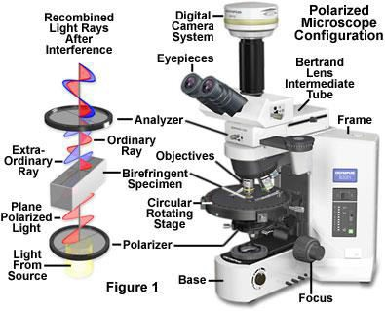
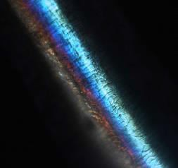
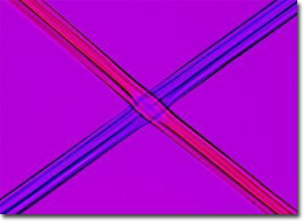
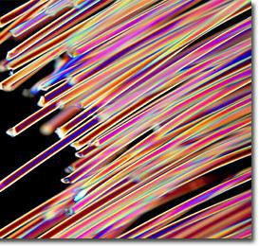
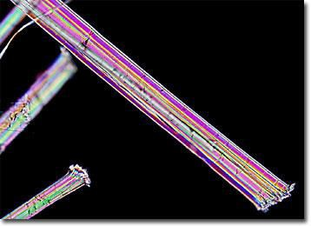
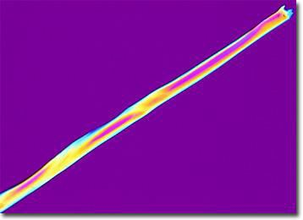
Two Non-Destructive Procedures are:
Polarizing light microscopy- allows scientists to look at optical properties of the fiber using
specific wavelengths of light.
Cotton
Silk
Hair
Hemp
Tencel
Acetate Fibers

Slide 12
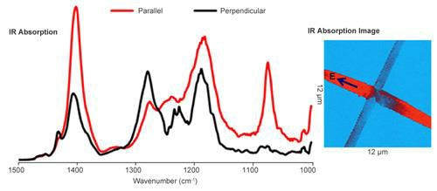
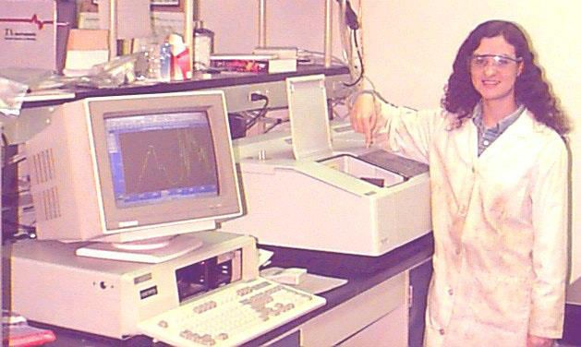
Infrared Spectroscopy- allows scientists to see
chemical structure of fiber using beams of light.

Slide 13
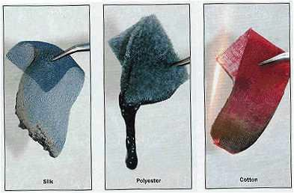
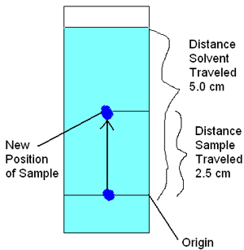
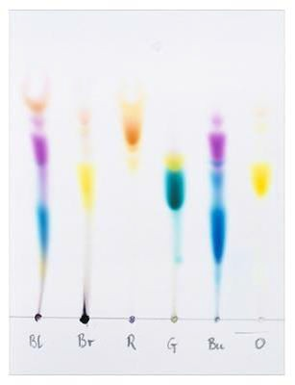
If large quantities of fibers are found, some of the
fibers can be used for more destructive
procedures, allowing for more conclusive data.
Burning- can compare melting points, odors, ash formation, etc.
Solvents- can compare
solubility
3. Staining- can compare absorption of various stains
4. Density- often a quick way
to classify fabric origins
Chromatography- gives
a more detailed analysis of the dye composition

Slide 14
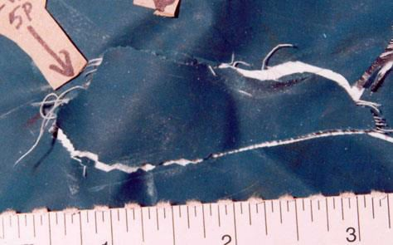
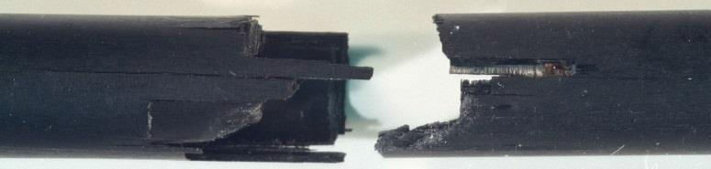
If fabric or cordage is found (many fibers still linked together) then scientists also look for a physical match (like puzzle pieces). They also can compare the pattern of knit or weave used.
Fabric (Raincoat)
Duct Tape
Arrow
Just as no two fingerprints are the same, no two objects can break exactly the same way every time. Physical matching (sometimes called physical fit or jigsaw fit) is the most incontrovertible evidence available.

Slide 15
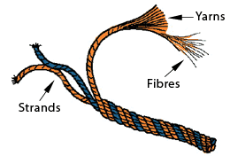
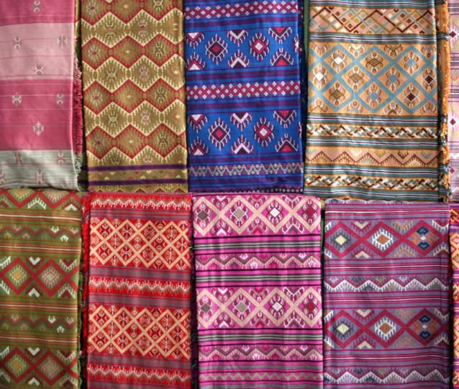
Classification of Fibers
Fiber → Yarn → Textile
A fiber is the smallest indivisible unit of a textile
Fibers too short to be used to make textiles in their raw state may be spun together to make yarns.
Yarn is woven, with different patterns, into textiles
Textiles

Slide 16
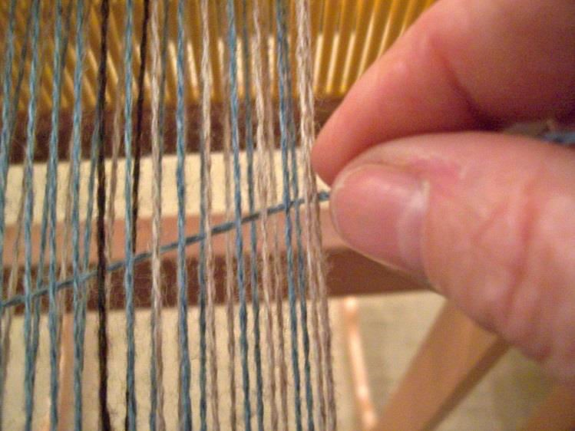
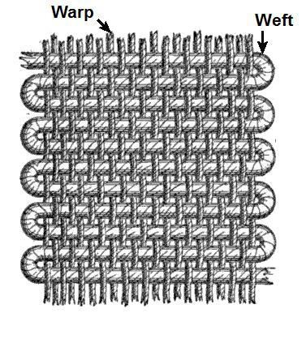
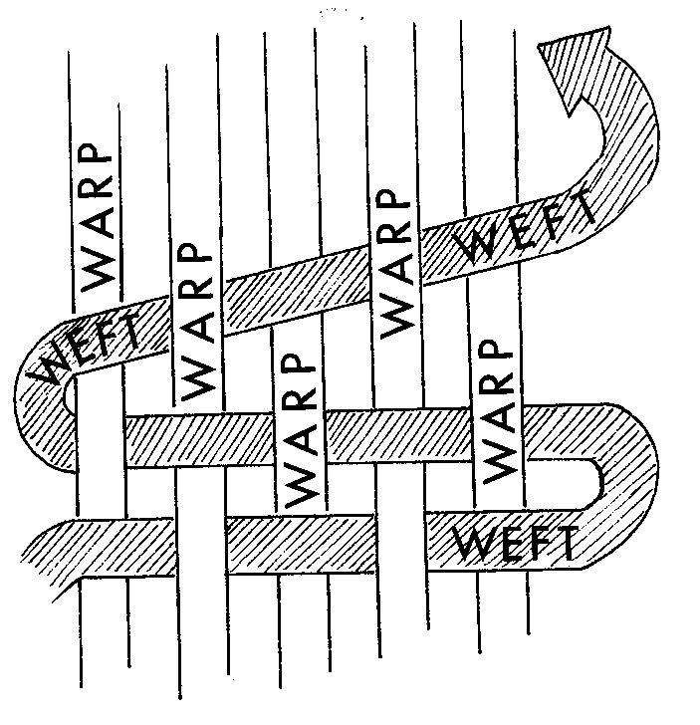
Weaving consists of arranging lengthwise threads (called the warp) side by side. Then crosswise threads (called the weft) are woven back and forth in one of many different patterns.

Slide 17
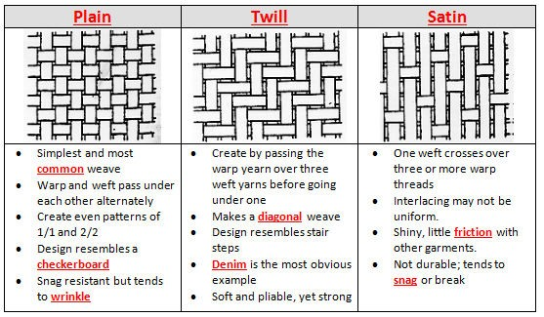
Weave patterns are determined by number of threads jumped as weave over and under. Weave patterns vary and can be used as forensic evidence.

Slide 18
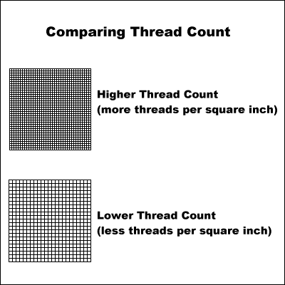
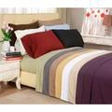
Thread Count
The number of threads that are packed together for any given amount of fabric; it also varies and can be used as forensic evidence.
Most people associate this with
bed sheets:
Balancing softness and affordability: You will find the widest variety of sheets with 300 to 500 thread count. These sheets will offer excellent softness at an affordable price.
Designer styles: Many designer sheets and other novelty-print sheets have a thread count of around 200 to 300.
The feeling of luxury: Luxury sheets will have a thread count of 800, 1000, or even 1200. Luxury sheets are usually also made of very fine materials, like Egyptian cotton.

Slide 19
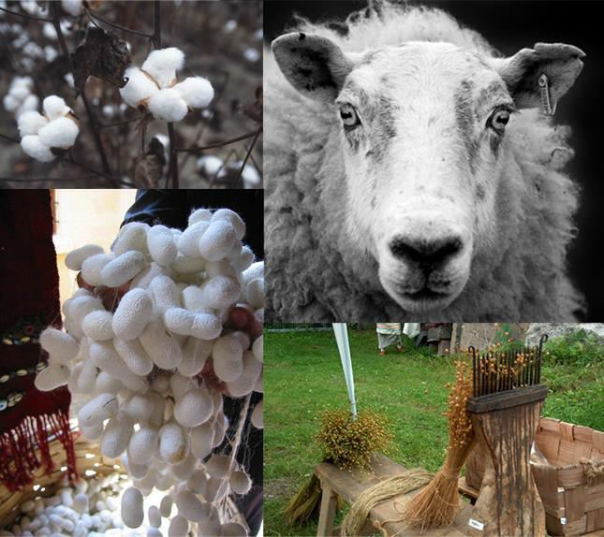
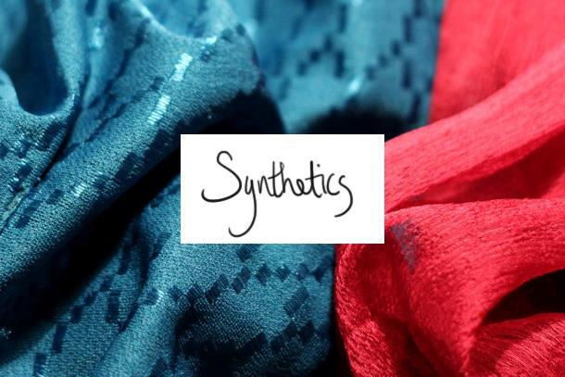
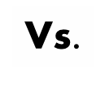

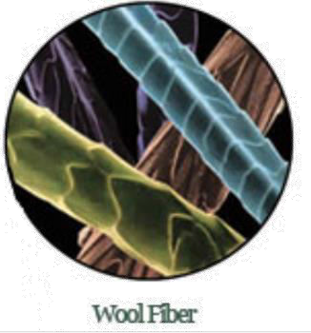
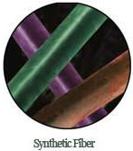
Fibers may be natural or synthetic
  Natural fibers come from animals, plants, and mined minerals.
  Synthetic fibers are man-made.

Slide 20

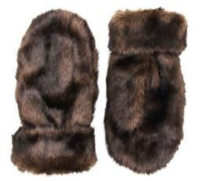

Animal fibers
All animal fibers are made of proteins.
Animals provide fibers from 3 sources: fur, hair, and
silk webbing.
Fur is a good donor of fibers, but not for textiles. Instead, fur is left on the skin and treated, then used to make coats and gloves.

Slide 21





Animal fibers
Hair can be brushed out of aŶ aŶiŵal’s Đoat, shed naturally and collected, or clipped off.
Sheep- wool
Goats- cashmere, mohair
Rabbits- angora
Alpacas, llamas, and camels

Slide 22



Animal fibers
Silk comes from the cocoons of the silkworm caterpillar, Bombyx mori.
Silk fibers tend to be very long and therefore do not shed as easily as hair fibers.

Slide 23






Plant fibers
All plant fibers are made of cellulose, a carbohydrate polymer.
Plant fibers are grouped by the part of the plant that they come from.
Most common plant fiber. If not dyed, it will
Seed- cotton
Fruit- Coir
not likely provide much forensic evidence- too common.
(surrounding of a coconut)
Often used for
doormats and baskets.

Slide 24









Plant fibers
Stem
  hemp (Cannabis)- popular alternative to cotton
  jute- used in rope, mats, handbags, burlap
sacks
  flax- used in linen

Slide 25









Plant fibers
Leaf
  Manila, relative of the banana tree- used to make paper and envelopes
  Sisal, a desert plant- used to make rope,
twine, and netting.
Manila Abaca Plant

Slide 26




Mineral fibers
Mineral fibers are neither protein nor cellulose.
Fiberglass- a fiber form of glass;
used to insulate buildings
Asbestos- mineral found in rocks; used mainly because of its fire resistance. Found around pipes and fireplaces, in ceiling and floor tiles, fire resistant cloth, shingles, home siding, and insulation.
  Asbestos is known to cause cancer. When broken we can inhale tiny fragments and damage the lungs. Scar tissue can then become cancerous.

Slide 27


Half of the fabrics produced today are man-made,
Synthetic fibers are made of polymers which are long string of repeating chemical units, called monomers.
By varying the chemical structure of the monomers or by varying the way they are weaved together, polymers are created that have different properties. As a result of these differences, forensically they can be distinguished from one another and be used as physical evidence.
They can be broken down into two groups: Regenerated fibers and Synthetic polymer fibers
synthetic fibers.

Slide 28


Regenerated Fibers
Cellulose esters-- These are derived from cellulose and produced by chemically modifying the natural polymers to create an entirely new compound not found in nature. Examples:
Rayon- most common. first man-made fiber; soft, versatile.
Acetate- less expensive, less polluting than rayon.

Slide 29



Synthetic Polymer Fibers
Petroleum Plastics- these originate from derivatives of petroleum, coal and natural gas. They are totally man-made. Examples:
  Nylon- most durable man-made fabric; extremely light weight.
First introduced as artificial silk for pantyhose.
  Acrylic- most widely used man-made fiber. Inexpensive and tends to ball easily.
  Polyester- -provides warmth from a lightweight, soft and resilient
fabric. Common in polar fleece and many wrinkle resistant pants.
  Spandex- extreme elastic properties.

Slide 30



Comparison of Natural and Synthetic Fibers
Synthetic fibers are much stronger than natural fibers.
Unlike natural fibers, synthetic fibers are not damaged by microorganisms.
Synthetic fibers can deteriorate in bright sun and melt at a lower temperature than natural fibers.
Under magnification, all synthetic fibers have very regular diameters.
Hairs have a cuticle.

