Slide 1
DNA
"The Blueprint of Life"
DNA Typing
DNA Profiling
DNA Fingerprinting

Slide 2
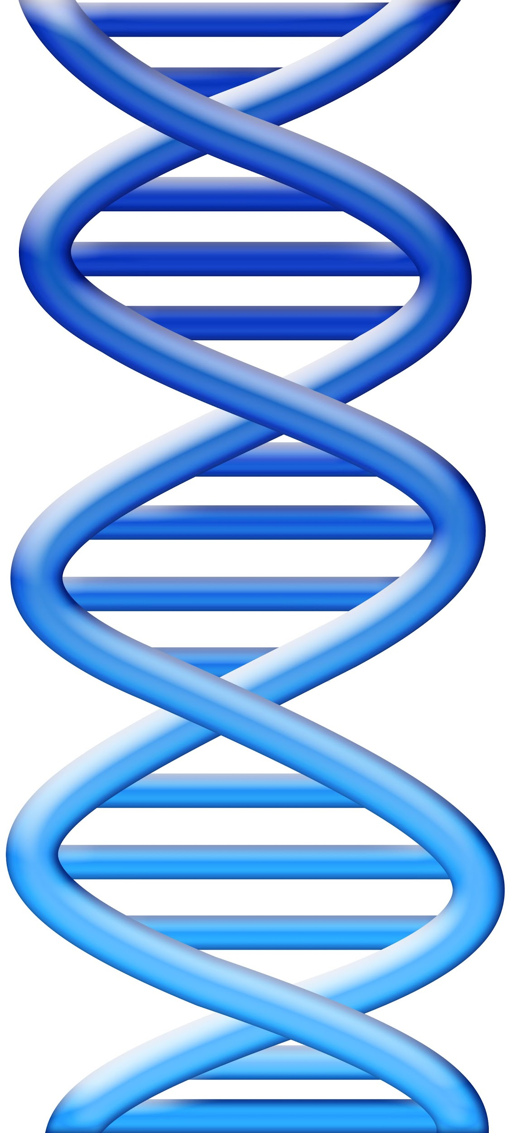
Chapter 7 Vocabulary
allele
chromosome
Combined DNA Index System (CODIS)
DNA fingerprint (profile)
electrophoresis
exon
gene
genome
intron
karyotype
Polymerase Chain Reaction (PCR)
polymorphism
primer
restriction enzyme
restriction fragment
Short Tandem Repeats (STR)

Slide 3
Historical Information (pg 203)
James Watson and Francis Crick—1953 discovered the configuration of the DNA molecule
Ray White—1980 describes first polymorphic RFLP marker
Alec Jeffreys—1985 isolated DNA markers and called them DNA fingerprints
Kary Mullis—1985 developed PCR testing
1988—FBI starts DNA casework
1991—first STR paper
1998—FBI launches CODIS database

Slide 4
Where is DNA found?
Genes are portions of DNA that code for specific proteins
DNA is found in all nucleated body cells—white blood cells, semen, saliva, urine, hair root, teeth, bone, tissue
Most abundant in buccal (cheek) cells
Red blood cells have no nuclei; and therefore, no nuclear DNA
DNA obtained from blood comes from white blood cells
All the DNA found in human cells makes up the human genome

Slide 5
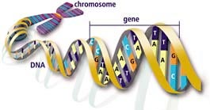
What is DNA?
DNA stands for deoxyribonucleic acid and contains genetic information. It is found on chromosomes located in the nucleus of our cells.
What makes up DNA?
The sides or backbone of the DNA molecule are made up of sugar (deoxyribose) and phosphate molecules.
The rungs that form the middle of the molecule are made up of pairs of nucleotides or nitrogen bases. Adenine (A) pairs with thymine (T), while guanine (G) always pairs with cytosine (C).
The order of the bases determines the genetic code.
Double Helix

Slide 6
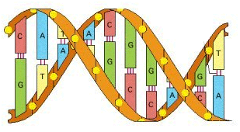
Label the DNA molecule shown below.
Word List:
Cytosine Adenine Thymine Guanine Backbone Hydrogen Bonds
BACKBONE
CYTOSINE
THYMINE
GUANINE
HYDROGEN BONDS
ADENINE

Slide 7
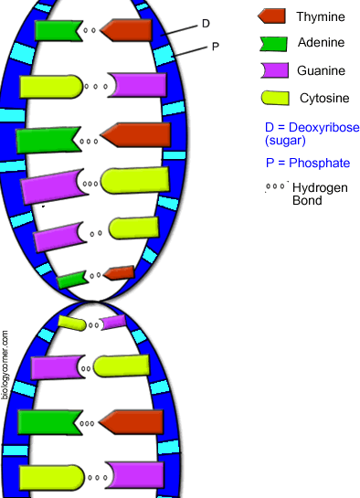
Base-Pair Rule “All Tigers Can Growl”
Adenine Thymine
Cytosine Guanine
These base pairs always go together!!!! Where there is a T, there will be an A, etc...
The sides of the DNA ladder are phosphate & sugar
Held together by hydrogen bonds

Slide 8
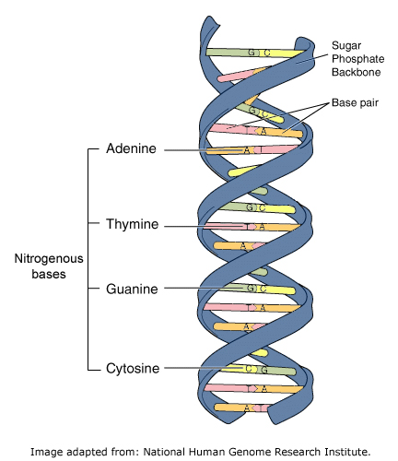
Practice
One side:
A T A T C A T G C G G G
Other side:

Slide 9
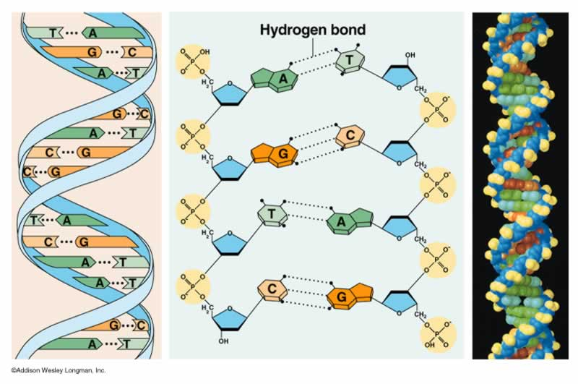
What makes up DNA?
DNA codes for your genes (traits)
DNA is made of repeating subunits called nucleotides

Slide 10
What is a Nucleotide?
Has three parts:
PHOSPHATE
DEOXYRIBOSE (sugar)
BASE (A,T,G,C)
Phosphate
Base
Sugar

Slide 11
Types of DNA
Nuclear
found in the nucleus
constitutes 23 pairs of chromosomes inherited from both parents
each cell contains only one nuclei
Mitochondrial
found in the cytoplasm
is inherited only from mother
each cell contains hundreds to thousands of mitochondria
can be found in skeletal remains
Nuclear DNA is present in the head of the sperm. Mitochondrial DNA is present in the tail. At conception, the head of the sperm enters the egg and unites with the nucleus. The tail falls off, losing the father’s mitochondrial DNA.

Slide 12
Mitochondrial DNA
Analysis of mtDNA is more:
rigorous
time consuming
costly than nucleic testing of DNA
mtDNA is constructed in a circular or loop
37 genes are involved in mitochondrial energy generation
is used when nuclear DNA typing is not possible

Slide 13
Chromosomes
DNA is stored in chromosomes
There are 46 chromosome in the human body
44 are autosomes and appear in homologous pairs
2 are sex chromosomes
XY – male
XX – female
Half of your DNA is inherited from your mother and the other half from your father

Slide 14
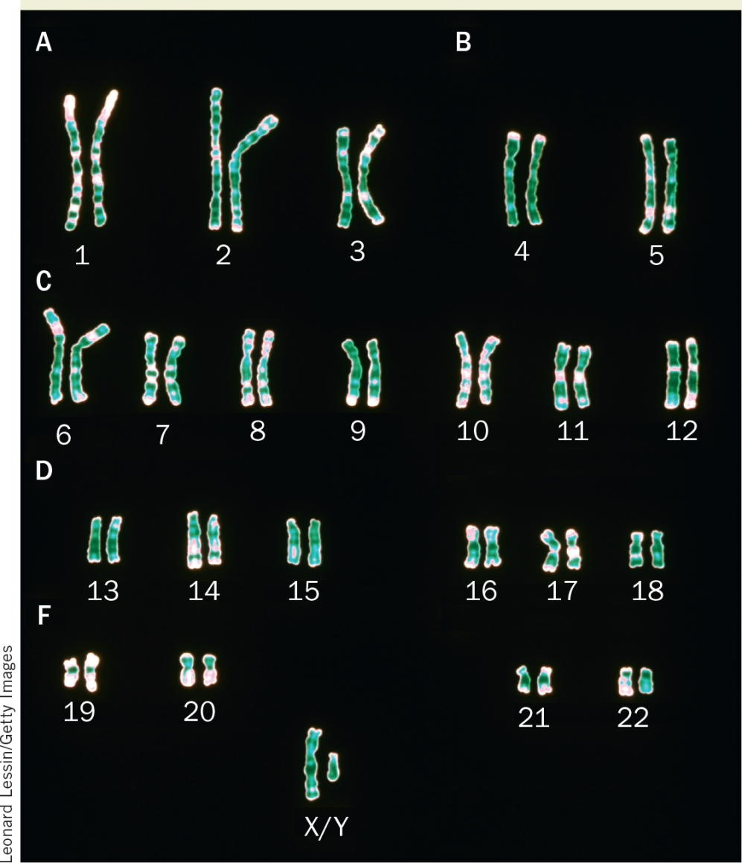
Chromosomes
karyotype

Slide 15
Genes
A gene is a segment of DNA in a chromosome that serves in the production or regulation of proteins.
Genes average about 3000 base pairs, but they can be composed of many thousands of base pairs.
Exon “blueprints for proteins” 5%
Intron “on-off switches” 95%
Allele “alternative gene”

Slide 16
What is DNA Profiling?
Also called DNA fingerprinting, or DNA typing
A technique used by scientists to distinguish between individuals of the same species using only samples of their DNA
Most useful tool since the development of fingerprinting
Use polymorphisms – regions of repeating DNA within an intron that is highly variable from person to person
DNA Fingerprint (6.09 minutes) https://www.youtube.com/watch?v=DbR9xMXuK7c

Slide 17
Stages of DNA Profiling
Stage 1:
Isolate - Cells are broken down to release DNA
If only a small amount of DNA is available it can be amplified using the polymerase chain reaction (PCR)

Slide 18
Stages of DNA Profiling
Step 2:
The DNA is cut into fragments using restriction enzymes.
Each restriction enzyme cuts DNA at a specific base sequence.

Slide 19
Stages of DNA Profiling
The sections of DNA that are cut out are called restriction fragments.
This yields thousands of restriction fragments of all different sizes because the base sequences being cut may be far apart (long fragment) or close together (short fragment).

Slide 20
Stages of DNA Profiling
Stage 3:
Fragments are sorted on the basis of size using a process called gel electrophoresis.
DNA fragments are injected into wells and an electric current is applied along the gel.

Slide 21
Stages of DNA Profiling
DNA is negatively charged so it is attracted to the positive end of the gel.
The shorter DNA fragments move faster than the longer fragments.
DNA is separated on basis of size.

Slide 22
Stages of DNA Profiling
A radioactive material is added which combines with the DNA fragments to produce a fluorescent image.
A photographic copy of the DNA bands is obtained.

Slide 23
Stages of DNA Profiling
Stage 4:
The pattern of fragment distribution is then analyzed.

Slide 24
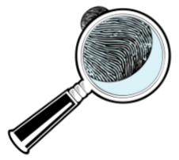
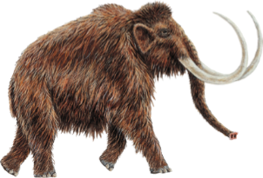
DNA Amplification
Using the technique called polymerase chain reaction (PCR), researchers are able to create huge quantities of DNA identical to trace samples. This process is also known as DNA amplification.
Many procedures in DNA technology require substantial amounts of DNA to work with, for example;
DNA sequencing
DNA profiling/fingerprinting
Gene cloning
Transformation
Making artificial genes
Samples from some sources, including those shown here, may be difficult to obtain in any quantity, so doing PCR Helps get a big sample.
A crime scene
(body tissue samples)
A single viral particle
(from an infection)
Fragments of DNA from
a long extinct animal

Slide 25
PCR – Polymerase Chain
Reaction Procedure
Heat the DNA strands, causing the strands to separate (unzip).
Cool the mixture and add a primer, a short sequence of base pairs that will add to its complementary sequence on the DNA strand.
Finally, add a DNA polymerase and a mixture of free nucleotides to the separated strands. Heat again to around 75° C for the completion.

Slide 26
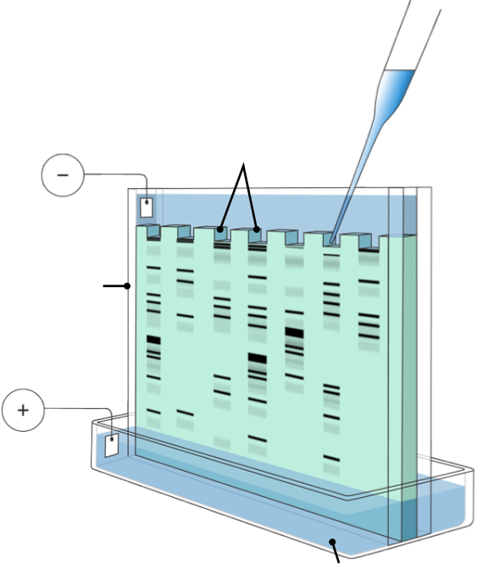
Gel Electrophoresis
A technique known as gel electrophoresis can be used to separate large molecules on the basis of their size, electric charge, and other physical properties.
Wells into which samples to be analyzed are placed.
Sample
Cathode
Buffer
Plastic Frame
Anode
Gel
DNA fragments, shown symbolically above, move towards the positive terminal (smaller fragments move faster than longer ones).
Buffer solution

Slide 27
Gel Electrophoresis Explained!
Amoeba Sisters Gel Electrophoresis (8.07 minutes) https://www.youtube.com/watch?v=ZDZUAleWX78

Slide 28
Short Tandem Repeats (STR)
STR is another method of DNA typing. STR’s are locations (loci) on the chromosome that contain short sequences of 2 to 6 bases that repeat themselves in the DNA molecule. The advantages of this method are that it provides greater discrimination, requires less time, a smaller sample size, and the DNA is less susceptible to degradation.
The FBI uses 13 core SRs for identification of Americans

Slide 29
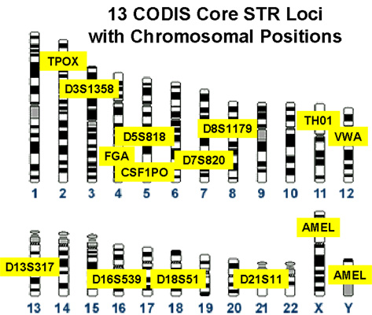
13 CODIS Core STR Loci with Chromosomal Positions

Slide 30
STR Procedure
Extract the gene TH01 from the sample. (TH01 has seven human variants with a repeating sequence of A-A-T-G)
Amplify the sample by means of PCR
Separate by electrophoresis
Examine the distance the STR migrates to determine the number of times TH01 repeats

Slide 31
STR
Each person has two STR types for TH01—one inherited from each parent.
By continuing the process with additional STRs from other genes, you can narrow down the probability of DNA belonging to only one person.
STR typing is visualized by peaks shown on a graph. Each represents the size of the DNA fragment.
The possible alleles are numbered for each loci.

Slide 32
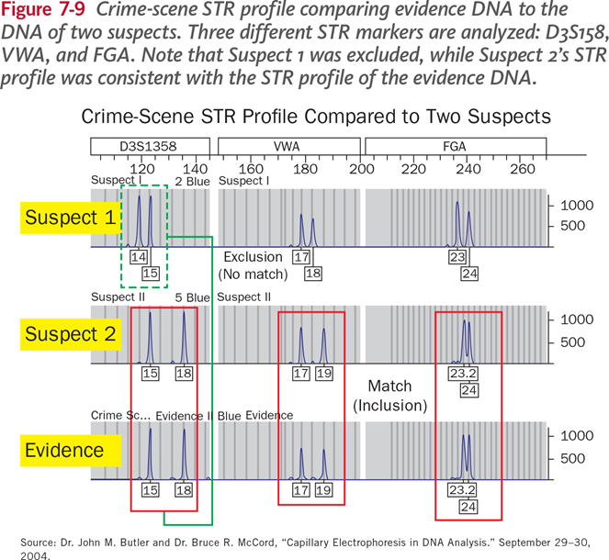
STR Example

Slide 33
Y STR and mtDNA Analyses
Y STRs
Trace ancestry through the male line
mtDNA
Only mothers pass on mitochondrial DNA
mtDNA and Y STRs
Can only yield class evidence
Fourth amendment rights may become a concern as DNA technology advances.

Slide 34
Uses of DNA Profiling
To identify potential suspects
To exonerate individuals
To identify crime and casualty victims
To establish paternity
To match organ donors
Forensic science is the use of scientific knowledge in legal situations.
The DNA profile of each individual is highly specific.
The chances of two people having exactly the same DNA profile is 30,000 million to 1 (except for identical twins).
https://www.youtube.com/watch?v=AkBUriMK9u8

Slide 35
What Factors Affect DNA Evidence?
Several factors can affect the DNA left at a crime scene, such as environmental factors (e.g., heat, sunlight, moisture, bacteria, and mold). Therefore, not all DNA evidence will result in a usable DNA profile. Further, DNA testing cannot identify when the suspect was at the crime scene or for how long.
What Exactly is CODIS?
CODIS stands for COmbined DNA Index System, which is an electronic database of DNA profiles that can identify suspects. DNA profiles from individuals convicted of certain crimes, such as rape, murder, and child abuse, are entered into CODIS and help officers identify possible suspects when no prior suspect existed. Links all 50 states. Requires >4 RFLP markers and/or 13 core STR markers.

Slide 36
Precautions to Avoid DNA Contamination
Wear disposable gloves and change them often
Use disposable instruments for handling each sample
Avoid touching the area where DNA may exist
Avoid talking, sneezing, and coughing on evidence
Avoid touching your face when collecting and packaging evidence
Air-dry evidence thoroughly before packaging
If wet evidence cannot be dried, it may be frozen, refrigerated, or placed in a paper bag
Put evidence into new paper bags or envelopes
Keep DNA evidence dry and cool during transportation and storage

Slide 37
Biological Materials Used
For DNA Profiling
Blood
Hair
Saliva
Semen
Body tissue cells
DNA samples have been obtained from vaginal cells transferred to the outside of a condom during sexual intercourse.

Slide 38
Example 1
A violent murder occurred.
The forensics team retrieved a blood sample from the crime scene.
They prepared DNA profiles of the blood sample, the victim and a suspect as follows:
Suspects Profile
Blood sample from crime scene
Victims profile
Was the Suspect at the Crime Scene?

Slide 39
Solving Medical Problems
DNA profiles can be used to determine whether a particular person is the parent of a child.
This information can be used in
Paternity suits
Inheritance cases
Immigration cases

Slide 40
Example 2
By comparing the DNA profile of a mother and her child it is possible to identify DNA fragments in the child which are absent from the mother and must therefore have been inherited from the biological father.
Mother
Child
Man
Is This Man the Father of the Child?

Slide 41
Three Possible Outcomes
Match—The DNA profile appears the same. Lab will determine the frequency.
Exclusion—The genotype comparison shows profile differences that can only be explained by the two samples originating from different sources.
Inconclusive—The data does not support a conclusion as to whether the profiles match.

Slide 42
Example 3
Who did it?
Which suspect matches the bloodstain?

Slide 43
Example 4
Whose your daddy?
Which sample is most likely to be the father?
F1 or F2

Slide 44
Example 5
C. Identical or not?
Which sets of twins are identical twins?

