Slide 1
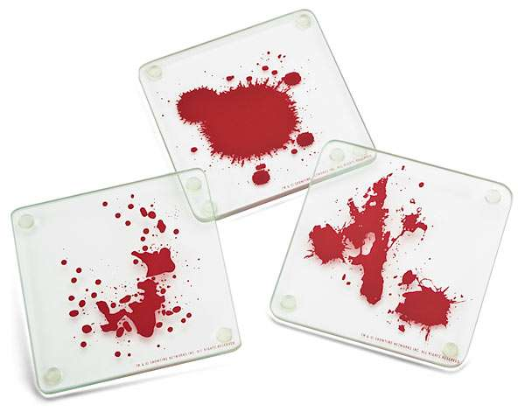
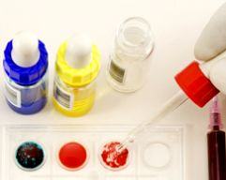

Slide 2
Chapter 8 Vocabulary
agglutination
angle of impact
antibodies
antigen
antigen-antibody response
area of convergence
area of origin
cast-off pattern
forensic serology*
passive drop
satellite
spine
swipe
wipe
*not in book

Slide 3
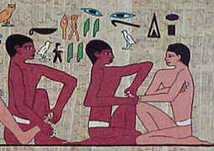
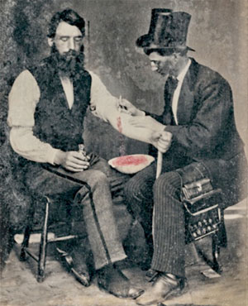
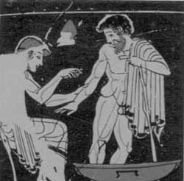
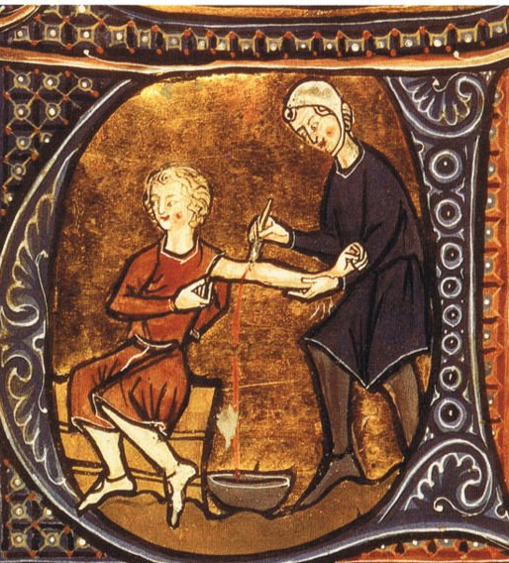
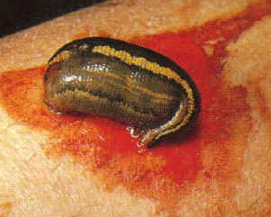
The practice of bloodletting began around 2500 B.C. with the Egyptians to try to cure diseases. It continued with the Greeks and Romans, the Arabs and Asians, then spread through Europe during the Middle Ages and the Renaissance. It reached its peak in Europe in the 19th century but subsequently declined and today in Western medicine is used only for a few select conditions.
Notes:
http://www.history.com/news/a-brief-history-of-bloodletting

Slide 4
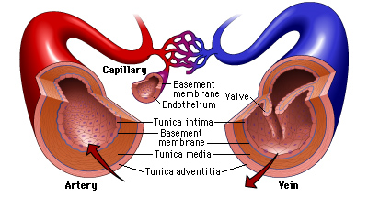
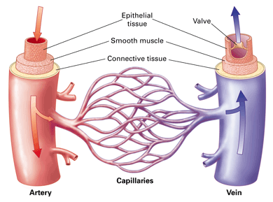
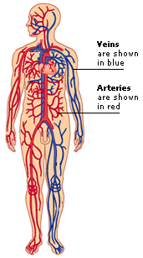
500 B.C. – Greeks distinguished between arteries and veins
arteries carry oxygenated blood from the heart to various parts of the body
Thick, elastic muscle layer that can handle high pressure of the blood
veins carry deoxygenated blood towards the heart
Thin, elastic muscle layer with valves that prevent the blood from flowing in the opposite direction

Slide 5
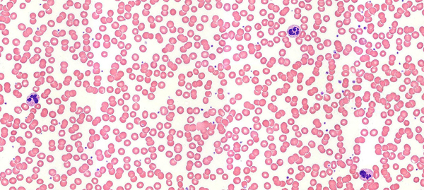
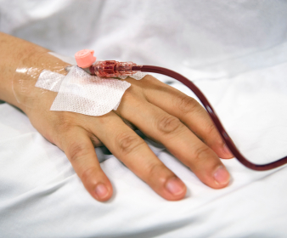
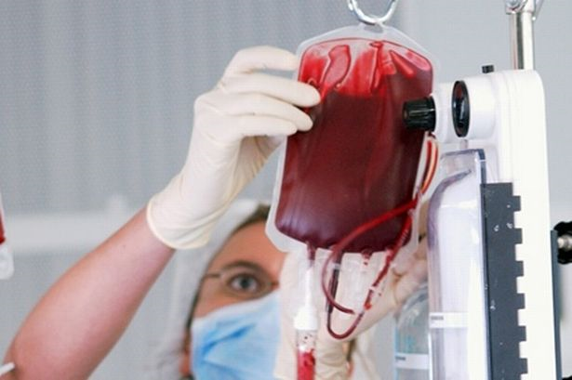
1659 A.D. – Anton van Leeuwenhoek viewed blood cells under a microscope
1795 – First blood transfusion performed

Slide 6
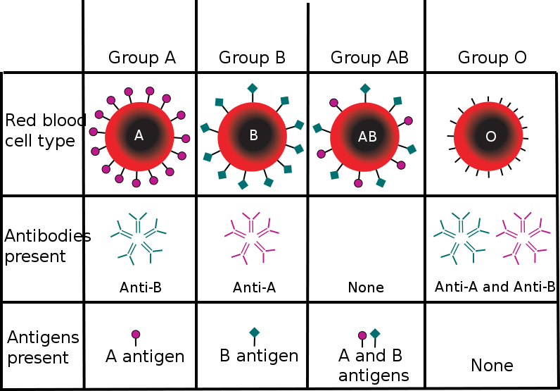
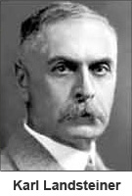
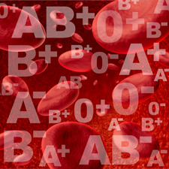
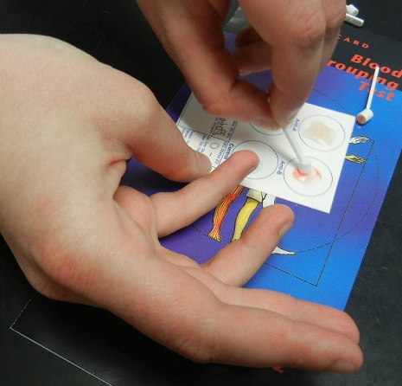
1901 – Karl Landsteiner discovered three blood types: A, B, O
1902 – Alfred Decastello discovered fourth blood type: AB

Slide 7
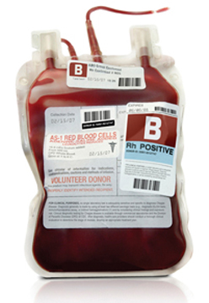
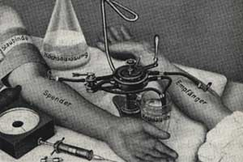
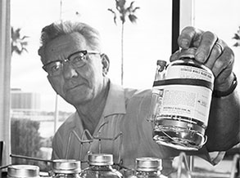
1922 – Percy Oliver established the first blood donor service
1935 – Mayo Clinic developed a method to store blood for transfusions
1937 – Dr. Bernard Fantus established the first blood bank

Slide 8
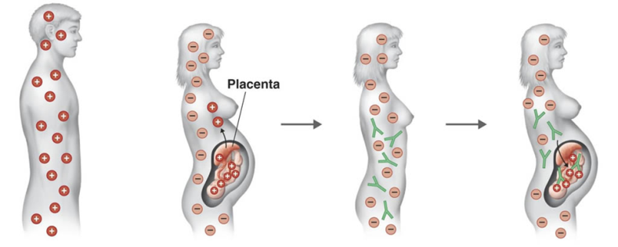
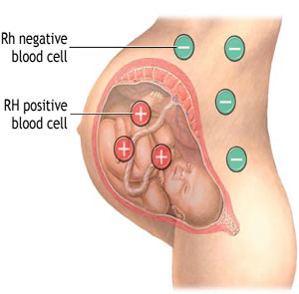
1940 – Karl Landsteiner discovered the Rh antigen
Rh factor is also called "Rhesus factor" because it was first discovered in the blood of Rhesus monkeys (small monkeys from India often used for experimentation).
Importance of Rh Factor
The Rh discovery had immediate practical importance because it explained a relatively common medical disorder known as erythroblastosis fetalis.
Rh-negative woman who becomes pregnant with an Rh-positive fetus (an unborn child) sometimes develops anti-bodies against the Rh factor in the fetus. Causes no problem during the woman's first pregnancy, since the number of anti-bodies produced tends to be small.
Second pregnancy: this can result in complications such as anemia, jaundice (a condition in which bile pigments build up in the blood and cause skin, eyeballs and urine to take on a sickly yellow tone) or premature birth.
Today, this reaction can be controlled by immunizing Rh negative women after their first pregnancy with a drug known as RhoGam.
Notes:
http://www.discoveriesinmedicine.com/Ra-Thy/Rh-Factor.html#ixzz2jhR0HJJr

Slide 9
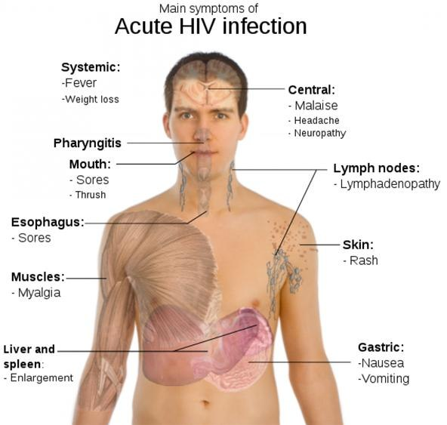
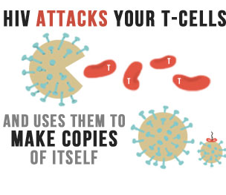
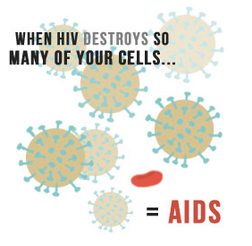
1959 – First case of AIDS recorded in the Congo
1984 – Robert Gallo identified the virus causing AIDS
1985 – Development of ELISA test to screen for diseases such as HIV
1987 – Scientists began developing blood-screening tests for infectious diseases
Notes:
http://www.aids.gov/hiv-aids-basics/index.html http://www.cnn.com/HEALTH/9802/03/earliest.aids/

