Slide 1
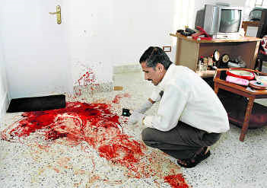
Blood can provide various evidence to investigators at a crime scene.
Blood spatter patterns can be used to reconstruct a crime scene and show how an attack was made
Blood can connect an object with a crime (ex. discarded weapon)
Blood can connect a suspect with a crime (ex. blood on clothing) or place a suspect at a crime scene (ex. criminal blood at scene)

Slide 2
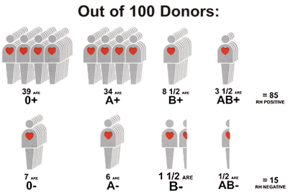
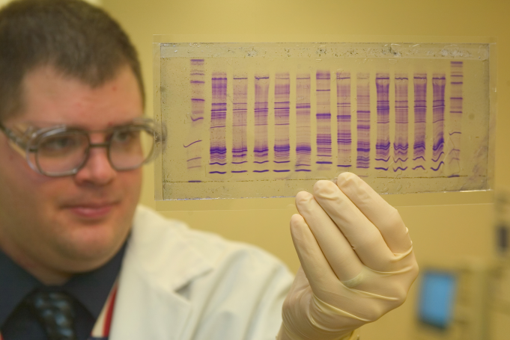
Blood typing is considered class evidence
and is good to rule out suspects
DNA profiling from blood is considered individual evidence and can help pinpoint a suspect

Slide 3
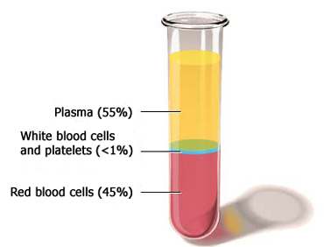
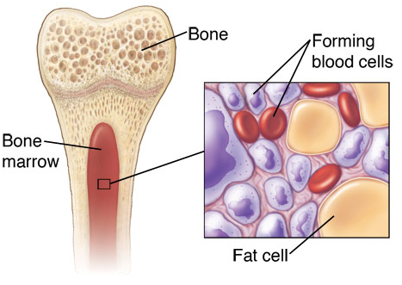
Blood is a tissue that circulates around through the body.
The average adult has about
5.5 liters of blood.
Blood is made of both cells
(45%) and Plasma (55%).
Blood cells are made in the bone marrow, the spongy material in the center of the bones. The body will replenish the elements given during a blood donation – some in a matter of hours and others in a matter of weeks.

Slide 4
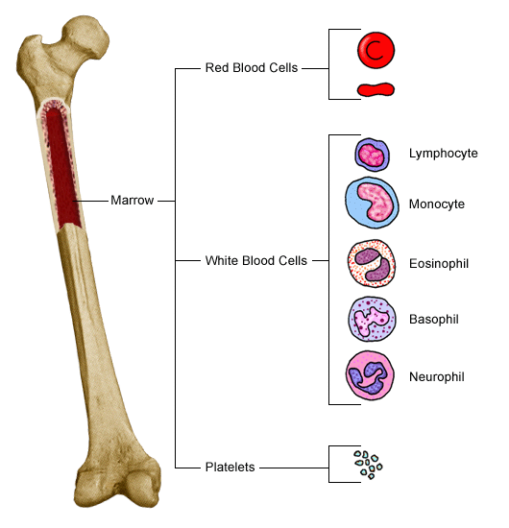
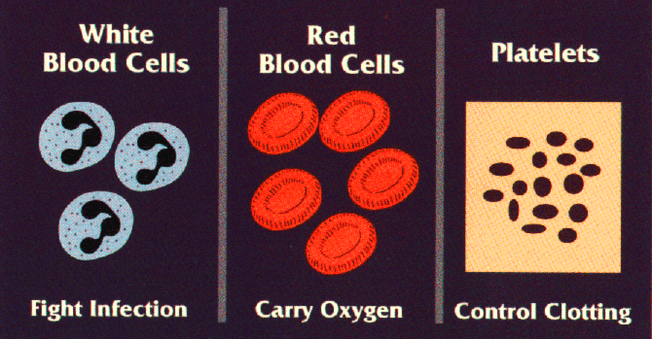
3 kinds of cells which make up blood
RBCs are called erythrocytes.
Have hemoglobin
Carry oxygen
Iron-containing protein
No nucleus
WBCs are called leukocytes
An immune system cell
Fight disease and produce antibodies
Contain DNA
The two most common types are the lymphocytes and neutrophils
Platelets are called thrombocytes
small cell fragments
assist in blood clotting

Slide 5
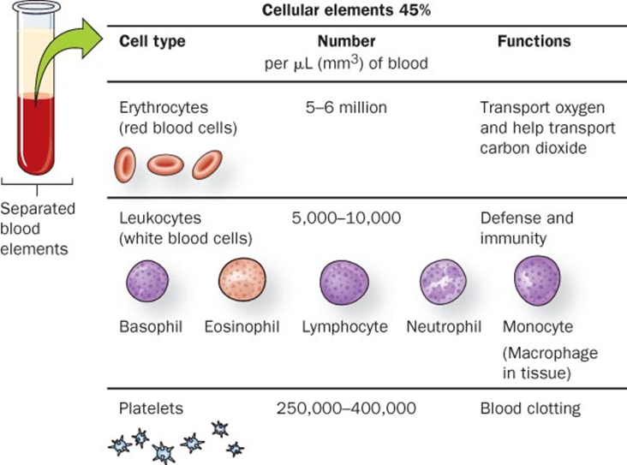
There are about one billion red blood cells in two to three drops of blood. For every 600 red blood cells, there are about 40 platelets and one white cell.

Slide 6
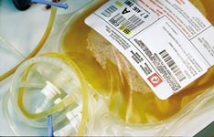
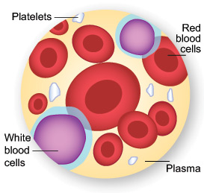
yellowish liquid portion of blood
Plasma is made of 90% water. The other 10% are:
Dissolved proteins (antibodies, hormones, clotting factors)
Nutrients (O₂, glucose, amino acids, salts, minerals)
Wastes (urea, CO₂)

Slide 7
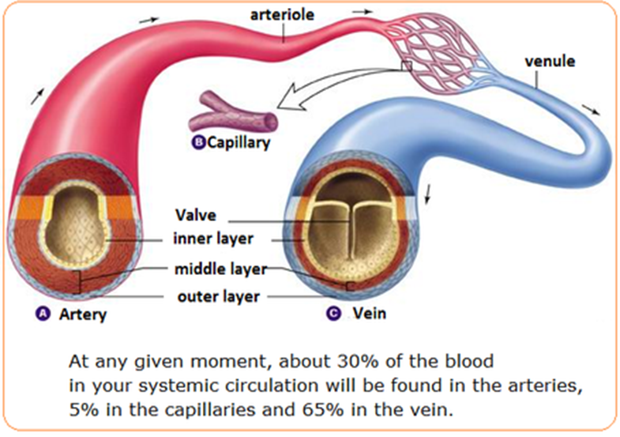
There are 3 main kinds of blood vessels.
Arteries carry blood away from the heart. They divide again and again, and eventually form very tiny vessels called capillaries. Capillaries supply cells with nutrients then remove wastes.
The capillaries gradually join up with one another to form large vessels called veins. Veins carry blood towards the heart.

Slide 8
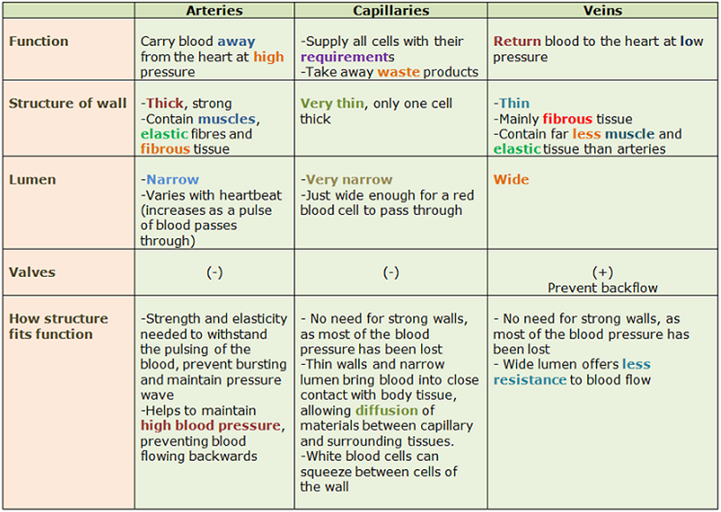

Slide 9
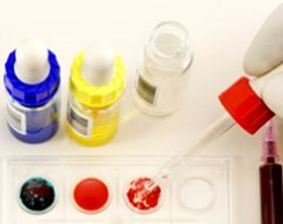
Blood Typing identifies the presence or absence of particular proteins embedded in the cell
It is quicker and less expensive than DNA profiling
Produces class evidence but can still link a suspect to a crime scene or exclude a suspect
The presence or absence of cell-surface proteins determines a person’s blood type.
Blood Types (10.45 minutes) https://www.youtube.com/watch?v=KXTF7WehgM8

Slide 10
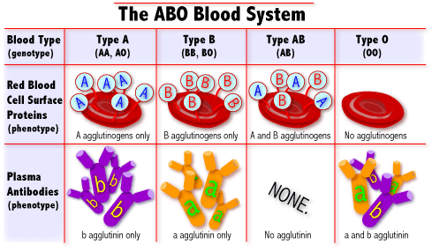
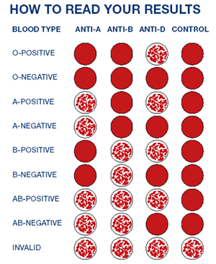
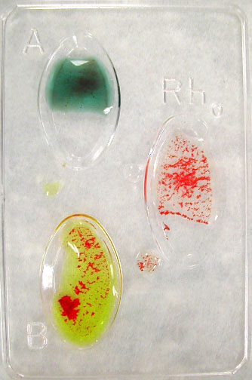
Rh antibody test
Anti-A antibody
test
Anti-B
antibody
test
39
12
4
45

Slide 11
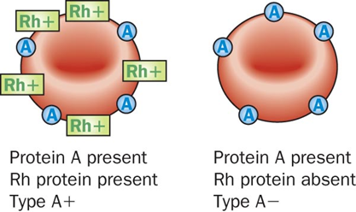
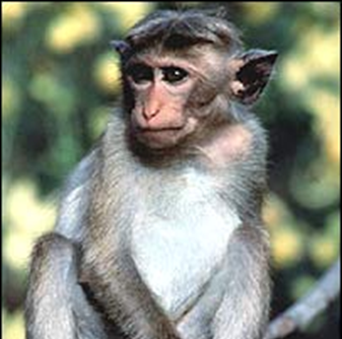
85% of the population has an additional surface protein called the Rh factor and therefore have Rh positive blood.
The other 15% lacks this protein and has what we call Rh negative blood.
Referred to as Rh because it was first discovered in 1940 in Rhesus monkeys.

Slide 12
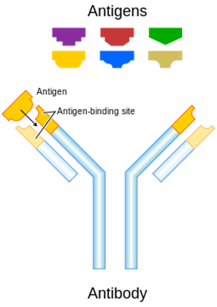
Antigens: in red blood cell (and foreign cell) membranes
Antibodies: in blood plasma
When a foreign material enters your body, your immune system launches an attack called an antigen-antibody response in which WBCs called B-lymphocytes release antibodies to attack the foreign substance.

Slide 13
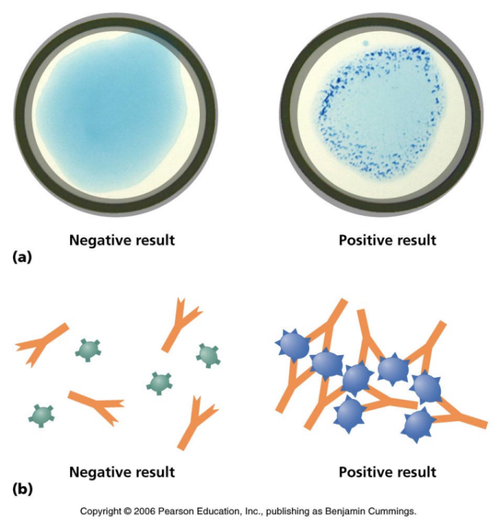
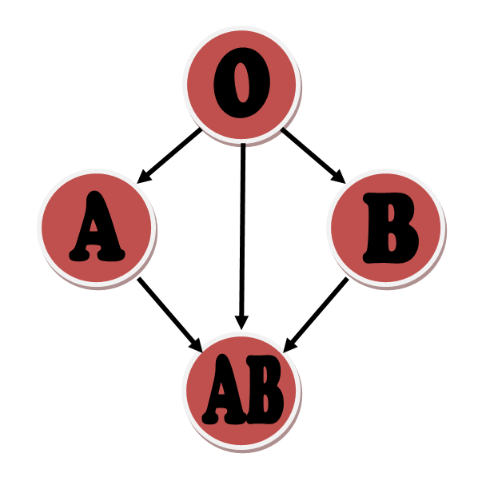
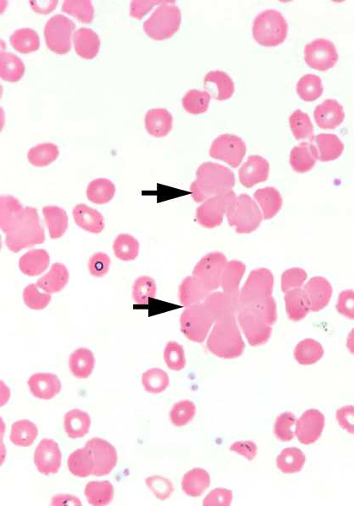
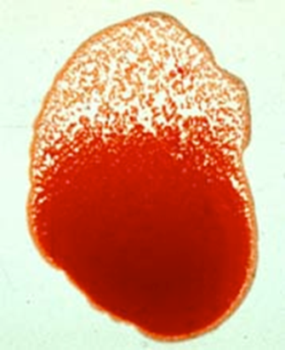
Blood typing is critical for blood transfusions. If a person receives a blood protein foreign to their body, antibodies can cause the blood to clump which can possibly lead to death.
The clumping of RBCs is called agglutination.
Blood typing tests identify the presence of A, B, and Rh surface proteins.
Universal Donor
Universal Recipient

Slide 14
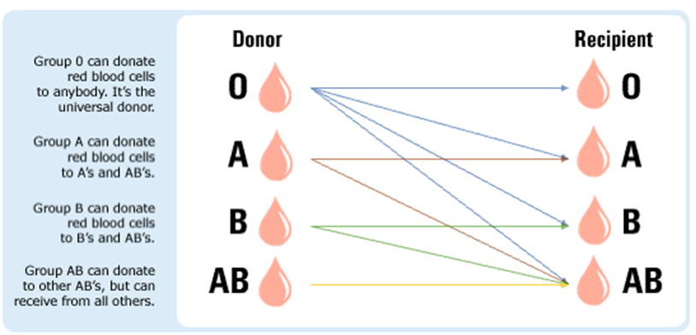

Slide 15
Some patients require a closer blood match than that provided by the ABO positive/negative blood typing. For example, sometimes if the donor and recipient are from the same ethnic background the chance of a reaction can be reduced.
There are more than 600 known antigens besides A and B.
Many other blood proteins have been identified. Examples include:
Glycophorin Antigen M
Glycophorin Antigen N
Phosphoglucomutase (PGM)
Adenylate kinase (AK)
Adenosine deaminase (ADA)
Esterase D (EsD)
Glucose-6-phosphate dehydrogenase (G-6-PD)
Polymorphic proteins: Group-specific Components (Gc) and haptoglobins (Hp)
By testing for more blood proteins, the probability of uniqueness increases, making blood evidence more individualized.

Slide 16
A grouping of blood stains constitutes a blood spatter pattern.
Patterns help to reconstruct the events surrounding shootings, stabbings, beatings, etc.
In 1939, Dr. Victor Balthazard first researched and analyzed spatter patterns.
Notes:
http://projects.nfstc.org/gallery/main.php?g2_itemId=3857

Slide 17
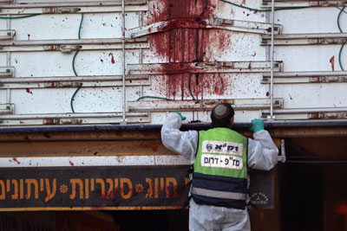
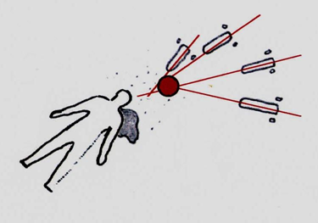
Analysis of a spatter pattern can help to determine
direction blood traveled
angle of impact
point of origin of the blood
velocity of the blood
manner of death
Bloodstain pattern analysis can also help one evaluate the credibility of statements provided by a witness, a victim, or a suspect.
Notes:
http://www.youtube.com/watch?v=Od8YuwUT794

