Slide 1
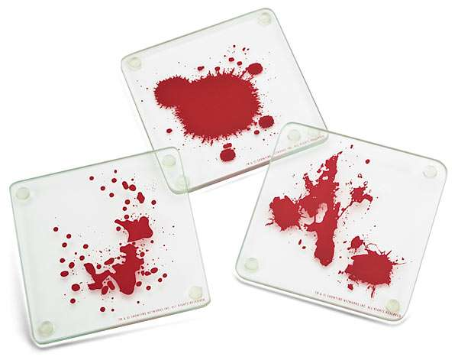
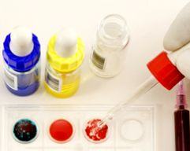

Slide 2
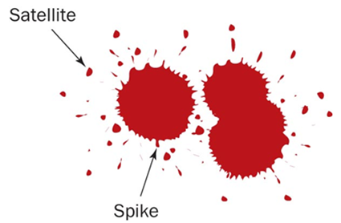
Cohesion
Blood sticks together as it falls maintaining a round shape.
Blood also resists flattening out when it falls on a flat surface. Cohesion and surface tension help it to maintain a curved shape.
The shape of an individual drop of blood can provide important clues in an investigation
When blood falls from a height, or at a high velocity, it forms satellite droplets, small secondary droplets around the main drop
When blood falls onto a less-than-smooth surface, the edges may have spikes or extensions

Slide 3
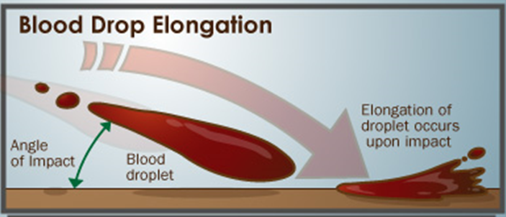
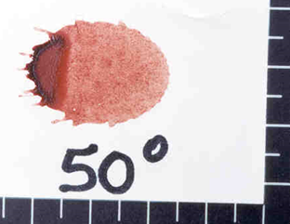
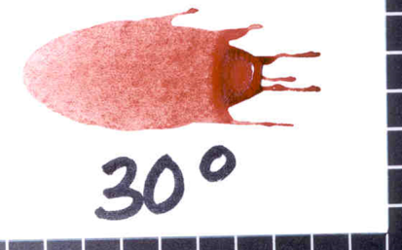
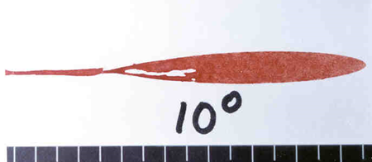
An elongated blood drop indicates blood was traveling from a different direction when it landed.
The point of impact may appear darker and wider than the rest of the drop, with a tail pointing in the direction of the blood’s movement.
Smaller, secondary droplets may break off and will land in front of the moving droplet of blood, allowing scientists to determine direction of spatter.

Slide 4
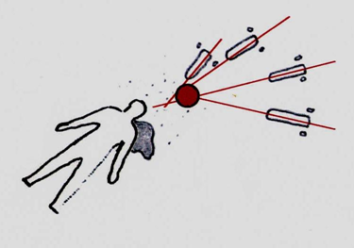
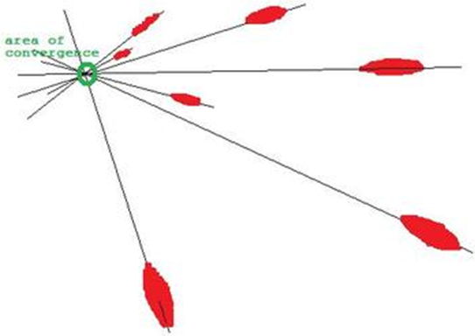
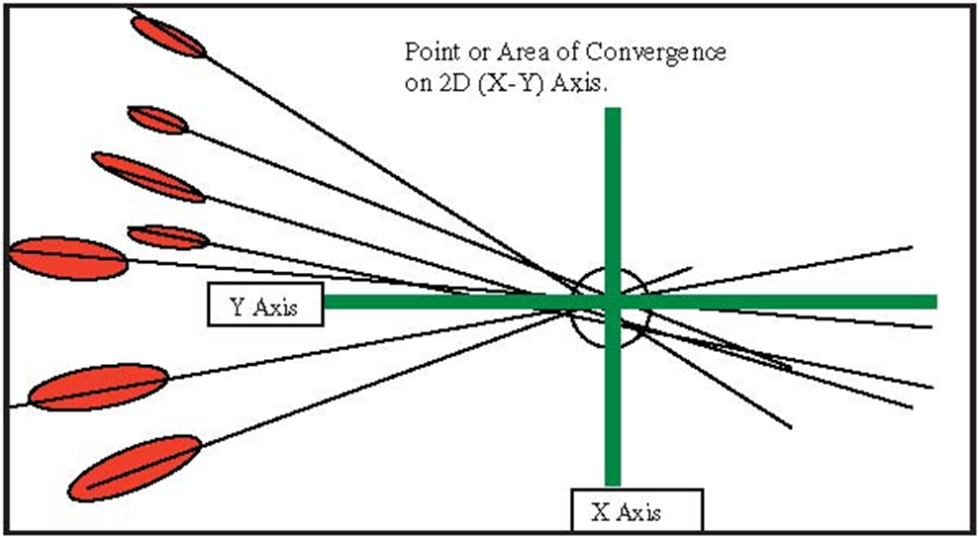
When there are two or more blood spatters a scientist can draw LINES OF CONVERGENCE that can pinpoint the location of the blood source.

Slide 5
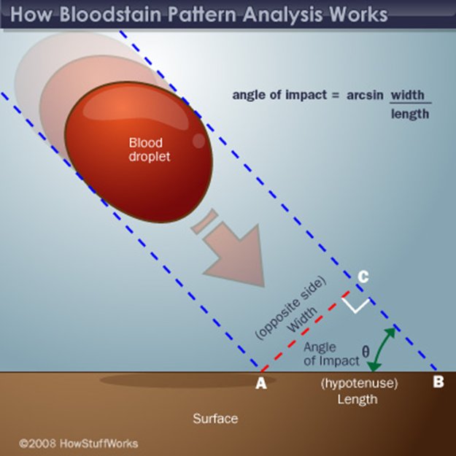
Measuring the length and width of blood drops and using trigonometry allows us to determine an approximate point of origin.
Only experienced analysts trained in this technique should perform these measurements.
Strings can be placed over blood drops along the axes of the stains at the calculated impact angles, and a resulting point of origin can be visualized in three dimensions.
angle of impact = | the width of the bloodstain in mm | Use answer to figure out the arc sin of that number (opposite side/hypotenuse)
 | the length of the bloodstain in mm

Slide 6
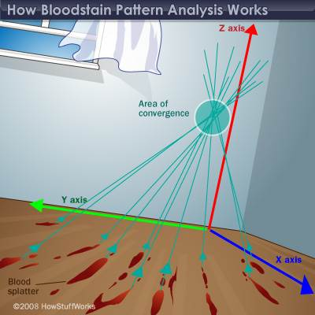

Slide 7
*Look at chart on page 240
Passive Bloodstains
Patterns created from the force of gravity
Drop, series of drops, flow patterns, blood pools, etc.
Projected Bloodstains
Patterns that occur when a force is applied to the source of the blood
Includes low, medium, or high impact spatters, cast-off, arterial gushing, expiratory blood blown out of the nose, mouth, or wound.
Smear/Transfer Bloodstains
These patterns are created when a wet, bloody object comes in contact with a target surface; may be used to identify an object or body part.
A wipe pattern is created from an object moving through a bloodstain, while a swipe pattern is created from an object leaving a bloodstain.
Shadowing or Void Bloodstains
Area devoid of blood spatter, shows that an object has been moved

Slide 8
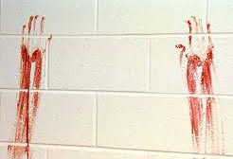
Smear patterns from a large volume of blood, at least 0.5 ml, are often distorted so much that further classification is not possible.
However, Transfer Patterns occur when a wet bloody surface contacts a second unstained surface creating recognizable mirror image or at least a recognizable portion of the original surface.
Swipe Pattern - the transfer of blood onto a surface not already contaminated with blood. One side is usually feathered which indicates the direction of travel.
One common pattern at scenes is a hair swipe - a long thin fine line transfer.
Wipe Pattern - created when an object moves through blood that has not completely dried and moves, removes, or otherwise alters it.

Slide 9
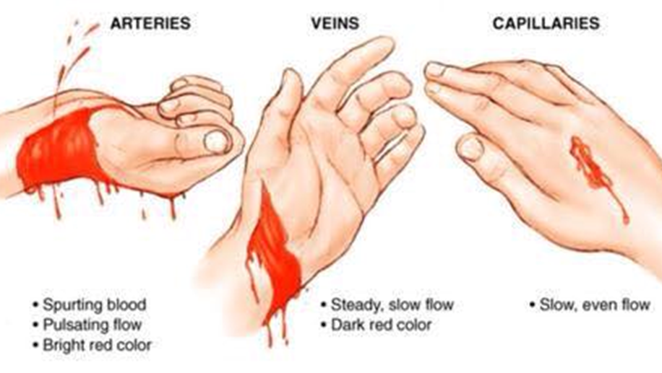
Arterial spurting usually occurs when an artery is damaged and the blood spurts or gushes from the wound in large volume pulses. It continues spurting as long as the heart continues beating.
Large drops striking a vertical surface decelerate from air resistance and produce a pattern without spines. The drops strike the surface and then characteristically drip or run downward due to their large volume.

Slide 10
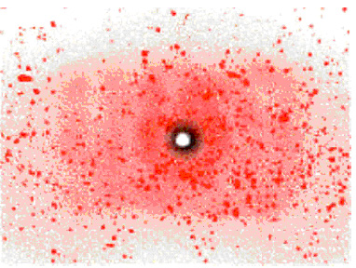
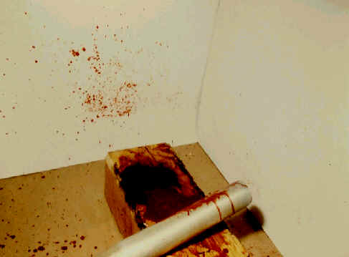
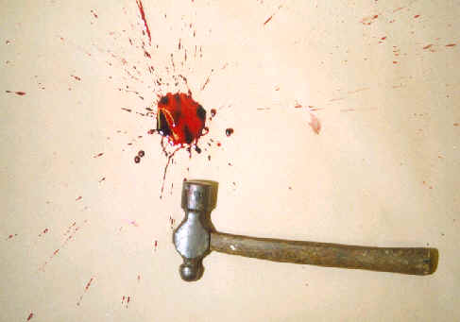
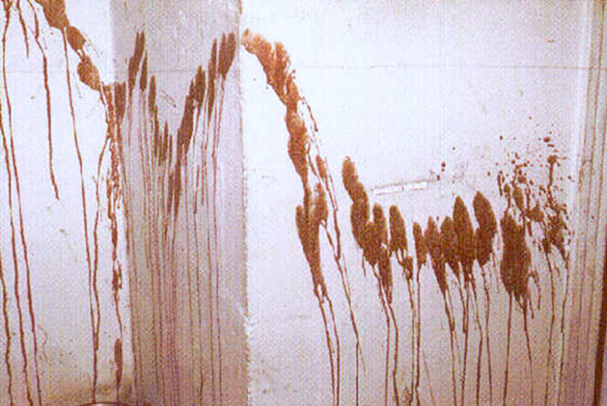
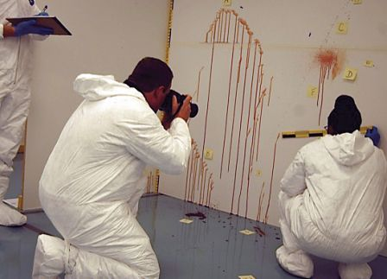
Speed and Velocity also impact blood spatter.
 | High Velocity | Medium Velocity | Low Velocity
Example: | Gunshot wound | Beating, stabbing | Blunt object impact
Size of blood droplets: | Less than 1 mm | 1-4 mm | 4-6 mm

Slide 11
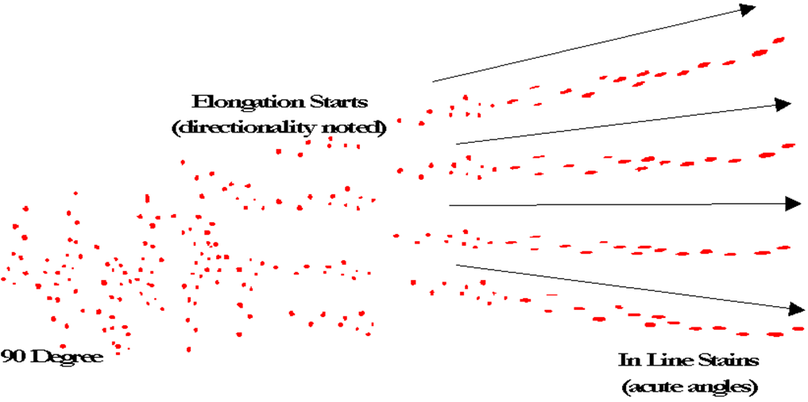
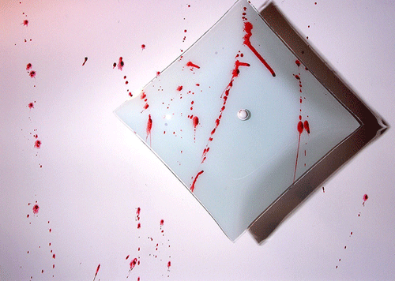
The movement and the number of swings can often be documented by examining the cast-off pattern.
During a beating with an instrument which produces the bleeding, blood will not normally collect on the surface of the instrument from the first strike.
On subsequent strikes at the same location, blood will adhere to the instrument since it now strikes a blood source. When the instrument is raised or swung backward, its movement allows small drops of blood to be released from its surface.
Some of these small drops will strike a surface, often a ceiling, at a 90-degree impact angle.

Slide 12
The field of bloodstain pattern analysis requires knowledge of math, physics, biology and chemistry. Students in Criminology and Criminal Justice learn about bloodstain pattern analysis in forensic science classes or classes specifically on blood spatter. But most analysts begin as law-enforcement officers who learn on the job, acquire certifications and take courses, workshops and seminars. Many train in bloodstain pattern (or blood spatter) analysis through the International Association of Bloodstain Pattern Analysis (IABPA). The IABPA developed criteria for the Basic Bloodstain Pattern Analysis Course, an introductory 40-hour course on the subject. Other organizations, such as the International Association for Identification (IAP), offer workshops and seminars as well as advanced courses which lead to certification in blood spatter analysis.

Slide 13
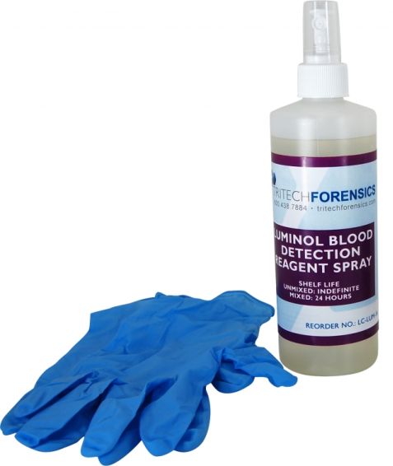
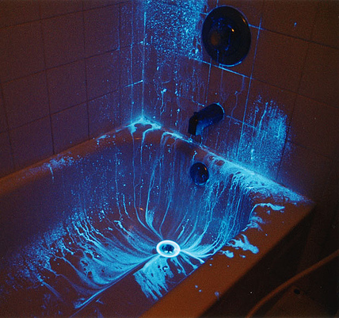
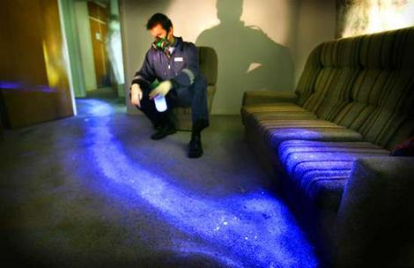
Don’t see any blood?
Even with the most thorough cleaning, blood leaves residue that is difficult to remove.
Luminol powder mixed with hydrogen peroxide is able to detect hemoglobin left behind by blood. Spray the area and if blood is present it will luminesce for about 30 seconds.
Luminol reacts to old or new blood, however it destroys the blood so it cannot be tested later.

Slide 14
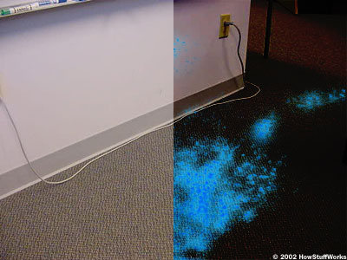
The basic idea of luminol is to reveal blood traces with a light-producing chemical reaction between several chemicals and hemoglobin.

Slide 15
See blood?
If blood stains or drops are found, confirm they are in fact blood. There are many chemicals to test for the presence of blood.
Kastle-Meyer Test- swab turns pink if blood is detected
To be presented accurately and usefully in court, bloodstain evidence must be recognized, documented, preserved, and correctly evaluated.
When possible, deliver blood or stained object to lab immediately.
If unable to deliver to the Laboratory, or if the object must be mailed, allow the stain to air dry completely before packaging.
Notes:
http://www.youtube.com/watch?v=6Ex0Fd_PDhU

Slide 16
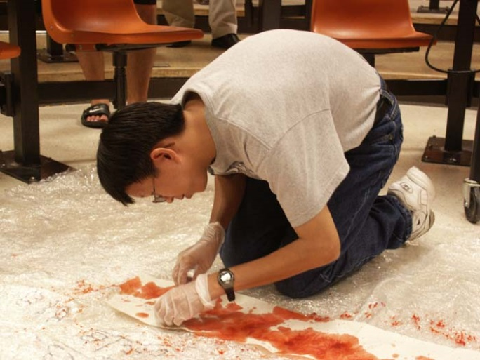
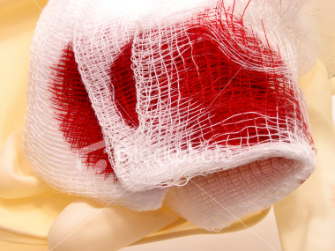
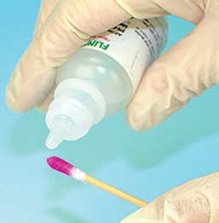
Blood that is in pools should be absorbed by a gauze pad and allowed to air dry. After it dries it should be refrigerated or frozen as soon as possible. Blood should be taken to the lab as quickly as possible; delays beyond 48 hours may make the samples useless.
If not completely dry, label and roll in paper or place in a brown paper bag or box and seal and label container. Place only one item in each container. Do not use plastic containers.
Notes:
http://www.youtube.com/watch?v=6Ex0Fd_PDhU

Slide 17
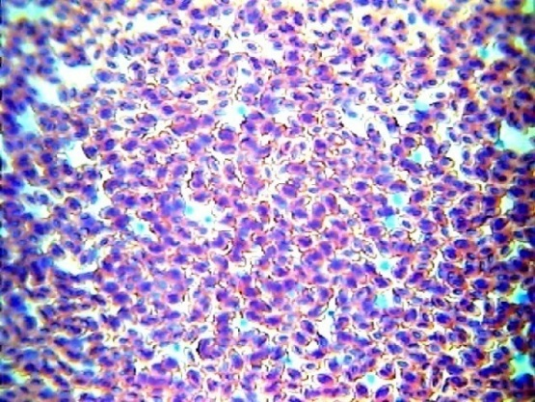
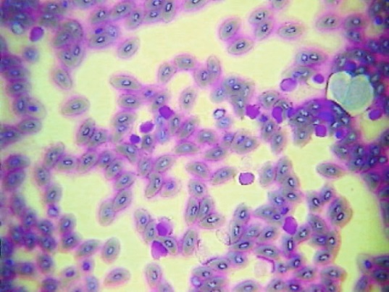
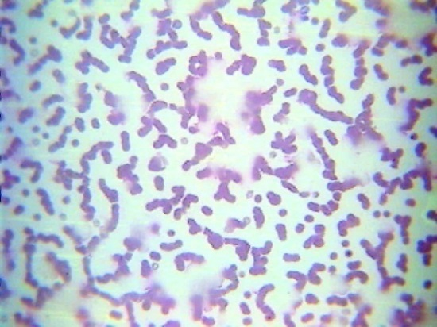
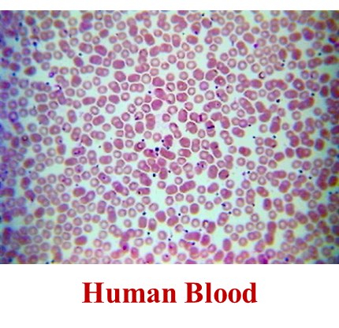
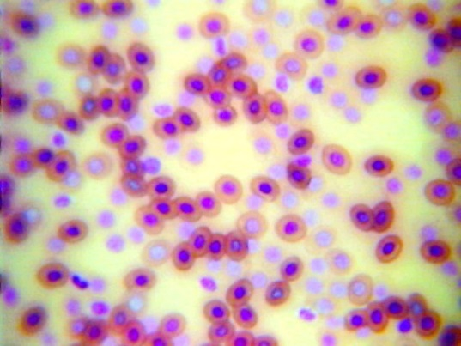
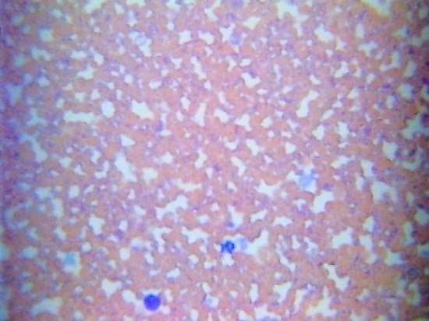
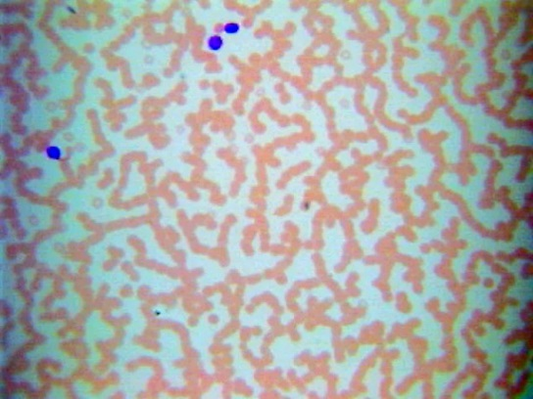
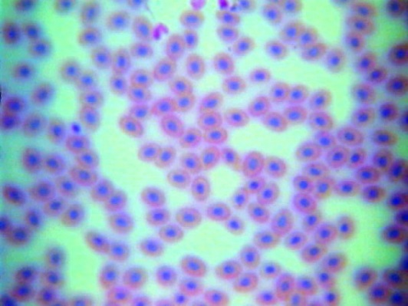
If blood is present, lab will need to confirm it is human blood.
All mammals, except camels and llamas, have circular, un-nucleated RBCs.
Animals that are not mammals (birds, fish, etc.) have oval blood cells with a nucleus.
Bird Blood
Fish Blood
Cat Blood
Frog Blood
Dog Blood
Horse Blood
Snake Blood

Slide 18
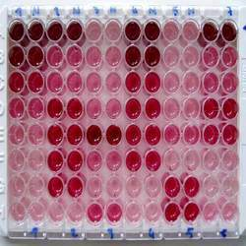
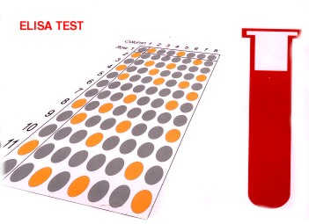
ELISA test uses antibodies that react to human blood to tell if mammal blood is from human. However in rare cases, it can be confused with chimpanzee and gorilla blood.
ELISA is an abbreviation for
"enzyme-linked immunosorbent assay."
ELISA is a test that detects and measures antibodies in your blood.

Slide 19
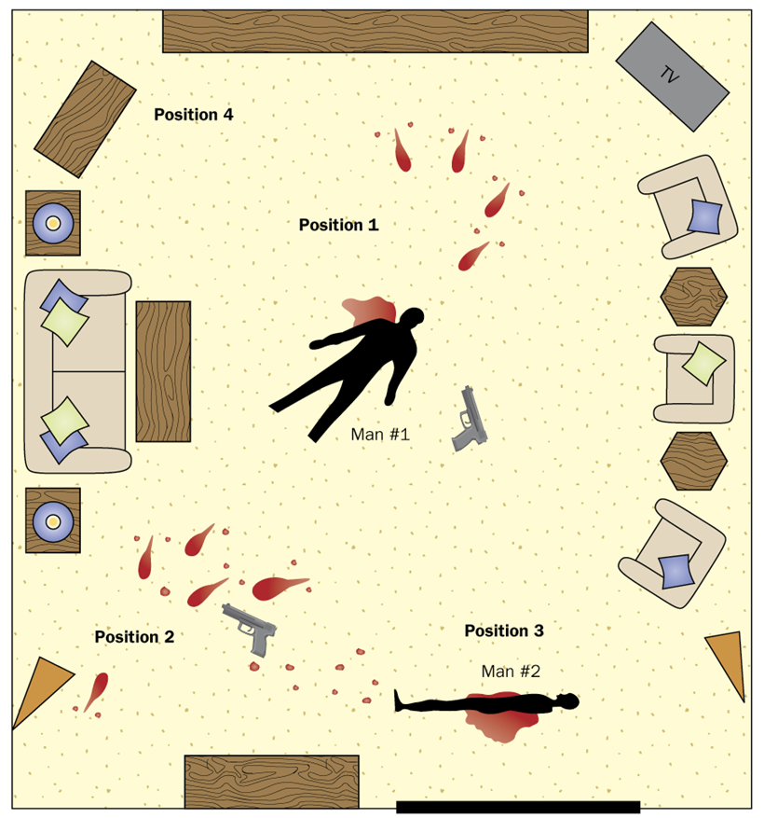
Confirm the stain is blood.
Visualization with Luminol
Kastle-Meyer test
Confirm the stain is human.
ELISA test
Determine blood type.
Antibody test
Try to determine whose blood it is. If individual information is needed, then do DNA analysis.
Notes:
http://www.youtube.com/watch?v=2UV_moaF45I

